Slide 1
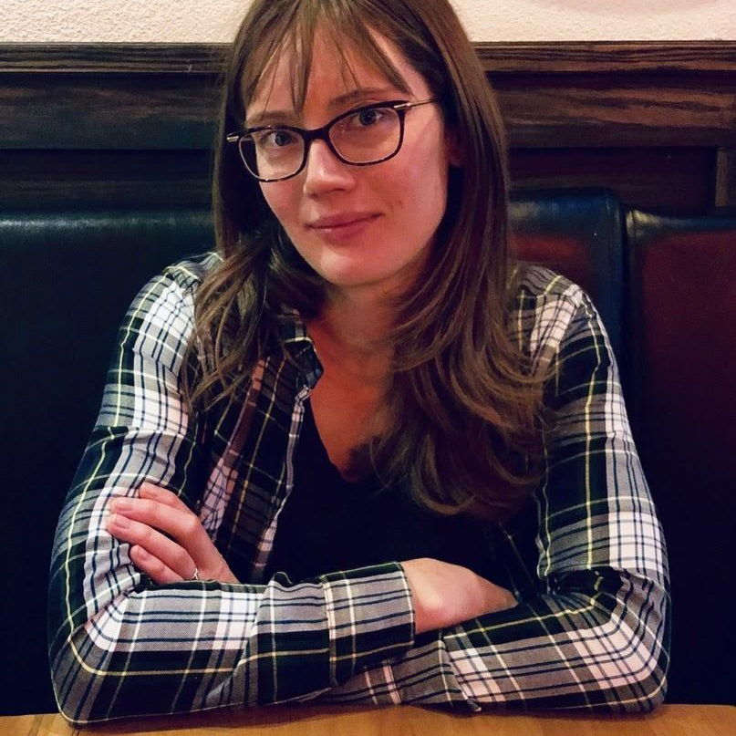
Learn To Efficiently Test ETL Pipelines
A story told with code
Jacqueline Bilston
Software Developer, Yelp
Notes:
Good Afternoon, My name is Jacqueline Bilston. I’m a software developer with Yelp on the Clickstream Platform team. Today I’d like to share with you the story of how I learned to efficiently test my ETL pipelines. I have a lot of really cool stuff to share, so if you would save your questions until the end, I will make sure to take time after the presentation to answer them.

Slide 2

Resources
github.com/jmasonlee/Talks/blob/master/LearnToEfficientlyTestETLPipelines.md

Slide 3
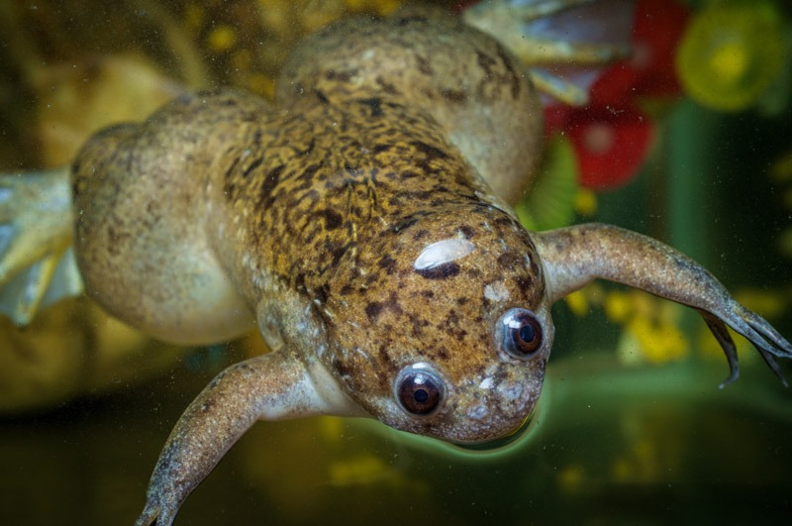
Xenopus

Slide 4
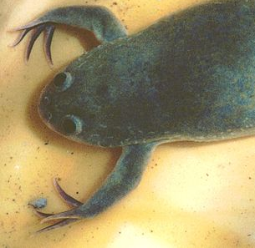
Frog Genomics
They’re Hoppin’
Extract
Transform
Load
A
G
T
G
C
A
E
T
L
@jmasonlee

Slide 5
Frog Genomics
They’re Hoppin’
Extract
Transform
Load
A
G
T
G
C
A
✗
✗
✓
✗
✗
✗
E
T
L
@jmasonlee

Slide 6
Frog Genomics
They’re Hoppin’
Extract
Transform
Load
A
G
T
G
C
A
✗
✓
✗
E
T
L
@jmasonlee

Slide 7
Frog Genomics
They’re Hoppin’
Extract
Transform
Load
A
G
T
G
C
A
✗
✓
✗
E
T
L
@jmasonlee

Slide 8
Frog Genomics
They’re Hoppin’
Extract
Transform
Load
A
G
T
G
C
A
✓
✗
E
T
L
@jmasonlee

Slide 9
Frog Genomics
They’re Hoppin’
Extract
Transform
Load
A
G
T
G
C
A
✓
✗
✗
E
T
L
@jmasonlee

Slide 10
Frog Genomics
They’re Hoppin’
Extract
Transform
Load
A
G
T
G
C
A
E
T
L
@jmasonlee

Slide 11
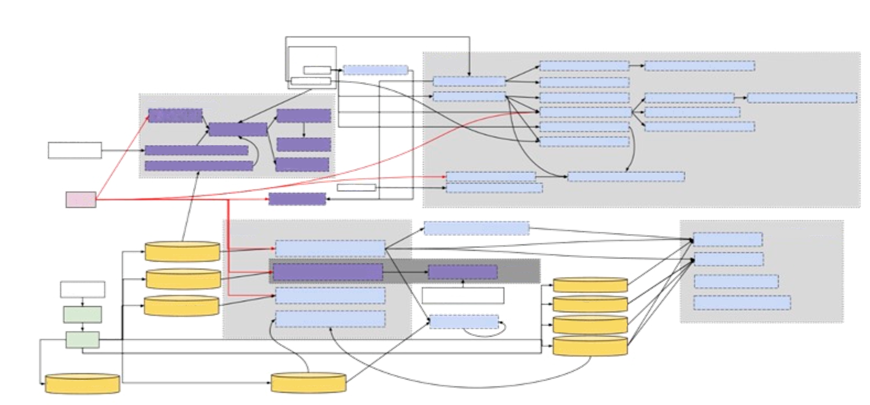
@jmasonlee
Notes:
I don’t just work on one pipeline. I work on a system of pipelines, each of which depends on one another.
This is a diagram one of my teammates made for one half of the system I help maintain.
Manually checking that each one of these pieces works together would be a nightmare
My data is important. It’s used to inform machine learning models that have a direct impact on our customers, and the small businesses we try to support.
This means that my team prefers to automate all the testing we can.

Slide 12

The Bug
@jmasonlee

Slide 13
“The number of interactions in the pandemic_recovery table doesn’t look right”
@jmasonlee

Slide 14
The Problem Table
The PANDEMIC_RECOVERY table
business_id | business_name | review_count | checkin_count | tip_count | interaction_count | date
bBDDEgkFA1Otx9Lfe7BZ | Sonic Drive-In | 0 | 1 | 3 | 4 | 2022-06-28
k0hlBqXX-Bt0vf1op7Jr1w | Tsevi's Pub And Grill | 2 | 0 | 1 | 3 | 2022-06-28
n_0UpQx1hsNbnPUSlodU | Famous Footwear | 0 | 0 | 0 | 0 | 2022-06-28
mWMc6_wTdE0EUBKIGX | Perkiomen Valley Brewery | 1 | 3 | 1 | 5 | 2022-06-28
MTSW4McQd7CbVtyjqoe | St Honore Pastries | 0 | 0 | 0 | 0 | 2022-06-28
@jmasonlee

Slide 15
The Problem
The PANDEMIC_RECOVERY table
business_id | business_name | review_count | checkin_count | tip_count | interaction_count | date
bBDDEgkFA1Otx9Lfe7BZ | Sonic Drive-In | 0 | 1 | 3 | 4 | 2022-06-28
k0hlBqXX-Bt0vf1op7Jr1w | Tsevi's Pub And Grill | 2 | 0 | 1 | 3 | 2022-06-28
n_0UpQx1hsNbnPUSlodU | Famous Footwear | 0 | 0 | 0 | 0 | 2022-06-28
mWMc6_wTdE0EUBKIGX | Perkiomen Valley Brewery | 1 | 3 | 1 | 5 | 2022-06-28
MTSW4McQd7CbVtyjqoe | St Honore Pastries | 0 | 0 | 0 | 0 | 2022-06-28
@jmasonlee

Slide 16
The Problem
The PANDEMIC_RECOVERY table
business_id | business_name | review_count | checkin_count | tip_count | interaction_count | date
bBDDEgkFA1Otx9Lfe7BZ | Sonic Drive-In | 0 | 1 | 3 | 4 | 2022-06-28
k0hlBqXX-Bt0vf1op7Jr1w | Tsevi's Pub And Grill | 2 | 0 | 1 | 3 | 2022-06-28
n_0UpQx1hsNbnPUSlodU | Famous Footwear | 0 | 0 | 0 | 0 | 2022-06-28
mWMc6_wTdE0EUBKIGX | Perkiomen Valley Brewery | 1 | 3 | 1 | 5 | 2022-06-28
MTSW4McQd7CbVtyjqoe | St Honore Pastries | 0 | 0 | 0 | 0 | 2022-06-28
@jmasonlee

Slide 17
The Problem
The PANDEMIC_RECOVERY table
business_id | business_name | review_count | checkin_count | tip_count | interaction_count | date
bBDDEgkFA1Otx9Lfe7BZ | Sonic Drive-In | 0 | 1 | 3 | 4 | 2022-06-28
k0hlBqXX-Bt0vf1op7Jr1w | Tsevi's Pub And Grill | 2 | 0 | 1 | 3 | 2022-06-28
n_0UpQx1hsNbnPUSlodU | Famous Footwear | 0 | 0 | 0 | 0 | 2022-06-28
mWMc6_wTdE0EUBKIGX | Perkiomen Valley Brewery | 1 | 3 | 1 | 5 | 2022-06-28
MTSW4McQd7CbVtyjqoe | St Honore Pastries | 0 | 0 | 0 | 0 | 2022-06-28
@jmasonlee

Slide 18
The Problem
The PANDEMIC_RECOVERY table
business_id | business_name | review_count | checkin_count | tip_count | interaction_count | date
bBDDEgkFA1Otx9Lfe7BZ | Sonic Drive-In | 0 | 1 | 3 | 4 | 2022-06-28
k0hlBqXX-Bt0vf1op7Jr1w | Tsevi's Pub And Grill | 2 | 0 | 1 | 3 | 2022-06-28
n_0UpQx1hsNbnPUSlodU | Famous Footwear | 0 | 0 | 0 | 0 | 2022-06-28
mWMc6_wTdE0EUBKIGX | Perkiomen Valley Brewery | 1 | 3 | 1 | 5 | 2022-06-28
MTSW4McQd7CbVtyjqoe | St Honore Pastries | 0 | 0 | 0 | 0 | 2022-06-28
@jmasonlee

Slide 19
The Problem
The PANDEMIC_RECOVERY table
business_id | business_name | review_count | checkin_count | tip_count | interaction_count | date
bBDDEgkFA1Otx9Lfe7BZ | Sonic Drive-In | 0 | 1 | 3 | 4 | 2022-06-28
k0hlBqXX-Bt0vf1op7Jr1w | Tsevi's Pub And Grill | 2 | 0 | 1 | 3 | 2022-06-28
n_0UpQx1hsNbnPUSlodU | Famous Footwear | 0 | 0 | 0 | 0 | 2022-06-28
mWMc6_wTdE0EUBKIGX | Perkiomen Valley Brewery | 1 | 3 | 1 | 5 | 2022-06-28
MTSW4McQd7CbVtyjqoe | St Honore Pastries | 0 | 0 | 0 | 0 | 2022-06-28
@jmasonlee

Slide 20
The Problem
The PANDEMIC_RECOVERY table
business_id | business_name | review_count | checkin_count | tip_count | interaction_count | date
bBDDEgkFA1Otx9Lfe7BZ | Sonic Drive-In | 0 | 1 | 3 | 4 | 2022-06-28
k0hlBqXX-Bt0vf1op7Jr1w | Tsevi's Pub And Grill | 2 | 0 | 1 | 3 | 2022-06-28
n_0UpQx1hsNbnPUSlodU | Famous Footwear | 0 | 0 | 0 | 0 | 2022-06-28
mWMc6_wTdE0EUBKIGX | Perkiomen Valley Brewery | 1 | 3 | 1 | 5 | 2022-06-28
MTSW4McQd7CbVtyjqoe | St Honore Pastries | 0 | 0 | 0 | 0 | 2022-06-28
@jmasonlee

Slide 21
The Problem
The PANDEMIC_RECOVERY table
business_name | review_count | tip_count | checkin_count | interaction_count | date
Perkiomen Valley Brewery | 2 | 1 | 3 | 6 | 2022-06-28
4
8
@jmasonlee

Slide 22

Machine Learning Models
Reports
The
pandemic_recovery
table
Other Pipelines
@jmasonlee

Slide 23
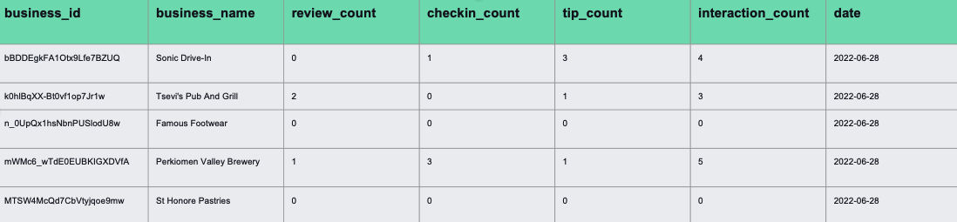
@jmasonlee
Notes:
-Lucky to be working on the Clickstream team, which means we help analyze user events.
- With a team passionate about quality software
Already had some testing infrastructure set up
Automated testing for data pipelines is HARD
Lots of integration points
Dealing with large amounts of data
pySpark isn’t optimized for working with small datasets
Can be costly to run pySpark many times
Dataframes with many columns
Often multiple sources of inputs and outputs

Slide 24
5 days to find the bug,
@jmasonlee
Notes:
-Lucky to be working on the Clickstream team, which means we help analyze user events.
- With a team passionate about quality software
Already had some testing infrastructure set up
Automated testing for data pipelines is HARD
Lots of integration points
Dealing with large amounts of data
pySpark isn’t optimized for working with small datasets
Can be costly to run pySpark many times
Dataframes with many columns
Often multiple sources of inputs and outputs

Slide 25

5 days to find the bug,
@jmasonlee

Slide 26

5 days to find the bug,
3 days to fix it,
@jmasonlee

Slide 27
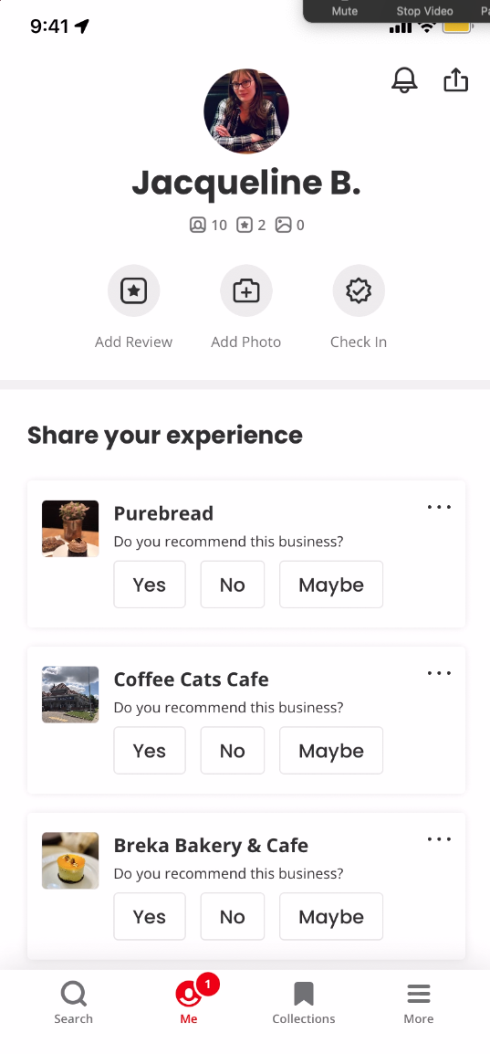
checkin_count
3
review_count
1
@jmasonlee

Slide 28
Left-Anti Join
Inner Join
Mobile
Reviews
Checkins
Mobile
Reviews
Checkins
mobile_reviews.join(
checkins,
on=[”user_id”, “business_id”, “date”]
how= “left_anti”
)
mobile_reviews.join(
checkins,
on=[”user_id”, “business_id”, “date”]
)

Slide 29

5 days to find the bug,
3 days to fix it,
followed by 7 days of running
backfills for 2 months of data
@jmasonlee

Slide 30
Automated Tests
For Data Pipelines
Data Tests
ID | Name | Age | Eye color
01452 | Alan | 452 | blue
64521 | NULL | 29 | green
49031 | Margaret | 45 | brown
49031 | Margaret | 45 | brown
@jmasonlee
Notes:
I don’t just work on one pipeline. I work on a system of pipelines, each of which depends on one another.
This is a diagram one of my teammates made for one half of the system I help maintain.
Manually checking that each one of these pieces works together would be a nightmare
My data is important. It’s used to inform machine learning models that have a direct impact on our customers, and the small businesses we try to support.
This means that my team prefers to automate all the testing we can.

Slide 31

Automated Tests
For Data Pipelines
Data Tests
Logic Tests
ID | Name | Age | Eye color
01452 | Alan | 452 | blue
64521 | NULL | 29 | green
49031 | Margaret | 45 | brown
49031 | Margaret | 45 | brown
City
Trono
Calgry
Vancover
City
Toronto
Calgary
Vancouver
@jmasonlee
Notes:
I don’t just work on one pipeline. I work on a system of pipelines, each of which depends on one another.
This is a diagram one of my teammates made for one half of the system I help maintain.
Manually checking that each one of these pieces works together would be a nightmare
My data is important. It’s used to inform machine learning models that have a direct impact on our customers, and the small businesses we try to support.
This means that my team prefers to automate all the testing we can.

Slide 32
Multi-Layered Tests
Data Tests
Large Logic Test
Large Logic Test
Large Logic Test
Large Logic Test
Large Logic Test
Pipeline
@jmasonlee

Slide 33
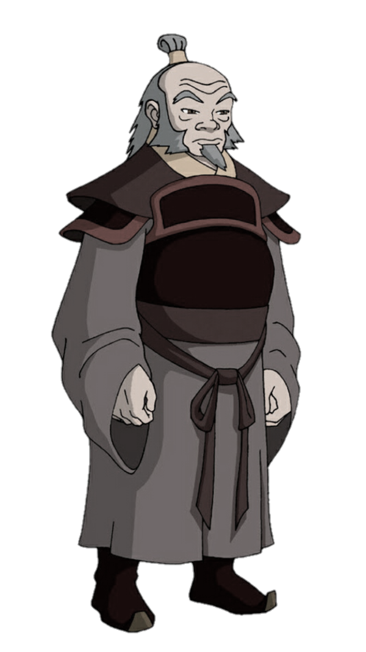


Slide 34


Slide 35
"What bug are you trying to catch?"

Slide 36
The Logic Test
def test_will_do_the_right_thing(spark: SparkSession) -> None:
browser_reviews_df = create_df_from_json("fixtures/browser_reviews.json", spark)
checkin_df = create_df_from_json("fixtures/checkin.json", spark)
tips_df = create_df_from_json("fixtures/tips.json", spark)
business_df = create_df_from_json("fixtures/business.json", spark)
mobile_reviews_df = create_df_from_json("fixtures/mobile_reviews.json", spark)
actual_df = transform(
business_df,
checkin_df,
browser_reviews_df,
tips_df,
mobile_reviews_df,
datetime(2022, 4, 14)
)
assert data_frame_to_json(actual_df) == expected_json()

Slide 37
The Logic Test
def test_will_do_the_right_thing(spark: SparkSession) -> None:
browser_reviews_df = create_df_from_json("fixtures/browser_reviews.json", spark)
checkin_df = create_df_from_json("fixtures/checkin.json", spark)
tips_df = create_df_from_json("fixtures/tips.json", spark)
business_df = create_df_from_json("fixtures/business.json", spark)
mobile_reviews_df = create_df_from_json("fixtures/mobile_reviews.json", spark)
actual_df = transform(
business_df,
checkin_df,
browser_reviews_df,
tips_df,
mobile_reviews_df,
datetime(2022, 4, 14)
)
assert data_frame_to_json(actual_df) == expected_json()

Slide 38
The Logic Test
def test_will_do_the_right_thing(spark: SparkSession) -> None:
browser_reviews_df = create_df_from_json("fixtures/browser_reviews.json", spark)
checkin_df = create_df_from_json("fixtures/checkin.json", spark)
tips_df = create_df_from_json("fixtures/tips.json", spark)
business_df = create_df_from_json("fixtures/business.json", spark)
mobile_reviews_df = create_df_from_json("fixtures/mobile_reviews.json", spark)
actual_df = transform(
business_df,
checkin_df,
browser_reviews_df,
tips_df,
mobile_reviews_df,
datetime(2022, 4, 14)
)
assert data_frame_to_json(actual_df) == expected_json()

Slide 39
The Logic Test
def test_will_do_the_right_thing(spark: SparkSession) -> None:
browser_reviews_df = create_df_from_json("fixtures/browser_reviews.json", spark)
checkin_df = create_df_from_json("fixtures/checkin.json", spark)
tips_df = create_df_from_json("fixtures/tips.json", spark)
business_df = create_df_from_json("fixtures/business.json", spark)
mobile_reviews_df = create_df_from_json("fixtures/mobile_reviews.json", spark)
actual_df = transform(
business_df,
checkin_df,
browser_reviews_df,
tips_df,
mobile_reviews_df,
datetime(2022, 4, 14)
)
assert data_frame_to_json(actual_df) == expected_json()

Slide 40
The Logic Test
def test_will_do_the_right_thing(spark: SparkSession) -> None:
browser_reviews_df = create_df_from_json("fixtures/browser_reviews.json", spark)
checkin_df = create_df_from_json("fixtures/checkin.json", spark)
tips_df = create_df_from_json("fixtures/tips.json", spark)
business_df = create_df_from_json("fixtures/business.json", spark)
mobile_reviews_df = create_df_from_json("fixtures/mobile_reviews.json", spark)
actual_df = transform(
business_df,
checkin_df,
browser_reviews_df,
tips_df,
mobile_reviews_df,
datetime(2022, 4, 14)
)
assert data_frame_to_json(actual_df) == expected_json()

Slide 41
The Logic Test
def test_will_do_the_right_thing(spark: SparkSession) -> None:
browser_reviews_df = create_df_from_json("fixtures/browser_reviews.json", spark)
checkin_df = create_df_from_json("fixtures/checkin.json", spark)
tips_df = create_df_from_json("fixtures/tips.json", spark)
business_df = create_df_from_json("fixtures/business.json", spark)
mobile_reviews_df = create_df_from_json("fixtures/mobile_reviews.json", spark)
actual_df = transform(
business_df,
checkin_df,
browser_reviews_df,
tips_df,
mobile_reviews_df,
datetime(2022, 4, 14)
)
assert data_frame_to_json(actual_df) == expected_json()

Slide 42
expected.json
[ { "business_id": "CF33F8-E6oudUQ46HnavjQ", "name": "Sonic Drive-In", "num_tips": 1, "num_checkins": 0, "num_reviews": 1, "num_interactions": 2, "dt": "2022-04-14" }, { "business_id": "MTSW4McQd7CbVtyjqoe9mw", "name": "St Honore Pastries", "num_tips": 0, "num_checkins": 13, "num_reviews": 1, "num_interactions": 14, "dt": "2022-04-14" }, { "business_id": "Pns2l4eNsfO8kk83dixA6A", "name": "Abby Rappoport, LAC, CMQ", "num_tips": 1, "num_checkins": 6, "num_reviews": 1, "num_interactions": 8, "dt": "2022-04-14" }, { "business_id": "bBDDEgkFA1Otx9Lfe7BZUQ", "name": "Sonic Drive-In", "num_tips": 0, "num_checkins": 0, "num_reviews": 0, "num_interactions": 0, "dt": "2022-04-14" }, { "business_id": "k0hlBqXX-Bt0vf1op7Jr1w", "name": "Tsevi's Pub And Grill", "num_tips": 0, "num_checkins": 0, "num_reviews": 2, "num_interactions": 2, "dt": "2022-04-14" }, { "business_id": "mWMc6_wTdE0EUBKIGXDVfA", "name": "Perkiomen Valley Brewery", "num_tips": 0, "num_checkins": 10, "num_reviews": 1, "num_interactions": 11, "dt": "2022-04-14" }, { "business_id": "mpf3x-BjTdTEA3yCZrAYPw", "name": "The UPS Store", "num_tips": 1, "num_checkins": 1, "num_reviews": 1, "num_interactions": 3, "dt": "2022-04-14" }, { "business_id": "n_0UpQx1hsNbnPUSlodU8w", "name": "Famous Footwear", "num_tips": 0, "num_checkins": 8, "num_reviews": 0, "num_interactions": 8, "dt": "2022-04-14" }, { "business_id": "qkRM_2X51Yqxk3btlwAQIg", "name": "Temple Beth-El", "num_tips": 0, "num_checkins": 1, "num_reviews": 1, "num_interactions": 2, "dt": "2022-04-14" }, { "business_id": "tUFrWirKiKi_TAnsVWINQQ", "name": "Target", "num_tips": 0, "num_checkins": 1, "num_reviews": 0, "num_interactions": 1, "dt": "2022-04-14" }]

Slide 43
[ { "business_id": "CF33F8-E6oudUQ46HnavjQ", "name": "Sonic Drive-In", "num_tips": 1, "num_checkins": 0, "num_reviews": 1, "num_interactions": 2, "dt": "2022-04-14" }, { "business_id": "MTSW4McQd7CbVtyjqoe9mw", "name": "St Honore Pastries", "num_tips": 0, "num_checkins": 13, "num_reviews": 1, "num_interactions": 14, "dt": "2022-04-14" }, { "business_id": "Pns2l4eNsfO8kk83dixA6A", "name": "Abby Rappoport, LAC, CMQ", "num_tips": 1, "num_checkins": 6, "num_reviews": 1, "num_interactions": 8, "dt": "2022-04-14" }, { "business_id": "bBDDEgkFA1Otx9Lfe7BZUQ", "name": "Sonic Drive-In", "num_tips": 0, "num_checkins": 0, "num_reviews": 0, "num_interactions": 0, "dt": "2022-04-14" }, { "business_id": "k0hlBqXX-Bt0vf1op7Jr1w", "name": "Tsevi's Pub And Grill", "num_tips": 0, "num_checkins": 0, "num_reviews": 2, "num_interactions": 2, "dt": "2022-04-14" }, { "business_id": "mWMc6_wTdE0EUBKIGXDVfA", "name": "Perkiomen Valley Brewery", "num_tips": 0, "num_checkins": 10, "num_reviews": 1, "num_interactions": 11, "dt": "2022-04-14" }, { "business_id": "mpf3x-BjTdTEA3yCZrAYPw", "name": "The UPS Store", "num_tips": 1, "num_checkins": 1, "num_reviews": 1, "num_interactions": 3, "dt": "2022-04-14" }, { "business_id": "n_0UpQx1hsNbnPUSlodU8w", "name": "Famous Footwear", "num_tips": 0, "num_checkins": 8, "num_reviews": 0, "num_interactions": 8, "dt": "2022-04-14" }, { "business_id": "qkRM_2X51Yqxk3btlwAQIg", "name": "Temple Beth-El", "num_tips": 0, "num_checkins": 1, "num_reviews": 1, "num_interactions": 2, "dt": "2022-04-14" }, { "business_id": "tUFrWirKiKi_TAnsVWINQQ", "name": "Target", "num_tips": 0, "num_checkins": 1, "num_reviews": 0, "num_interactions": 1, "dt": "2022-04-14" }]

Slide 44
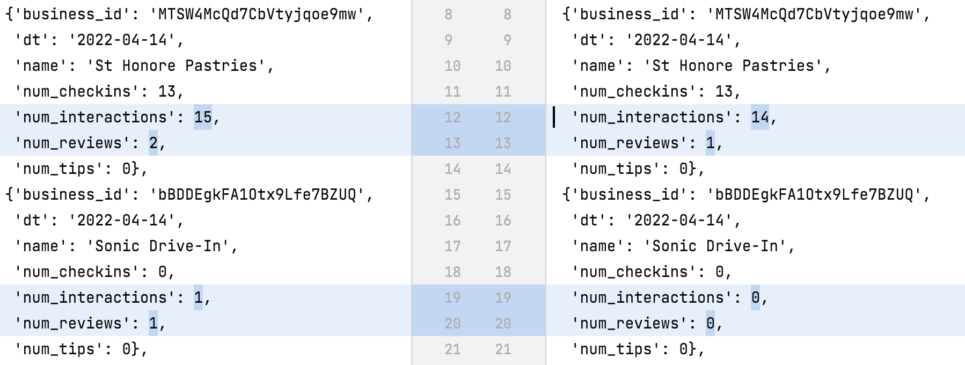
Large Outputs
Old values
New values

Slide 45
Large Outputs
Old values
New values

Slide 46
Large Outputs
Old values
New values

Slide 47
Large Outputs
Old values
New values

Slide 48
Large Outputs
actual_df = transform(
business_df,
checkin_df,
reviews_df,
tips_df,
mobile_reviews_df,
datetime(2022, 4, 14).strftime('%Y-%m-%d')
)
assert data_frame_to_json(actual_df) == expected_json()
#overwrite_expected(actual_df)

Slide 49
5 days to find the bug,
3 days to fix it,
followed by 7 days of running
backfills for 2 months of data
@jmasonlee

Slide 50

Notes:
Efficient tests are: Fast, Confidence Inspiring, Reproducible and easy to write
The easiest tests to write are the ones that are set up for you.

Slide 51
"Have you ever heard of a Saff squeeze?"
Notes:
Efficient tests are: Fast, Confidence Inspiring, Reproducible and easy to write
The easiest tests to write are the ones that are set up for you.

Slide 52
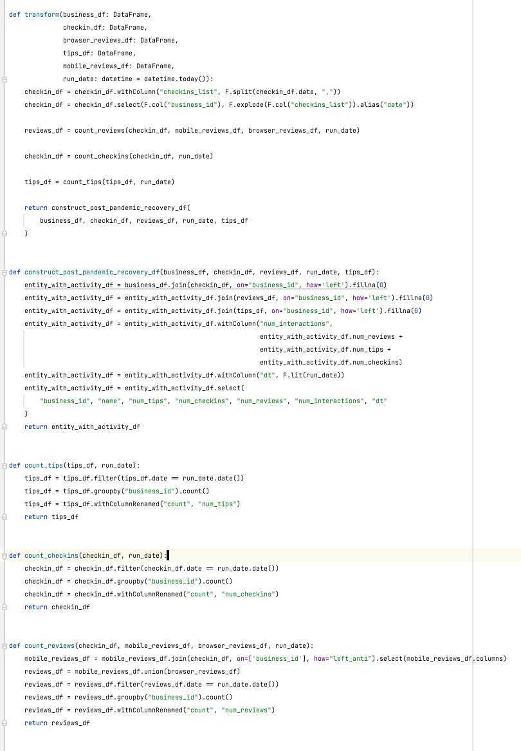
The Saff Squeeze
Create a simpler test based off of a big one
A large integration test covers all of this code
A Saff Squeeze will let us write a test for only the logic we care about
@jmasonlee

Slide 53
Give it a specific name
def test_will_do_the_right_thing(spark: SparkSession) -> None:
browser_reviews_df = create_df_from_json("fixtures/browser_reviews.json", spark) checkin_df = create_df_from_json("fixtures/checkin.json", spark) tips_df = create_df_from_json("fixtures/tips.json", spark) business_df = create_df_from_json("fixtures/business.json", spark) mobile_reviews_df = create_df_from_json("fixtures/mobile_reviews.json", spark) actual_df = transform( business_df, checkin_df, browser_reviews_df, tips_df, mobile_reviews_df, datetime(2022, 4, 14) ) assert data_frame_to_json(actual_df) == expected_json()
@jmasonlee

Slide 54
Give it a specific name
def test_will_count_mobile_reviews_without_matching_checkins(spark: SparkSession) -> None:
browser_reviews_df = create_df_from_json("fixtures/browser_reviews.json", spark) checkin_df = create_df_from_json("fixtures/checkin.json", spark) tips_df = create_df_from_json("fixtures/tips.json", spark) business_df = create_df_from_json("fixtures/business.json", spark) mobile_reviews_df = create_df_from_json("fixtures/mobile_reviews.json", spark) actual_df = transform( business_df, checkin_df, browser_reviews_df, tips_df, mobile_reviews_df, datetime(2022, 4, 14) ) assert data_frame_to_json(actual_df) == expected_json()
@jmasonlee

Slide 55
Squeeze the Bottom
def test_will_count_mobile_reviews_without_matching_checkins(spark: SparkSession) -> None:
@jmasonlee

Slide 56
Squeeze the Bottom
def test_will_count_mobile_reviews_without_matching_checkins(spark: SparkSession) -> None:
@jmasonlee

Slide 57
Squeeze the Bottom
def test_will_count_mobile_reviews_without_matching_checkins(spark: SparkSession) -> None:
✓
@jmasonlee

Slide 58
Squeeze the Bottom
def test_will_count_mobile_reviews_without_matching_checkins(spark: SparkSession) -> None:
✓
@jmasonlee

Slide 59
Squeeze the Bottom
def test_will_count_mobile_reviews_without_matching_checkins(spark: SparkSession) -> None:
✓
@jmasonlee

Slide 60
Squeeze the Bottom
def test_will_count_mobile_reviews_without_matching_checkins(spark: SparkSession) -> None:
✓
@jmasonlee

Slide 61
Squeeze the Bottom
def test_will_count_mobile_reviews_without_matching_checkins(spark: SparkSession) -> None:
✓
@jmasonlee

Slide 62
Squeeze the Bottom
def test_will_count_mobile_reviews_without_matching_checkins(spark: SparkSession) -> None:
✓
@jmasonlee

Slide 63
Squeeze the Bottom
def test_will_count_mobile_reviews_without_matching_checkins(spark: SparkSession) -> None:
✓
@jmasonlee

Slide 64
Squeeze the Bottom
def test_will_count_mobile_reviews_without_matching_checkins(spark: SparkSession) -> None:
✓
@jmasonlee

Slide 65
Squeeze the Bottom
def test_will_count_mobile_reviews_without_matching_checkins(spark: SparkSession) -> None:
✓
@jmasonlee

Slide 66
Squeeze the Bottom
def test_will_count_mobile_reviews_without_matching_checkins(spark: SparkSession) -> None:
✓
@jmasonlee

Slide 67
Find What’s Important
def test_will_count_mobile_reviews_without_matching_checkins(spark: SparkSession) -> None:
✗
@jmasonlee

Slide 68
Find What’s important
def test_will_count_mobile_reviews_without_matching_checkins(spark: SparkSession) -> None:
@jmasonlee

Slide 69
Find What’s important
def test_will_count_mobile_reviews_without_matching_checkins(spark: SparkSession) -> None:
@jmasonlee

Slide 70
Find What’s important
def test_will_count_mobile_reviews_without_matching_checkins(spark: SparkSession) -> None:
@jmasonlee

Slide 71
Squeeze The Top
def test_will_count_mobile_reviews_without_matching_checkins(spark: SparkSession) -> None:
@jmasonlee

Slide 72
Squeeze the Top
def test_will_count_mobile_reviews_without_matching_checkins(spark: SparkSession) -> None:
@jmasonlee

Slide 73
You Have a Smaller Test
def test_will_count_mobile_reviews_without_matching_checkins(spark: SparkSession) -> None:
@jmasonlee

Slide 74
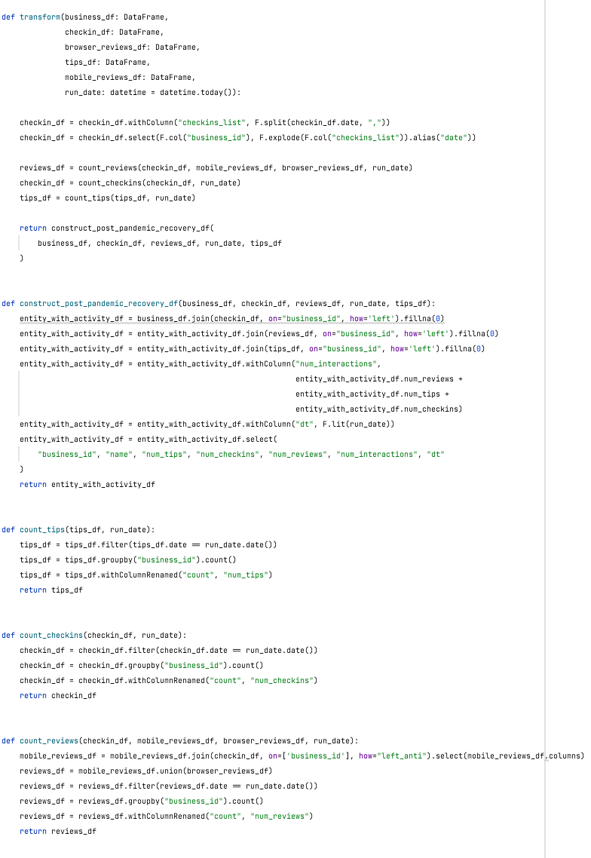
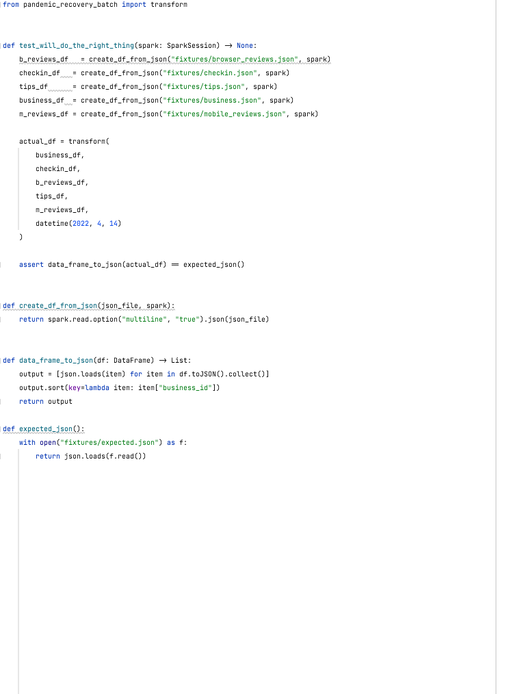
Set Things Up
Duplicate the large test
The code that we are testing
The large integration test
@jmasonlee

Slide 75
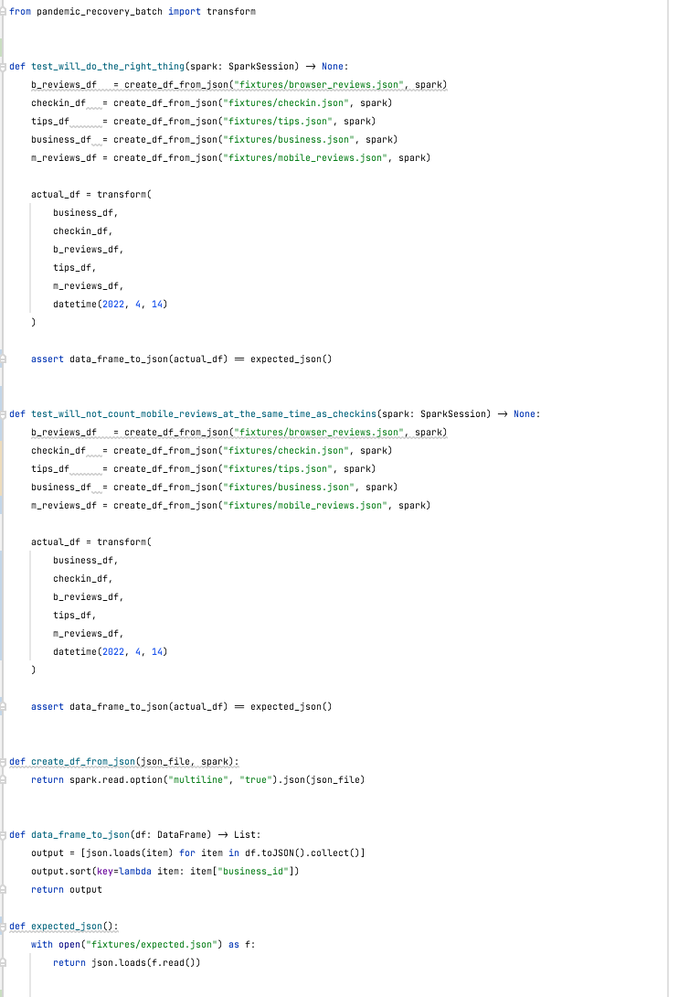
Set Things Up
Duplicate the large test
The code that we are testing
The large integration test
@jmasonlee

Slide 76
Starting with the Duplicated Test…
def test_will_do_the_right_thing(spark: SparkSession) -> None:
browser_reviews_df = create_df_from_json("fixtures/browser_reviews.json", spark) checkin_df = create_df_from_json("fixtures/checkin.json", spark) tips_df = create_df_from_json("fixtures/tips.json", spark) business_df = create_df_from_json("fixtures/business.json", spark) mobile_reviews_df = create_df_from_json("fixtures/mobile_reviews.json", spark) actual_df = transform( business_df, checkin_df, browser_reviews_df, tips_df, mobile_reviews_df, datetime(2022, 4, 14) ) expected_json = read_json() assert data_frame_to_json(actual_df) == expected_json #overwrite_expected(actual_df)
@jmasonlee

Slide 77
Give it a better name
def test_will_do_the_right_thing(spark: SparkSession) -> None:
browser_reviews_df = create_df_from_json("fixtures/browser_reviews.json", spark) checkin_df = create_df_from_json("fixtures/checkin.json", spark) tips_df = create_df_from_json("fixtures/tips.json", spark) business_df = create_df_from_json("fixtures/business.json", spark) mobile_reviews_df = create_df_from_json("fixtures/mobile_reviews.json", spark) actual_df = transform( business_df, checkin_df, browser_reviews_df, tips_df, mobile_reviews_df, datetime(2022, 4, 14) ) expected_json = read_json() assert data_frame_to_json(actual_df) == expected_json #overwrite_expected(actual_df)
@jmasonlee

Slide 78
This is the bug
1
Mobile Review
0
Checkins
0
Reviews
+
=
Mobile
Reviews
Checkins
1
Mobile Review
1
Checkin
1
Review
+
=
@jmasonlee

Slide 79
This is what we want
1
Mobile Review
0
Checkins
1
Review
+
=
Mobile
Reviews
Checkins
1
Mobile Review
1
Checkin
0
Reviews
+
=
@jmasonlee

Slide 80
This is what we want
1
Mobile Review
0
Checkins
1
Review
+
=
Mobile
Reviews
Checkins
1
Mobile Review
1
Checkin
0
Reviews
+
=
@jmasonlee

Slide 81
This is what we want
1
Mobile Review
0
Checkins
1
Review
+
=
@jmasonlee

Slide 82
This is what we are testing
1
Mobile Review
for
Inglewood Pizza
0
Checkins
at
Inglewood Pizza
1
Review
for
Inglewood Pizza
+
=
@jmasonlee

Slide 83
Give it a better name
def test_will_count_mobile_reviews_without_matching_checkins(spark: SparkSession) -> None:
browser_reviews_df = create_df_from_json("fixtures/browser_reviews.json", spark) checkin_df = create_df_from_json("fixtures/checkin.json", spark) tips_df = create_df_from_json("fixtures/tips.json", spark) business_df = create_df_from_json("fixtures/business.json", spark) mobile_reviews_df = create_df_from_json("fixtures/mobile_reviews.json", spark) actual_df = transform( business_df, checkin_df, browser_reviews_df, tips_df, mobile_reviews_df, datetime(2022, 4, 14) ) expected_json = read_json() assert data_frame_to_json(actual_df) == expected_json #overwrite_expected(actual_df)
@jmasonlee

Slide 84
Check out the test input
def test_will_count_mobile_reviews_without_matching_checkins(spark: SparkSession) -> None:
browser_reviews_df = create_df_from_json("fixtures/browser_reviews.json", spark) checkin_df = create_df_from_json("fixtures/checkin.json", spark) tips_df = create_df_from_json("fixtures/tips.json", spark) business_df = create_df_from_json("fixtures/business.json", spark) mobile_reviews_df = create_df_from_json("fixtures/ ", spark) actual_df = transform( business_df, checkin_df, browser_reviews_df, tips_df, mobile_reviews_df, datetime(2022, 4, 14) ) expected_json = read_json() assert data_frame_to_json(actual_df) == expected_json #overwrite_expected(actual_df)
mobile_reviews.json
@jmasonlee

Slide 85
mobile_reviews.json
[ { "review_id": "XQfwVwDr-v0ZS3_CbbE5Xw", "user_id": "mh_-eMZ6K5RLWhZyISBhwA", "business_id": "Pns2l4eNsfO8kk83dixA6A", "stars": 3.0, "useful": 0, "funny": 0, "cool": 0, "text": "If you decide to eat here, just be aware it is going to take about 2 hours from beginning to end. We have tried it multiple times, because I want to like it! I have been to its other locations in NJ and never had a bad experience. \n\nThe food is good, but it takes a very long time to come out. The waitstaff is very young, but usually pleasant. We have just had too many experiences where we spent way too long waiting. We usually opt for another diner or restaurant on the weekends, in order to be done quicker.", "date": "2018-07-07 22:09:11" }, { "review_id": "7ATYjTIgM3jUlt4UM3IypQ", "user_id": "OyoGAe7OKpv6SyGZT5g77Q", "business_id": "qkRM_2X51Yqxk3btlwAQIg", "stars": 5.0, "useful": 1, "funny": 0, "cool": 1, "text": "Ive taken a lot of spin classes over the years, and nothing compares to the classes at Body Cycle. From the nice, clean space and amazing bikes, to the welcoming and motivating instructors, every class is a top notch work out.\n\nFor anyone who struggles to fit workouts in, the online scheduling system makes it easy to plan ahead (and theres no need to line up way in advanced like many gyms make you do).\n\nThere is no way I can write this review without giving Russell, the owner of Body Cycle, a shout out. Russells passion for fitness and cycling is so evident, as is his desire for all of his clients to succeed. He is always dropping in to classes to check in\/provide encouragement, and is open to ideas and recommendations from anyone. Russell always wears a smile on his face, even when hes kicking your butt in class!", "date": "2022-04-14 13:18:32" }, { "review_id": "YjUWPpI6HXG530lwP-fb2A", "user_id": "8g_iMtfSiwikVnbP2etR0A", "business_id": "Pns2l4eNsfO8kk83dixA6A", "stars": 3.0, "useful": 0, "funny": 0, "cool": 0, "text": "Family diner. Had the buffet. Eclectic assortment: a large chicken leg, fried jalapeño, tamale, two rolled grape leaves, fresh melon. All good. Lots of Mexican choices there. Also has a menu with breakfast served all day long. Friendly, attentive staff. Good place for a casual relaxed meal with no expectations. Next to the Clarion Hotel.", "date": "2022-04-14 16:23:50" }, { "review_id": "kxX2SOes4o-D3ZQBkiMRfA", "user_id": "_7bHUi9Uuf5__HHc_Q8guQ", "business_id": "bBDDEgkFA1Otx9Lfe7BZUQ", "stars": 5.0, "useful": 1, "funny": 0, "cool": 1, "text": "Wow! Yummy, different, delicious. Our favorite is the lamb curry and korma. With 10 different kinds of naan!!! Dont let the outside deter you (because we almost changed our minds)...go in and try something new! Youll be glad you did!", "date": "2021-01-04 00:01:03" }, { "review_id": "e4Vwtrqf-wpJfwesgvdgxQ", "user_id": "bcjbaE6dDog4jkNY91ncLQ", "business_id": "tUFrWirKiKi_TAnsVWINQQ", "stars": 4.0, "useful": 1, "funny": 0, "cool": 1, "text": "Cute interior and owner (?) gave us tour of upcoming patio\/rooftop area which will be great on beautiful days like today. Cheese curds were very good and very filling. Really like that sandwiches come w salad, esp after eating too many curds! Had the onion, gruyere, tomato sandwich. Wasnt too much cheese which I liked. Needed something else...pepper jelly maybe. Would like to see more menu options added such as salads w fun cheeses. Lots of beer and wine as well as limited cocktails. Next time I will try one of the draft wines.", "date": "2017-01-14 20:54:15" }, { "review_id": "kxX2SOes4o-D3ZQBkiMRfA", "user_id": "_7bHUi9Uuf5__HHc_Q8guQ", "business_id": "mpf3x-BjTdTEA3yCZrAYPw", "stars": 5.0, "useful": 1, "funny": 0, "cool": 1, "text": "Wow! Yummy, different, delicious. Our favorite is the lamb curry and korma. With 10 different kinds of naan!!! Dont let the outside deter you (because we almost changed our minds)...go in and try something new! Youll be glad you did!", "date": "2022-04-14 00:01:03" }, { "review_id": "bBDDEgkFA1Otx9Lfe7BZUQ", "user_id": "r3zeYsv1XFBRA4dJpL78cw", "business_id": "mWMc6_wTdE0EUBKIGXDVfA", "stars": 5.0, "useful": 0, "funny": 2, "cool": 0, "text": "Loved this tour! I grabbed a groupon and the price was great. It was the perfect way to explore New Orleans for someone whod never been there before and didnt know a lot about the history of the city. Our tour guide had tons of interesting tidbits about the city, and I really enjoyed the experience. Highly recommended tour. I actually thought we were just going to tour through the cemetery, but she took us around the French Quarter for the first hour, and the cemetery for the second half of the tour. Youll meet up in front of a grocery store (seems strange at first, but its not terribly hard to find, and itll give you a chance to get some water), and youll stop at a visitor center part way through the tour for a bathroom break if needed. This tour was one of my favorite parts of my trip!", "date": "2021-01-03 23:21:18" }, { "review_id": "LHSTtnW3YHCeUkRDGyJOyw", "user_id": "yfFzsLmaWF2d4Sr0UNbBgg", "business_id": "_ZeMknuYdlQcUqng_Im3yg", "stars": 5.0, "useful": 2, "funny": 0, "cool": 0, "text": "Amazingly amazing wings and homemade bleu cheese. Had the ribeye: tender, perfectly prepared, delicious. Nice selection of craft beers. Would DEFINITELY recommend checking out this hidden gem.", "date": "2021-08-07 02:29:16" }, { "review_id": "B5XSoSG3SfvQGtKEGQ1tSQ", "user_id": "wSTuiTk-sKNdcFyprzZAjg", "business_id": "k0hlBqXX-Bt0vf1op7Jr1w", "stars": 3.0, "useful": 1, "funny": 1, "cool": 0, "text": "This easter instead of going to Lopez Lake we went to Los Padres National Forest which is really pretty but if you go to white rock the staff needs to cut down all the dead grass that invades the rock and the water. I would wish the staff would also clean or get rid of the dead grass thats also living by the water. The water is really green and dirty. Los padres national forest staff need to work hard to maintain this forest looking pretty and not like a dumpster. Even Cachuma lake looks like they put a bit more effort.", "date": "2022-04-14 22:46:33" }, { "review_id": "gebiRewfieSdtt17PTW6Zg", "user_id": "59MxRhNVhU9MYndMkz0wtw", "business_id": "pUycOfUwM8vqX7KjRRhUEA", "stars": 3.0, "useful": 0, "funny": 0, "cool": 0, "text": "Had a party of 6 here for hibachi. Our waitress brought our separate sushi orders on one plate so we couldnt really tell whos was whos and forgot several items on an order. I understand making mistakes but the restaraunt was really quiet so we were kind of surprised. Usually hibachi is a fun lively experience and our cook said maybe three words, but he cooked very well his name was Francisco. Service was fishy, food was pretty good, and im hoping it was just an off night here. But for the money I wouldnt go back.", "date": "2016-07-25 07:31:06" },
{ "review_id": "be02921c1ccd4c5dabdc63bd29f3bd35", "user_id": "0dea283273fa4f40ac12ea210994d5f8", "business_id": "41189bbb4fb446a586b0d69aba01d39b", "stars": 5.0, "useful": 1, "funny": 0, "cool": 0, "text": "They have the absolute best pizza on this entire planet. Gooey and greasy, without the soggy crust, they are allergy friendly and know what is in all their ingredients and their dough!", "date": "2022-04-14 07:31:06" } ]

Slide 86
[ { "review_id": "XQfwVwDr-v0ZS3_CbbE5Xw", "user_id": "mh_-eMZ6K5RLWhZyISBhwA", "business_id": "Pns2l4eNsfO8kk83dixA6A", "stars": 3.0, "useful": 0, "funny": 0, "cool": 0, "text": "If you decide to eat here, just be aware it is going to take about 2 hours from beginning to end. We have tried it multiple times, because I want to like it! I have been to its other locations in NJ and never had a bad experience. \n\nThe food is good, but it takes a very long time to come out. The waitstaff is very young, but usually pleasant. We have just had too many experiences where we spent way too long waiting. We usually opt for another diner or restaurant on the weekends, in order to be done quicker.", "date": "2018-07-07 22:09:11" }, { "review_id": "7ATYjTIgM3jUlt4UM3IypQ", "user_id": "OyoGAe7OKpv6SyGZT5g77Q", "business_id": "qkRM_2X51Yqxk3btlwAQIg", "stars": 5.0, "useful": 1, "funny": 0, "cool": 1, "text": "Ive taken a lot of spin classes over the years, and nothing compares to the classes at Body Cycle. From the nice, clean space and amazing bikes, to the welcoming and motivating instructors, every class is a top notch work out.\n\nFor anyone who struggles to fit workouts in, the online scheduling system makes it easy to plan ahead (and theres no need to line up way in advanced like many gyms make you do).\n\nThere is no way I can write this review without giving Russell, the owner of Body Cycle, a shout out. Russells passion for fitness and cycling is so evident, as is his desire for all of his clients to succeed. He is always dropping in to classes to check in\/provide encouragement, and is open to ideas and recommendations from anyone. Russell always wears a smile on his face, even when hes kicking your butt in class!", "date": "2022-04-14 13:18:32" }, { "review_id": "YjUWPpI6HXG530lwP-fb2A", "user_id": "8g_iMtfSiwikVnbP2etR0A", "business_id": "Pns2l4eNsfO8kk83dixA6A", "stars": 3.0, "useful": 0, "funny": 0, "cool": 0, "text": "Family diner. Had the buffet. Eclectic assortment: a large chicken leg, fried jalapeño, tamale, two rolled grape leaves, fresh melon. All good. Lots of Mexican choices there. Also has a menu with breakfast served all day long. Friendly, attentive staff. Good place for a casual relaxed meal with no expectations. Next to the Clarion Hotel.", "date": "2022-04-14 16:23:50" }, { "review_id": "kxX2SOes4o-D3ZQBkiMRfA", "user_id": "_7bHUi9Uuf5__HHc_Q8guQ", "business_id": "bBDDEgkFA1Otx9Lfe7BZUQ", "stars": 5.0, "useful": 1, "funny": 0, "cool": 1, "text": "Wow! Yummy, different, delicious. Our favorite is the lamb curry and korma. With 10 different kinds of naan!!! Dont let the outside deter you (because we almost changed our minds)...go in and try something new! Youll be glad you did!", "date": "2021-01-04 00:01:03" }, { "review_id": "e4Vwtrqf-wpJfwesgvdgxQ", "user_id": "bcjbaE6dDog4jkNY91ncLQ", "business_id": "tUFrWirKiKi_TAnsVWINQQ", "stars": 4.0, "useful": 1, "funny": 0, "cool": 1, "text": "Cute interior and owner (?) gave us tour of upcoming patio\/rooftop area which will be great on beautiful days like today. Cheese curds were very good and very filling. Really like that sandwiches come w salad, esp after eating too many curds! Had the onion, gruyere, tomato sandwich. Wasnt too much cheese which I liked. Needed something else...pepper jelly maybe. Would like to see more menu options added such as salads w fun cheeses. Lots of beer and wine as well as limited cocktails. Next time I will try one of the draft wines.", "date": "2017-01-14 20:54:15" }, { "review_id": "kxX2SOes4o-D3ZQBkiMRfA", "user_id": "_7bHUi9Uuf5__HHc_Q8guQ", "business_id": "mpf3x-BjTdTEA3yCZrAYPw", "stars": 5.0, "useful": 1, "funny": 0, "cool": 1, "text": "Wow! Yummy, different, delicious. Our favorite is the lamb curry and korma. With 10 different kinds of naan!!! Dont let the outside deter you (because we almost changed our minds)...go in and try something new! Youll be glad you did!", "date": "2022-04-14 00:01:03" }, { "review_id": "bBDDEgkFA1Otx9Lfe7BZUQ", "user_id": "r3zeYsv1XFBRA4dJpL78cw", "business_id": "mWMc6_wTdE0EUBKIGXDVfA", "stars": 5.0, "useful": 0, "funny": 2, "cool": 0, "text": "Loved this tour! I grabbed a groupon and the price was great. It was the perfect way to explore New Orleans for someone whod never been there before and didnt know a lot about the history of the city. Our tour guide had tons of interesting tidbits about the city, and I really enjoyed the experience. Highly recommended tour. I actually thought we were just going to tour through the cemetery, but she took us around the French Quarter for the first hour, and the cemetery for the second half of the tour. Youll meet up in front of a grocery store (seems strange at first, but its not terribly hard to find, and itll give you a chance to get some water), and youll stop at a visitor center part way through the tour for a bathroom break if needed. This tour was one of my favorite parts of my trip!", "date": "2021-01-03 23:21:18" }, { "review_id": "LHSTtnW3YHCeUkRDGyJOyw", "user_id": "yfFzsLmaWF2d4Sr0UNbBgg", "business_id": "_ZeMknuYdlQcUqng_Im3yg", "stars": 5.0, "useful": 2, "funny": 0, "cool": 0, "text": "Amazingly amazing wings and homemade bleu cheese. Had the ribeye: tender, perfectly prepared, delicious. Nice selection of craft beers. Would DEFINITELY recommend checking out this hidden gem.", "date": "2021-08-07 02:29:16" }, { "review_id": "B5XSoSG3SfvQGtKEGQ1tSQ", "user_id": "wSTuiTk-sKNdcFyprzZAjg", "business_id": "k0hlBqXX-Bt0vf1op7Jr1w", "stars": 3.0, "useful": 1, "funny": 1, "cool": 0, "text": "This easter instead of going to Lopez Lake we went to Los Padres National Forest which is really pretty but if you go to white rock the staff needs to cut down all the dead grass that invades the rock and the water. I would wish the staff would also clean or get rid of the dead grass thats also living by the water. The water is really green and dirty. Los padres national forest staff need to work hard to maintain this forest looking pretty and not like a dumpster. Even Cachuma lake looks like they put a bit more effort.", "date": "2022-04-14 22:46:33" }, { "review_id": "gebiRewfieSdtt17PTW6Zg", "user_id": "59MxRhNVhU9MYndMkz0wtw", "business_id": "pUycOfUwM8vqX7KjRRhUEA", "stars": 3.0, "useful": 0, "funny": 0, "cool": 0, "text": "Had a party of 6 here for hibachi. Our waitress brought our separate sushi orders on one plate so we couldnt really tell whos was whos and forgot several items on an order. I understand making mistakes but the restaraunt was really quiet so we were kind of surprised. Usually hibachi is a fun lively experience and our cook said maybe three words, but he cooked very well his name was Francisco. Service was fishy, food was pretty good, and im hoping it was just an off night here. But for the money I wouldnt go back.", "date": "2016-07-25 07:31:06" }, { "review_id": "be02921c1ccd4c5dabdc63bd29f3bd35", "user_id": "0dea283273fa4f40ac12ea210994d5f8", "business_id": "41189bbb4fb446a586b0d69aba01d39b", "stars": 5.0, "useful": 1, "funny": 0, "cool": 0, "text": "They have the absolute best pizza on this entire planet. Gooey and greasy, without the soggy crust, they are allergy friendly and know what is in all their ingredients and their dough!", "date": "2022-04-14 07:31:06" } ]

Slide 87
[ { "review_id": "XQfwVwDr-v0ZS3_CbbE5Xw", "user_id": "mh_-eMZ6K5RLWhZyISBhwA", "business_id": "Pns2l4eNsfO8kk83dixA6A", "stars": 3.0, "useful": 0, "funny": 0, "cool": 0, "text": "If you decide to eat here, just be aware it is going to take about 2 hours from beginning to end. We have tried it multiple times, because I want to like it! I have been to its other locations in NJ and never had a bad experience. \n\nThe food is good, but it takes a very long time to come out. The waitstaff is very young, but usually pleasant. We have just had too many experiences where we spent way too long waiting. We usually opt for another diner or restaurant on the weekends, in order to be done quicker.", "date": "2018-07-07 22:09:11" }, { "review_id": "7ATYjTIgM3jUlt4UM3IypQ", "user_id": "OyoGAe7OKpv6SyGZT5g77Q", "business_id": "qkRM_2X51Yqxk3btlwAQIg", "stars": 5.0, "useful": 1, "funny": 0, "cool": 1, "text": "Ive taken a lot of spin classes over the years, and nothing compares to the classes at Body Cycle. From the nice, clean space and amazing bikes, to the welcoming and motivating instructors, every class is a top notch work out.\n\nFor anyone who struggles to fit workouts in, the online scheduling system makes it easy to plan ahead (and theres no need to line up way in advanced like many gyms make you do).\n\nThere is no way I can write this review without giving Russell, the owner of Body Cycle, a shout out. Russells passion for fitness and cycling is so evident, as is his desire for all of his clients to succeed. He is always dropping in to classes to check in\/provide encouragement, and is open to ideas and recommendations from anyone. Russell always wears a smile on his face, even when hes kicking your butt in class!", "date": "2022-04-14 13:18:32" }, { "review_id": "YjUWPpI6HXG530lwP-fb2A", "user_id": "8g_iMtfSiwikVnbP2etR0A", "business_id": "Pns2l4eNsfO8kk83dixA6A", "stars": 3.0, "useful": 0, "funny": 0, "cool": 0, "text": "Family diner. Had the buffet. Eclectic assortment: a large chicken leg, fried jalapeño, tamale, two rolled grape leaves, fresh melon. All good. Lots of Mexican choices there. Also has a menu with breakfast served all day long. Friendly, attentive staff. Good place for a casual relaxed meal with no expectations. Next to the Clarion Hotel.", "date": "2022-04-14 16:23:50" }, { "review_id": "kxX2SOes4o-D3ZQBkiMRfA", "user_id": "_7bHUi9Uuf5__HHc_Q8guQ", "business_id": "bBDDEgkFA1Otx9Lfe7BZUQ", "stars": 5.0, "useful": 1, "funny": 0, "cool": 1, "text": "Wow! Yummy, different, delicious. Our favorite is the lamb curry and korma. With 10 different kinds of naan!!! Dont let the outside deter you (because we almost changed our minds)...go in and try something new! Youll be glad you did!", "date": "2021-01-04 00:01:03" }, { "review_id": "e4Vwtrqf-wpJfwesgvdgxQ", "user_id": "bcjbaE6dDog4jkNY91ncLQ", "business_id": "tUFrWirKiKi_TAnsVWINQQ", "stars": 4.0, "useful": 1, "funny": 0, "cool": 1, "text": "Cute interior and owner (?) gave us tour of upcoming patio\/rooftop area which will be great on beautiful days like today. Cheese curds were very good and very filling. Really like that sandwiches come w salad, esp after eating too many curds! Had the onion, gruyere, tomato sandwich. Wasnt too much cheese which I liked. Needed something else...pepper jelly maybe. Would like to see more menu options added such as salads w fun cheeses. Lots of beer and wine as well as limited cocktails. Next time I will try one of the draft wines.", "date": "2017-01-14 20:54:15" }, { "review_id": "kxX2SOes4o-D3ZQBkiMRfA", "user_id": "_7bHUi9Uuf5__HHc_Q8guQ", "business_id": "mpf3x-BjTdTEA3yCZrAYPw", "stars": 5.0, "useful": 1, "funny": 0, "cool": 1, "text": "Wow! Yummy, different, delicious. Our favorite is the lamb curry and korma. With 10 different kinds of naan!!! Dont let the outside deter you (because we almost changed our minds)...go in and try something new! Youll be glad you did!", "date": "2022-04-14 00:01:03" }, { "review_id": "bBDDEgkFA1Otx9Lfe7BZUQ", "user_id": "r3zeYsv1XFBRA4dJpL78cw", "business_id": "mWMc6_wTdE0EUBKIGXDVfA", "stars": 5.0, "useful": 0, "funny": 2, "cool": 0, "text": "Loved this tour! I grabbed a groupon and the price was great. It was the perfect way to explore New Orleans for someone whod never been there before and didnt know a lot about the history of the city. Our tour guide had tons of interesting tidbits about the city, and I really enjoyed the experience. Highly recommended tour. I actually thought we were just going to tour through the cemetery, but she took us around the French Quarter for the first hour, and the cemetery for the second half of the tour. Youll meet up in front of a grocery store (seems strange at first, but its not terribly hard to find, and itll give you a chance to get some water), and youll stop at a visitor center part way through the tour for a bathroom break if needed. This tour was one of my favorite parts of my trip!", "date": "2021-01-03 23:21:18" }, { "review_id": "LHSTtnW3YHCeUkRDGyJOyw", "user_id": "yfFzsLmaWF2d4Sr0UNbBgg", "business_id": "_ZeMknuYdlQcUqng_Im3yg", "stars": 5.0, "useful": 2, "funny": 0, "cool": 0, "text": "Amazingly amazing wings and homemade bleu cheese. Had the ribeye: tender, perfectly prepared, delicious. Nice selection of craft beers. Would DEFINITELY recommend checking out this hidden gem.", "date": "2021-08-07 02:29:16" }, { "review_id": "B5XSoSG3SfvQGtKEGQ1tSQ", "user_id": "wSTuiTk-sKNdcFyprzZAjg", "business_id": "k0hlBqXX-Bt0vf1op7Jr1w", "stars": 3.0, "useful": 1, "funny": 1, "cool": 0, "text": "This easter instead of going to Lopez Lake we went to Los Padres National Forest which is really pretty but if you go to white rock the staff needs to cut down all the dead grass that invades the rock and the water. I would wish the staff would also clean or get rid of the dead grass thats also living by the water. The water is really green and dirty. Los padres national forest staff need to work hard to maintain this forest looking pretty and not like a dumpster. Even Cachuma lake looks like they put a bit more effort.", "date": "2022-04-14 22:46:33" }, { "review_id": "gebiRewfieSdtt17PTW6Zg", "user_id": "59MxRhNVhU9MYndMkz0wtw", "business_id": "pUycOfUwM8vqX7KjRRhUEA", "stars": 3.0, "useful": 0, "funny": 0, "cool": 0, "text": "Had a party of 6 here for hibachi. Our waitress brought our separate sushi orders on one plate so we couldnt really tell whos was whos and forgot several items on an order. I understand making mistakes but the restaraunt was really quiet so we were kind of surprised. Usually hibachi is a fun lively experience and our cook said maybe three words, but he cooked very well his name was Francisco. Service was fishy, food was pretty good, and im hoping it was just an off night here. But for the money I wouldnt go back.", "date": "2016-07-25 07:31:06" }, { "review_id": "be02921c1ccd4c5dabdc63bd29f3bd35", "user_id": "0dea283273fa4f40ac12ea210994d5f8", "business_id": "41189bbb4fb446a586b0d69aba01d39b", "stars": 5.0, "useful": 1, "funny": 0, "cool": 0, "text": "They have the absolute best pizza on this entire planet. Gooey and greasy, without the soggy crust, they are allergy friendly and know what is in all their ingredients and their dough!", "date": "2022-04-14 07:31:06" } ]

Slide 88
[ { "review_id": "XQfwVwDr-v0ZS3_CbbE5Xw", "user_id": "mh_-eMZ6K5RLWhZyISBhwA", "business_id": "Pns2l4eNsfO8kk83dixA6A", "stars": 3.0, "useful": 0, "funny": 0, "cool": 0, "text": "If you decide to eat here, just be aware it is going to take about 2 hours from beginning to end. We have tried it multiple times, because I want to like it! I have been to its other locations in NJ and never had a bad experience. \n\nThe food is good, but it takes a very long time to come out. The waitstaff is very young, but usually pleasant. We have just had too many experiences where we spent way too long waiting. We usually opt for another diner or restaurant on the weekends, in order to be done quicker.", "date": "2018-07-07 22:09:11" }, { "review_id": "7ATYjTIgM3jUlt4UM3IypQ", "user_id": "OyoGAe7OKpv6SyGZT5g77Q", "business_id": "qkRM_2X51Yqxk3btlwAQIg", "stars": 5.0, "useful": 1, "funny": 0, "cool": 1, "text": "Ive taken a lot of spin classes over the years, and nothing compares to the classes at Body Cycle. From the nice, clean space and amazing bikes, to the welcoming and motivating instructors, every class is a top notch work out.\n\nFor anyone who struggles to fit workouts in, the online scheduling system makes it easy to plan ahead (and theres no need to line up way in advanced like many gyms make you do).\n\nThere is no way I can write this review without giving Russell, the owner of Body Cycle, a shout out. Russells passion for fitness and cycling is so evident, as is his desire for all of his clients to succeed. He is always dropping in to classes to check in\/provide encouragement, and is open to ideas and recommendations from anyone. Russell always wears a smile on his face, even when hes kicking your butt in class!", "date": "2022-04-14 13:18:32" }, { "review_id": "YjUWPpI6HXG530lwP-fb2A", "user_id": "8g_iMtfSiwikVnbP2etR0A", "business_id": "Pns2l4eNsfO8kk83dixA6A", "stars": 3.0, "useful": 0, "funny": 0, "cool": 0, "text": "Family diner. Had the buffet. Eclectic assortment: a large chicken leg, fried jalapeño, tamale, two rolled grape leaves, fresh melon. All good. Lots of Mexican choices there. Also has a menu with breakfast served all day long. Friendly, attentive staff. Good place for a casual relaxed meal with no expectations. Next to the Clarion Hotel.", "date": "2022-04-14 16:23:50" }, { "review_id": "kxX2SOes4o-D3ZQBkiMRfA", "user_id": "_7bHUi9Uuf5__HHc_Q8guQ", "business_id": "bBDDEgkFA1Otx9Lfe7BZUQ", "stars": 5.0, "useful": 1, "funny": 0, "cool": 1, "text": "Wow! Yummy, different, delicious. Our favorite is the lamb curry and korma. With 10 different kinds of naan!!! Dont let the outside deter you (because we almost changed our minds)...go in and try something new! Youll be glad you did!", "date": "2021-01-04 00:01:03" }, { "review_id": "e4Vwtrqf-wpJfwesgvdgxQ", "user_id": "bcjbaE6dDog4jkNY91ncLQ", "business_id": "tUFrWirKiKi_TAnsVWINQQ", "stars": 4.0, "useful": 1, "funny": 0, "cool": 1, "text": "Cute interior and owner (?) gave us tour of upcoming patio\/rooftop area which will be great on beautiful days like today. Cheese curds were very good and very filling. Really like that sandwiches come w salad, esp after eating too many curds! Had the onion, gruyere, tomato sandwich. Wasnt too much cheese which I liked. Needed something else...pepper jelly maybe. Would like to see more menu options added such as salads w fun cheeses. Lots of beer and wine as well as limited cocktails. Next time I will try one of the draft wines.", "date": "2017-01-14 20:54:15" }, { "review_id": "kxX2SOes4o-D3ZQBkiMRfA", "user_id": "_7bHUi9Uuf5__HHc_Q8guQ", "business_id": "mpf3x-BjTdTEA3yCZrAYPw", "stars": 5.0, "useful": 1, "funny": 0, "cool": 1, "text": "Wow! Yummy, different, delicious. Our favorite is the lamb curry and korma. With 10 different kinds of naan!!! Dont let the outside deter you (because we almost changed our minds)...go in and try something new! Youll be glad you did!", "date": "2022-04-14 00:01:03" }, { "review_id": "bBDDEgkFA1Otx9Lfe7BZUQ", "user_id": "r3zeYsv1XFBRA4dJpL78cw", "business_id": "mWMc6_wTdE0EUBKIGXDVfA", "stars": 5.0, "useful": 0, "funny": 2, "cool": 0, "text": "Loved this tour! I grabbed a groupon and the price was great. It was the perfect way to explore New Orleans for someone whod never been there before and didnt know a lot about the history of the city. Our tour guide had tons of interesting tidbits about the city, and I really enjoyed the experience. Highly recommended tour. I actually thought we were just going to tour through the cemetery, but she took us around the French Quarter for the first hour, and the cemetery for the second half of the tour. Youll meet up in front of a grocery store (seems strange at first, but its not terribly hard to find, and itll give you a chance to get some water), and youll stop at a visitor center part way through the tour for a bathroom break if needed. This tour was one of my favorite parts of my trip!", "date": "2021-01-03 23:21:18" }, { "review_id": "LHSTtnW3YHCeUkRDGyJOyw", "user_id": "yfFzsLmaWF2d4Sr0UNbBgg", "business_id": "_ZeMknuYdlQcUqng_Im3yg", "stars": 5.0, "useful": 2, "funny": 0, "cool": 0, "text": "Amazingly amazing wings and homemade bleu cheese. Had the ribeye: tender, perfectly prepared, delicious. Nice selection of craft beers. Would DEFINITELY recommend checking out this hidden gem.", "date": "2021-08-07 02:29:16" }, { "review_id": "B5XSoSG3SfvQGtKEGQ1tSQ", "user_id": "wSTuiTk-sKNdcFyprzZAjg", "business_id": "k0hlBqXX-Bt0vf1op7Jr1w", "stars": 3.0, "useful": 1, "funny": 1, "cool": 0, "text": "This easter instead of going to Lopez Lake we went to Los Padres National Forest which is really pretty but if you go to white rock the staff needs to cut down all the dead grass that invades the rock and the water. I would wish the staff would also clean or get rid of the dead grass thats also living by the water. The water is really green and dirty. Los padres national forest staff need to work hard to maintain this forest looking pretty and not like a dumpster. Even Cachuma lake looks like they put a bit more effort.", "date": "2022-04-14 22:46:33" }, { "review_id": "gebiRewfieSdtt17PTW6Zg", "user_id": "59MxRhNVhU9MYndMkz0wtw", "business_id": "pUycOfUwM8vqX7KjRRhUEA", "stars": 3.0, "useful": 0, "funny": 0, "cool": 0, "text": "Had a party of 6 here for hibachi. Our waitress brought our separate sushi orders on one plate so we couldnt really tell whos was whos and forgot several items on an order. I understand making mistakes but the restaraunt was really quiet so we were kind of surprised. Usually hibachi is a fun lively experience and our cook said maybe three words, but he cooked very well his name was Francisco. Service was fishy, food was pretty good, and im hoping it was just an off night here. But for the money I wouldnt go back.", "date": "2016-07-25 07:31:06" }, { "review_id": "be02921c1ccd4c5dabdc63bd29f3bd35", "user_id": "0dea283273fa4f40ac12ea210994d5f8", "business_id": ”mobile_review_no_checkins", "stars": 5.0, "useful": 1, "funny": 0, "cool": 0, "text": "They have the absolute best pizza on this entire planet. Gooey and greasy, without the soggy crust, they are allergy friendly and know what is in all their ingredients and their dough!", "date": "2022-04-14 07:31:06" } ]

Slide 89
Make Sure the Test Passes
def test_will_count_mobile_reviews_without_matching_checkins(spark: SparkSession) -> None:
browser_reviews_df = create_df_from_json("fixtures/browser_reviews.json", spark) checkin_df = create_df_from_json("fixtures/checkin.json", spark) tips_df = create_df_from_json("fixtures/tips.json", spark) business_df = create_df_from_json("fixtures/business.json", spark) mobile_reviews_df = create_df_from_json("fixtures/ ", spark) actual_df = transform( business_df, checkin_df, browser_reviews_df, tips_df, mobile_reviews_df, datetime(2022, 4, 14) ) expected_json = read_json() assert data_frame_to_json(actual_df) == expected_json #overwrite_expected(actual_df)
mobile_reviews.json
✓
@jmasonlee

Slide 90
Arrange, Act, Assert
def test_will_count_mobile_reviews_without_matching_checkins(spark: SparkSession) -> None:
browser_reviews_df = create_df_from_json("fixtures/browser_reviews.json", spark) checkin_df = create_df_from_json("fixtures/checkin.json", spark) tips_df = create_df_from_json("fixtures/tips.json", spark) business_df = create_df_from_json("fixtures/business.json", spark) mobile_reviews_df = create_df_from_json("fixtures/mobile_reviews.json", spark) actual_df = transform( business_df, checkin_df, browser_reviews_df, tips_df, mobile_reviews_df, datetime(2022, 4, 14) ) expected_json = read_json() assert data_frame_to_json(actual_df) == expected_json #overwrite_expected(actual_df)
@jmasonlee

Slide 91
Make the assertion specific
def test_will_count_mobile_reviews_without_matching_checkins(spark: SparkSession) -> None:
browser_reviews_df = create_df_from_json("fixtures/browser_reviews.json", spark) checkin_df = create_df_from_json("fixtures/checkin.json", spark) tips_df = create_df_from_json("fixtures/tips.json", spark) business_df = create_df_from_json("fixtures/business.json", spark) mobile_reviews_df = create_df_from_json("fixtures/mobile_reviews.json", spark) actual_df = transform( business_df, checkin_df, browser_reviews_df, tips_df, mobile_reviews_df, datetime(2022, 4, 14) )
expected_json = read_json() assert data_frame_to_json(actual_df) == expected_json #overwrite_expected(actual_df)
@jmasonlee

Slide 92
Make the assertion specific
expected_json = read_json() assert data_frame_to_json(actual_df) == expected_json #overwrite_expected(actual_df)
@jmasonlee

Slide 93
Make the assertion specific
expected_json = read_json() assert data_frame_to_json( ) == expected_json
actual_df
@jmasonlee

Slide 94
Make the assertion specific
expected_json = read_json() assert data_frame_to_json( ) == expected_json
actual_df
@jmasonlee

Slide 95
actual_df
[ { "business_id": "mobile_review_no_checkins", "name": ”Inglewood Pizza", "num_tips": 0, "num_checkins": 0, "num_reviews": 1, "num_interactions": 1, "dt": "2022-04-14" },
{ "business_id": "MTSW4McQd7CbVtyjqoe9mw", "name": "St Honore Pastries", "num_tips": 0, "num_checkins": 13, "num_reviews": 1, "num_interactions": 14, "dt": "2022-04-14" }, { "business_id": "Pns2l4eNsfO8kk83dixA6A", "name": "Abby Rappoport, LAC, CMQ", "num_tips": 1, "num_checkins": 6, "num_reviews": 1, "num_interactions": 8, "dt": "2022-04-14" }, { "business_id": "bBDDEgkFA1Otx9Lfe7BZUQ", "name": "Sonic Drive-In", "num_tips": 0, "num_checkins": 0, "num_reviews": 0, "num_interactions": 0, "dt": "2022-04-14" }, { "business_id": "k0hlBqXX-Bt0vf1op7Jr1w", "name": "Tsevi's Pub And Grill", "num_tips": 0, "num_checkins": 0, "num_reviews": 2, "num_interactions": 2, "dt": "2022-04-14" }, { "business_id": "mWMc6_wTdE0EUBKIGXDVfA", "name": "Perkiomen Valley Brewery", "num_tips": 0, "num_checkins": 10, "num_reviews": 1, "num_interactions": 11, "dt": "2022-04-14" }, { "business_id": "mpf3x-BjTdTEA3yCZrAYPw", "name": "The UPS Store", "num_tips": 1, "num_checkins": 1, "num_reviews": 1, "num_interactions": 3, "dt": "2022-04-14" }, { "business_id": "n_0UpQx1hsNbnPUSlodU8w", "name": "Famous Footwear", "num_tips": 0, "num_checkins": 8, "num_reviews": 0, "num_interactions": 8, "dt": "2022-04-14" }, { "business_id": "qkRM_2X51Yqxk3btlwAQIg", "name": "Temple Beth-El", "num_tips": 0, "num_checkins": 1, "num_reviews": 1, "num_interactions": 2, "dt": "2022-04-14" }, { "business_id": "tUFrWirKiKi_TAnsVWINQQ", "name": "Target", "num_tips": 0, "num_checkins": 1, "num_reviews": 0, "num_interactions": 1, "dt": "2022-04-14" }]

Slide 96
actual_df
[ { "business_id": "mobile_review_no_checkins", "name": ”Inglewood Pizza", "num_tips": 0, "num_checkins": 0, "num_reviews": 1, "num_interactions": 1, "dt": "2022-04-14" },
{ "business_id": "MTSW4McQd7CbVtyjqoe9mw", "name": "St Honore Pastries", "num_tips": 0, "num_checkins": 13, "num_reviews": 1, "num_interactions": 14, "dt": "2022-04-14" }, { "business_id": "Pns2l4eNsfO8kk83dixA6A", "name": "Abby Rappoport, LAC, CMQ", "num_tips": 1, "num_checkins": 6, "num_reviews": 1, "num_interactions": 8, "dt": "2022-04-14" }, { "business_id": "bBDDEgkFA1Otx9Lfe7BZUQ", "name": "Sonic Drive-In", "num_tips": 0, "num_checkins": 0, "num_reviews": 0, "num_interactions": 0, "dt": "2022-04-14" }, { "business_id": "k0hlBqXX-Bt0vf1op7Jr1w", "name": "Tsevi's Pub And Grill", "num_tips": 0, "num_checkins": 0, "num_reviews": 2, "num_interactions": 2, "dt": "2022-04-14" }, { "business_id": "mWMc6_wTdE0EUBKIGXDVfA", "name": "Perkiomen Valley Brewery", "num_tips": 0, "num_checkins": 10, "num_reviews": 1, "num_interactions": 11, "dt": "2022-04-14" }, { "business_id": "mpf3x-BjTdTEA3yCZrAYPw", "name": "The UPS Store", "num_tips": 1, "num_checkins": 1, "num_reviews": 1, "num_interactions": 3, "dt": "2022-04-14" }, { "business_id": "n_0UpQx1hsNbnPUSlodU8w", "name": "Famous Footwear", "num_tips": 0, "num_checkins": 8, "num_reviews": 0, "num_interactions": 8, "dt": "2022-04-14" }, { "business_id": "qkRM_2X51Yqxk3btlwAQIg", "name": "Temple Beth-El", "num_tips": 0, "num_checkins": 1, "num_reviews": 1, "num_interactions": 2, "dt": "2022-04-14" }, { "business_id": "tUFrWirKiKi_TAnsVWINQQ", "name": "Target", "num_tips": 0, "num_checkins": 1, "num_reviews": 0, "num_interactions": 1, "dt": "2022-04-14" }]

Slide 97
actual_df
[ { "business_id": "mobile_review_no_checkins", "name": ”Inglewood Pizza", "num_tips": 0, "num_checkins": 0, "num_reviews": 1, "num_interactions": 1, "dt": "2022-04-14" },
{ "business_id": "MTSW4McQd7CbVtyjqoe9mw", "name": "St Honore Pastries", "num_tips": 0, "num_checkins": 13, "num_reviews": 1, "num_interactions": 14, "dt": "2022-04-14" }, { "business_id": "Pns2l4eNsfO8kk83dixA6A", "name": "Abby Rappoport, LAC, CMQ", "num_tips": 1, "num_checkins": 6, "num_reviews": 1, "num_interactions": 8, "dt": "2022-04-14" }, { "business_id": "bBDDEgkFA1Otx9Lfe7BZUQ", "name": "Sonic Drive-In", "num_tips": 0, "num_checkins": 0, "num_reviews": 0, "num_interactions": 0, "dt": "2022-04-14" }, { "business_id": "k0hlBqXX-Bt0vf1op7Jr1w", "name": "Tsevi's Pub And Grill", "num_tips": 0, "num_checkins": 0, "num_reviews": 2, "num_interactions": 2, "dt": "2022-04-14" }, { "business_id": "mWMc6_wTdE0EUBKIGXDVfA", "name": "Perkiomen Valley Brewery", "num_tips": 0, "num_checkins": 10, "num_reviews": 1, "num_interactions": 11, "dt": "2022-04-14" }, { "business_id": "mpf3x-BjTdTEA3yCZrAYPw", "name": "The UPS Store", "num_tips": 1, "num_checkins": 1, "num_reviews": 1, "num_interactions": 3, "dt": "2022-04-14" }, { "business_id": "n_0UpQx1hsNbnPUSlodU8w", "name": "Famous Footwear", "num_tips": 0, "num_checkins": 8, "num_reviews": 0, "num_interactions": 8, "dt": "2022-04-14" }, { "business_id": "qkRM_2X51Yqxk3btlwAQIg", "name": "Temple Beth-El", "num_tips": 0, "num_checkins": 1, "num_reviews": 1, "num_interactions": 2, "dt": "2022-04-14" }, { "business_id": "tUFrWirKiKi_TAnsVWINQQ", "name": "Target", "num_tips": 0, "num_checkins": 1, "num_reviews": 0, "num_interactions": 1, "dt": "2022-04-14" }]

Slide 98
actual_df
[ { "business_id": "mobile_review_no_checkins", "name": ”Inglewood Pizza", "num_tips": 0, "num_checkins": 0, "num_reviews": 1, "num_interactions": 1, "dt": "2022-04-14" },
{ "business_id": "MTSW4McQd7CbVtyjqoe9mw", "name": "St Honore Pastries", "num_tips": 0, "num_checkins": 13, "num_reviews": 1, "num_interactions": 14, "dt": "2022-04-14" }, { "business_id": "Pns2l4eNsfO8kk83dixA6A", "name": "Abby Rappoport, LAC, CMQ", "num_tips": 1, "num_checkins": 6, "num_reviews": 1, "num_interactions": 8, "dt": "2022-04-14" }, { "business_id": "bBDDEgkFA1Otx9Lfe7BZUQ", "name": "Sonic Drive-In", "num_tips": 0, "num_checkins": 0, "num_reviews": 0, "num_interactions": 0, "dt": "2022-04-14" }, { "business_id": "k0hlBqXX-Bt0vf1op7Jr1w", "name": "Tsevi's Pub And Grill", "num_tips": 0, "num_checkins": 0, "num_reviews": 2, "num_interactions": 2, "dt": "2022-04-14" }, { "business_id": "mWMc6_wTdE0EUBKIGXDVfA", "name": "Perkiomen Valley Brewery", "num_tips": 0, "num_checkins": 10, "num_reviews": 1, "num_interactions": 11, "dt": "2022-04-14" }, { "business_id": "mpf3x-BjTdTEA3yCZrAYPw", "name": "The UPS Store", "num_tips": 1, "num_checkins": 1, "num_reviews": 1, "num_interactions": 3, "dt": "2022-04-14" }, { "business_id": "n_0UpQx1hsNbnPUSlodU8w", "name": "Famous Footwear", "num_tips": 0, "num_checkins": 8, "num_reviews": 0, "num_interactions": 8, "dt": "2022-04-14" }, { "business_id": "qkRM_2X51Yqxk3btlwAQIg", "name": "Temple Beth-El", "num_tips": 0, "num_checkins": 1, "num_reviews": 1, "num_interactions": 2, "dt": "2022-04-14" }, { "business_id": "tUFrWirKiKi_TAnsVWINQQ", "name": "Target", "num_tips": 0, "num_checkins": 1, "num_reviews": 0, "num_interactions": 1, "dt": "2022-04-14" }]

Slide 99
Make the assertion specific
expected_json = read_json() assert data_frame_to_json(actual_df) == expected_json
{ "business_id": "mobile_review_no_checkins", "name": ”Inglewood Pizza", "num_tips": 0, "num_checkins": 0, "num_reviews": 1, "num_interactions": 1, "dt": "2022-04-14" },
@jmasonlee

Slide 100
Make the assertion specific
expected_json = read_json() assert data_frame_to_json(actual_df)[0] == expected_json[0]
{ "business_id": "mobile_review_no_checkins", "name": ”Inglewood Pizza", "num_tips": 0, "num_checkins": 0, "num_reviews": 1, "num_interactions": 1, "dt": "2022-04-14" },
@jmasonlee

Slide 101
Make the assertion specific
expected_json = read_json() assert data_frame_to_json(actual_df)[0] == expected_json[0]
{ "business_id": "mobile_review_no_checkins", "name": ”Inglewood Pizza", "num_tips": 0, "num_checkins": 0, "num_reviews": 1, "num_interactions": 1, "dt": "2022-04-14" },
@jmasonlee

Slide 102
Make the assertion specific
assert data_frame_to_json(actual_df)[0] == expected_json[0]
{ "business_id": "mobile_review_no_checkins", "name": ”Inglewood Pizza", "num_tips": 0, "num_checkins": 0, "num_reviews": 1, "num_interactions": 1, "dt": "2022-04-14" },
@jmasonlee

Slide 103
Make the assertion specific
assert data_frame_to_json(actual_df)[0]["business_id"] == "mobile_review_no_checkins" assert data_frame_to_json(actual_df)[0]["num_reviews"] == 1
{ "business_id": "mobile_review_no_checkins", "name": ”Inglewood Pizza", "num_tips": 0, "num_checkins": 0, "num_reviews": 1, "num_interactions": 1, "dt": "2022-04-14" },
@jmasonlee

Slide 104
Make the assertion specific
assert data_frame_to_json(actual_df)[0]["business_id"] == "mobile_review_no_checkins" assert data_frame_to_json(actual_df)[0]["num_reviews"] == 1
@jmasonlee

Slide 105
Make the assertion specific
assert_inglewood_pizza_has_correct_review_count(actual_df, 1)
def assert_inglewood_pizza_has_correct_review_count(actual_df, review_count): assert data_frame_to_json(actual_df)[0]["business_id"] == "mobile_review_no_checkins" assert data_frame_to_json(actual_df)[0]["num_reviews"] == review_count
@jmasonlee

Slide 106
Make the assertion specific
assert_inglewood_pizza_has_correct_review_count(actual_df, 1)
def assert_inglewood_pizza_has_correct_review_count(actual_df, review_count): assert data_frame_to_json(actual_df)[0]["business_id"] == "mobile_review_no_checkins" assert data_frame_to_json(actual_df)[0]["num_reviews"] == review_count
@jmasonlee

Slide 107
Make the assertion specific
def test_mobile_reviews_count_without_checkins(spark: SparkSession) -> None: browser_reviews_df = create_df_from_json("fixtures/browser_reviews.json", spark) checkin_df = create_df_from_json("fixtures/checkin.json", spark) tips_df = create_df_from_json("fixtures/tips.json", spark) business_df = create_df_from_json("fixtures/business.json", spark) mobile_reviews_df = create_df_from_json("fixtures/mobile_reviews.json", spark)
assert_inglewood_pizza_has_correct_review_count(actual_df, 1)
actual_df = transform( business_df, checkin_df, browser_reviews_df, tips_df, mobile_reviews_df, datetime(2022, 4, 14) )
@jmasonlee

Slide 108
Squeeze the Bottom
def test_mobile_reviews_count_without_checkins(spark: SparkSession) -> None: browser_reviews_df = create_df_from_json("fixtures/browser_reviews.json", spark) checkin_df = create_df_from_json("fixtures/checkin.json", spark) tips_df = create_df_from_json("fixtures/tips.json", spark) business_df = create_df_from_json("fixtures/business.json", spark) mobile_reviews_df = create_df_from_json("fixtures/mobile_reviews.json", spark)
actual_df = transform( business_df, checkin_df, browser_reviews_df, tips_df, mobile_reviews_df, datetime(2022, 4, 14) )
assert_inglewood_pizza_has_correct_review_count(actual_df, 1)
@jmasonlee

Slide 109
Squeeze the Bottom
def test_mobile_reviews_count_without_checkins(spark: SparkSession) -> None: browser_reviews_df = create_df_from_json("fixtures/browser_reviews.json", spark) checkin_df = create_df_from_json("fixtures/checkin.json", spark) tips_df = create_df_from_json("fixtures/tips.json", spark) business_df = create_df_from_json("fixtures/business.json", spark) mobile_reviews_df = create_df_from_json("fixtures/mobile_reviews.json", spark)
actual_df = transform( business_df, checkin_df, browser_reviews_df, tips_df, mobile_reviews_df, datetime(2022, 4, 14) )
assert_inglewood_pizza_has_correct_review_count(actual_df, 1)
@jmasonlee

Slide 110
Squeeze the Bottom
def transform(
business_df: DataFrame, checkin_df: DataFrame, browser_reviews_df: DataFrame, tips_df: DataFrame, mobile_reviews_df: DataFrame, run_date: datetime = datetime.today()
):
def test_mobile_reviews_count_without_checkins(spark: SparkSession) -> None: browser_reviews_df = create_df_from_json("fixtures/browser_reviews.json", spark) checkin_df = create_df_from_json("fixtures/checkin.json", spark) tips_df = create_df_from_json("fixtures/tips.json", spark) business_df = create_df_from_json("fixtures/business.json", spark) mobile_reviews_df = create_df_from_json("fixtures/mobile_reviews.json", spark)
checkin_df = create_checkin_df_with_one_date_per_row(checkin_df) reviews_df = count_reviews(checkin_df, mobile_reviews_df, browser_reviews_df, run_date) checkin_df = count_checkins(checkin_df, run_date) tips_df = count_tips(tips_df, run_date) return construct_post_pandemic_recovery_df( business_df, checkin_df, reviews_df, run_date, tips_df )
@jmasonlee

Slide 111
Squeeze the Bottom
def test_mobile_reviews_count_without_checkins(spark: SparkSession) -> None: browser_reviews_df = create_df_from_json("fixtures/browser_reviews.json", spark) checkin_df = create_df_from_json("fixtures/checkin.json", spark) tips_df = create_df_from_json("fixtures/tips.json", spark) business_df = create_df_from_json("fixtures/business.json", spark) mobile_reviews_df = create_df_from_json("fixtures/mobile_reviews.json", spark)
checkin_df = create_checkin_df_with_one_date_per_row(checkin_df)
reviews_df = count_reviews(checkin_df, mobile_reviews_df, browser_reviews_df, run_date) checkin_df = count_checkins(checkin_df, run_date) tips_df = count_tips(tips_df, run_date) actual_df = construct_post_pandemic_recovery_df( business_df, checkin_df, reviews_df, run_date, tips_df )
actual_df = transform( business_df, checkin_df, browser_reviews_df, tips_df, mobile_reviews_df, datetime(2022, 4, 14) )
assert_inglewood_pizza_has_correct_review_count(actual_df, 1)
@jmasonlee

Slide 112
Squeeze the Bottom
def test_mobile_reviews_count_without_checkins(spark: SparkSession) -> None: browser_reviews_df = create_df_from_json("fixtures/browser_reviews.json", spark) checkin_df = create_df_from_json("fixtures/checkin.json", spark) tips_df = create_df_from_json("fixtures/tips.json", spark) business_df = create_df_from_json("fixtures/business.json", spark) mobile_reviews_df = create_df_from_json("fixtures/mobile_reviews.json", spark)
actual_df = transform( business_df, checkin_df, browser_reviews_df, tips_df, mobile_reviews_df, datetime(2022, 4, 14) )
checkin_df = create_checkin_df_with_one_date_per_row(checkin_df)
reviews_df = count_reviews(checkin_df, mobile_reviews_df, browser_reviews_df, run_date) checkin_df = count_checkins(checkin_df, run_date) tips_df = count_tips(tips_df, run_date) actual_df = construct_post_pandemic_recovery_df( business_df, checkin_df, reviews_df, run_date, tips_df )
assert_inglewood_pizza_has_correct_review_count(actual_df, 1)
@jmasonlee

Slide 113
Squeeze the Bottom
def test_mobile_reviews_count_without_checkins(spark: SparkSession) -> None: browser_reviews_df = create_df_from_json("fixtures/browser_reviews.json", spark) checkin_df = create_df_from_json("fixtures/checkin.json", spark) tips_df = create_df_from_json("fixtures/tips.json", spark) business_df = create_df_from_json("fixtures/business.json", spark) mobile_reviews_df = create_df_from_json("fixtures/mobile_reviews.json", spark)
checkin_df = create_checkin_df_with_one_date_per_row(checkin_df)
reviews_df = count_reviews(checkin_df, mobile_reviews_df, browser_reviews_df, run_date) checkin_df = count_checkins(checkin_df, run_date) tips_df = count_tips(tips_df, run_date)
actual_df = construct_post_pandemic_recovery_df( business_df, checkin_df, reviews_df, run_date, tips_df )
assert_inglewood_pizza_has_correct_review_count(actual_df, 1)
@jmasonlee

Slide 114
Squeeze the Bottom
def test_mobile_reviews_count_without_checkins(spark: SparkSession) -> None: browser_reviews_df = create_df_from_json("fixtures/browser_reviews.json", spark) checkin_df = create_df_from_json("fixtures/checkin.json", spark) tips_df = create_df_from_json("fixtures/tips.json", spark) business_df = create_df_from_json("fixtures/business.json", spark) mobile_reviews_df = create_df_from_json("fixtures/mobile_reviews.json", spark)
checkin_df = create_checkin_df_with_one_date_per_row(checkin_df)
reviews_df = count_reviews(checkin_df, mobile_reviews_df, browser_reviews_df, run_date) checkin_df = count_checkins(checkin_df, run_date) tips_df = count_tips(tips_df, run_date)
assert_inglewood_pizza_has_correct_review_count(actual_df, 1)
✗
actual_df = construct_post_pandemic_recovery_df( business_df, checkin_df, reviews_df, run_date, tips_df )
@jmasonlee

Slide 115
Squeeze the Bottom
def test_mobile_reviews_count_without_checkins(spark: SparkSession) -> None: browser_reviews_df = create_df_from_json("fixtures/browser_reviews.json", spark) checkin_df = create_df_from_json("fixtures/checkin.json", spark) tips_df = create_df_from_json("fixtures/tips.json", spark) business_df = create_df_from_json("fixtures/business.json", spark) mobile_reviews_df = create_df_from_json("fixtures/mobile_reviews.json", spark)
checkin_df = create_checkin_df_with_one_date_per_row(checkin_df)
reviews_df = count_reviews(checkin_df, mobile_reviews_df, browser_reviews_df, run_date) checkin_df = count_checkins(checkin_df, run_date) tips_df = count_tips(tips_df, run_date)
actual_df = construct_post_pandemic_recovery_df( business_df, checkin_df, reviews_df, run_date, tips_df )
assert_inglewood_pizza_has_correct_review_count(actual_df, 1)
@jmasonlee

Slide 116
Squeeze the Bottom
def test_mobile_reviews_count_without_checkins(spark: SparkSession) -> None: browser_reviews_df = create_df_from_json("fixtures/browser_reviews.json", spark) checkin_df = create_df_from_json("fixtures/checkin.json", spark) tips_df = create_df_from_json("fixtures/tips.json", spark) business_df = create_df_from_json("fixtures/business.json", spark) mobile_reviews_df = create_df_from_json("fixtures/mobile_reviews.json", spark)
checkin_df = create_checkin_df_with_one_date_per_row(checkin_df)
reviews_df = count_reviews(checkin_df, mobile_reviews_df, browser_reviews_df, run_date) checkin_df = count_checkins(checkin_df, run_date) tips_df = count_tips(tips_df, run_date)
pandemic_recovery_df = business_df.join(
checkin_df, on="business_id", how='left').fillna(0) pandemic_recovery_df = pandemic_recovery_df.join(
reviews_df, on="business_id",how='left').fillna(0) pandemic_recovery_df = pandemic_recovery_df.join(
tips_df, on="business_id",how='left').fillna(0)
pandemic_recovery_df = pandemic_recovery_df.withColumn(
"num_interactions", pandemic_recovery_df.num_reviews + pandemic_recovery_df.num_tips + pandemic_recovery_df.num_checkins) pandemic_recovery_df = pandemic_recovery_df.withColumn(
"dt", F.lit(run_date.strftime("%Y-%m-%d"))) pandemic_recovery_df = select_important_columns(pandemic_recovery_df) actual_df = pandemic_recovery_df
actual_df = construct_post_pandemic_recovery_df( business_df, checkin_df, reviews_df, run_date, tips_df )
assert_inglewood_pizza_has_correct_review_count(actual_df, 1)
@jmasonlee

Slide 117
Squeeze the Bottom
def test_mobile_reviews_count_without_checkins(spark: SparkSession) -> None: browser_reviews_df = create_df_from_json("fixtures/browser_reviews.json", spark) checkin_df = create_df_from_json("fixtures/checkin.json", spark) tips_df = create_df_from_json("fixtures/tips.json", spark) business_df = create_df_from_json("fixtures/business.json", spark) mobile_reviews_df = create_df_from_json("fixtures/mobile_reviews.json", spark)
pandemic_recovery_df = business_df.join(
checkin_df, on="business_id", how='left').fillna(0) pandemic_recovery_df = pandemic_recovery_df.join(
reviews_df, on="business_id",how='left').fillna(0) pandemic_recovery_df = pandemic_recovery_df.join(
tips_df, on="business_id",how='left').fillna(0)
pandemic_recovery_df = pandemic_recovery_df.withColumn(
"num_interactions", pandemic_recovery_df.num_reviews + pandemic_recovery_df.num_tips + pandemic_recovery_df.num_checkins) pandemic_recovery_df = pandemic_recovery_df.withColumn(
"dt", F.lit(run_date.strftime("%Y-%m-%d"))) pandemic_recovery_df = select_important_columns(pandemic_recovery_df) actual_df = pandemic_recovery_df
actual_df = construct_post_pandemic_recovery_df( business_df, checkin_df, reviews_df, run_date, tips_df )
assert_inglewood_pizza_has_correct_review_count(actual_df, 1)
@jmasonlee

Slide 118
Squeeze the Bottom
def test_mobile_reviews_count_without_checkins(spark: SparkSession) -> None: browser_reviews_df = create_df_from_json("fixtures/browser_reviews.json", spark) checkin_df = create_df_from_json("fixtures/checkin.json", spark) tips_df = create_df_from_json("fixtures/tips.json", spark) business_df = create_df_from_json("fixtures/business.json", spark) mobile_reviews_df = create_df_from_json("fixtures/mobile_reviews.json", spark)
pandemic_recovery_df = business_df.join(
checkin_df, on="business_id", how='left').fillna(0) pandemic_recovery_df = pandemic_recovery_df.join(
reviews_df, on="business_id",how='left').fillna(0) pandemic_recovery_df = pandemic_recovery_df.join(
tips_df, on="business_id",how='left').fillna(0)
pandemic_recovery_df = pandemic_recovery_df.withColumn(
"num_interactions", pandemic_recovery_df.num_reviews + pandemic_recovery_df.num_tips + pandemic_recovery_df.num_checkins) pandemic_recovery_df = pandemic_recovery_df.withColumn(
"dt", F.lit(run_date.strftime("%Y-%m-%d"))) pandemic_recovery_df = select_important_columns(pandemic_recovery_df) actual_df = pandemic_recovery_df
actual_df = construct_post_pandemic_recovery_df( business_df, checkin_df, reviews_df, run_date, tips_df )
assert_inglewood_pizza_has_correct_review_count(actual_df, 1)
@jmasonlee

Slide 119
Squeeze the Bottom
pandemic_recovery_df = business_df.join(
checkin_df, on="business_id", how='left').fillna(0) pandemic_recovery_df = pandemic_recovery_df.join(
reviews_df, on="business_id",how='left').fillna(0) pandemic_recovery_df = pandemic_recovery_df.join(
tips_df, on="business_id",how='left').fillna(0)
pandemic_recovery_df = pandemic_recovery_df.withColumn(
"num_interactions", pandemic_recovery_df.num_reviews + pandemic_recovery_df.num_tips + pandemic_recovery_df.num_checkins) pandemic_recovery_df = pandemic_recovery_df.withColumn(
"dt", F.lit(run_date.strftime("%Y-%m-%d"))) pandemic_recovery_df = select_important_columns(pandemic_recovery_df) actual_df = pandemic_recovery_df
assert_inglewood_pizza_has_correct_review_count(pandemic_recovery_df, 1)
@jmasonlee

Slide 120
Squeeze the Bottom
pandemic_recovery_df = business_df.join(
checkin_df, on="business_id", how='left').fillna(0) pandemic_recovery_df = pandemic_recovery_df.join(
reviews_df, on="business_id",how='left').fillna(0) pandemic_recovery_df = pandemic_recovery_df.join(
tips_df, on="business_id",how='left').fillna(0)
pandemic_recovery_df = pandemic_recovery_df.withColumn(
"num_interactions", pandemic_recovery_df.num_reviews + pandemic_recovery_df.num_tips + pandemic_recovery_df.num_checkins) pandemic_recovery_df = pandemic_recovery_df.withColumn(
"dt", F.lit(run_date.strftime("%Y-%m-%d"))) pandemic_recovery_df = select_important_columns(pandemic_recovery_df)
assert_inglewood_pizza_has_correct_review_count(pandemic_recovery_df, 1)
@jmasonlee

Slide 121
Squeeze the Bottom
pandemic_recovery_df = business_df.join(
checkin_df, on="business_id", how='left').fillna(0) pandemic_recovery_df = pandemic_recovery_df.join(
reviews_df, on="business_id",how='left').fillna(0) pandemic_recovery_df = pandemic_recovery_df.join(
tips_df, on="business_id",how='left').fillna(0)
pandemic_recovery_df = pandemic_recovery_df.withColumn(
"num_interactions", pandemic_recovery_df.num_reviews + pandemic_recovery_df.num_tips + pandemic_recovery_df.num_checkins) pandemic_recovery_df = pandemic_recovery_df.withColumn(
"dt", F.lit(run_date.strftime("%Y-%m-%d")))
assert_inglewood_pizza_has_correct_review_count(pandemic_recovery_df, 1)
✓
pandemic_recovery_df = select_important_columns(pandemic_recovery_df)
@jmasonlee

Slide 122
Squeeze the Bottom
pandemic_recovery_df = business_df.join(
checkin_df, on="business_id", how='left').fillna(0) pandemic_recovery_df = pandemic_recovery_df.join(
reviews_df, on="business_id",how='left').fillna(0) pandemic_recovery_df = pandemic_recovery_df.join(
tips_df, on="business_id",how='left').fillna(0)
pandemic_recovery_df = pandemic_recovery_df.withColumn(
"num_interactions", pandemic_recovery_df.num_reviews + pandemic_recovery_df.num_tips + pandemic_recovery_df.num_checkins) pandemic_recovery_df = pandemic_recovery_df.withColumn(
"dt", F.lit(run_date.strftime("%Y-%m-%d")))
assert_inglewood_pizza_has_correct_review_count(pandemic_recovery_df, 1)
@jmasonlee

Slide 123
Squeeze the Bottom
pandemic_recovery_df = business_df.join(
checkin_df, on="business_id", how='left').fillna(0) pandemic_recovery_df = pandemic_recovery_df.join(
reviews_df, on="business_id",how='left').fillna(0) pandemic_recovery_df = pandemic_recovery_df.join(
tips_df, on="business_id",how='left').fillna(0)
pandemic_recovery_df = pandemic_recovery_df.withColumn(
"num_interactions", pandemic_recovery_df.num_reviews + pandemic_recovery_df.num_tips + pandemic_recovery_df.num_checkins)
assert_inglewood_pizza_has_correct_review_count(pandemic_recovery_df, 1)
✓
pandemic_recovery_df = pandemic_recovery_df.withColumn(
"dt", F.lit(run_date.strftime("%Y-%m-%d")))
@jmasonlee

Slide 124
Squeeze the Bottom
pandemic_recovery_df = business_df.join(
checkin_df, on="business_id", how='left').fillna(0) pandemic_recovery_df = pandemic_recovery_df.join(
reviews_df, on="business_id",how='left').fillna(0) pandemic_recovery_df = pandemic_recovery_df.join(
tips_df, on="business_id",how='left').fillna(0)
pandemic_recovery_df = pandemic_recovery_df.withColumn(
"num_interactions", pandemic_recovery_df.num_reviews + pandemic_recovery_df.num_tips + pandemic_recovery_df.num_checkins)
assert_inglewood_pizza_has_correct_review_count(pandemic_recovery_df, 1)
@jmasonlee

Slide 125
Squeeze the Bottom
pandemic_recovery_df = business_df.join(
checkin_df, on="business_id", how='left').fillna(0) pandemic_recovery_df = pandemic_recovery_df.join(
reviews_df, on="business_id",how='left').fillna(0) pandemic_recovery_df = pandemic_recovery_df.join(
tips_df, on="business_id",how='left').fillna(0)
assert_inglewood_pizza_has_correct_review_count(pandemic_recovery_df, 1)
✓
pandemic_recovery_df = pandemic_recovery_df.withColumn(
"num_interactions", pandemic_recovery_df.num_reviews + pandemic_recovery_df.num_tips + pandemic_recovery_df.num_checkins)
@jmasonlee

Slide 126
Squeeze the Bottom
pandemic_recovery_df = business_df.join(
checkin_df, on="business_id", how='left').fillna(0) pandemic_recovery_df = pandemic_recovery_df.join(
reviews_df, on="business_id",how='left').fillna(0) pandemic_recovery_df = pandemic_recovery_df.join(
tips_df, on="business_id",how='left').fillna(0)
assert_inglewood_pizza_has_correct_review_count(pandemic_recovery_df, 1)
@jmasonlee

Slide 127
Squeeze the Bottom
tips_df = count_tips(tips_df, run_date)
pandemic_recovery_df = business_df.join(
checkin_df, on="business_id", how='left').fillna(0) pandemic_recovery_df = pandemic_recovery_df.join(
reviews_df, on="business_id",how='left').fillna(0)
assert_inglewood_pizza_has_correct_review_count(pandemic_recovery_df, 1)
✓
pandemic_recovery_df = pandemic_recovery_df.join(
tips_df, on="business_id",how='left').fillna(0)
@jmasonlee

Slide 128
Squeeze the Bottom
tips_df = count_tips(tips_df, run_date)
pandemic_recovery_df = business_df.join(
checkin_df, on="business_id", how='left').fillna(0) pandemic_recovery_df = pandemic_recovery_df.join(
reviews_df, on="business_id",how='left').fillna(0)
assert_inglewood_pizza_has_correct_review_count(pandemic_recovery_df, 1)
@jmasonlee

Slide 129
Squeeze the Bottom
tips_df = count_tips(tips_df, run_date)
pandemic_recovery_df = business_df.join(
checkin_df, on="business_id", how='left').fillna(0)
assert_inglewood_pizza_has_correct_review_count(pandemic_recovery_df, 1)
✗
pandemic_recovery_df = pandemic_recovery_df.join(
reviews_df, on="business_id",how='left').fillna(0)
@jmasonlee

Slide 130
Squeeze the Bottom
tips_df = count_tips(tips_df, run_date)
pandemic_recovery_df = business_df.join(
checkin_df, on="business_id", how='left').fillna(0) pandemic_recovery_df = pandemic_recovery_df.join(
reviews_df, on="business_id",how='left').fillna(0)
assert_inglewood_pizza_has_correct_review_count(pandemic_recovery_df, 1)
@jmasonlee

Slide 131
Squeeze the Bottom
tips_df = count_tips(tips_df, run_date)
pandemic_recovery_df = business_df.join(
checkin_df, on="business_id", how='left').fillna(0) pandemic_recovery_df = pandemic_recovery_df.join(
reviews_df, on="business_id",how='left').fillna(0)
pandemic_recovery_df.printSchema()
assert_inglewood_pizza_has_correct_review_count(pandemic_recovery_df, 1)
@jmasonlee

Slide 132
pandemic_recovery_df.printSchema()
root
|-- business_id: string (nullable = true)
|-- address: string (nullable = true)
|-- attributes: struct (nullable = true)
| |-- Alcohol: string (nullable = true)
| |-- Ambience: string (nullable = true)
| |-- BikeParking: string (nullable = true)
| |-- BusinessAcceptsCreditCards: string (nullable = true)
| |-- BusinessParking: string (nullable = true)
| |-- ByAppointmentOnly: string (nullable = true)
| |-- Caters: string (nullable = true)
| |-- CoatCheck: string (nullable = true)
| |-- DogsAllowed: string (nullable = true)
| |-- DriveThru: string (nullable = true)
| |-- GoodForKids: string (nullable = true)
| |-- HappyHour: string (nullable = true)
| |-- HasTV: string (nullable = true)
| |-- NoiseLevel: string (nullable = true)
| |-- OutdoorSeating: string (nullable = true)
| |-- RestaurantsAttire: string (nullable = true)
| |-- RestaurantsDelivery: string (nullable = true)
| |-- RestaurantsGoodForGroups: string (nullable = true)
| |-- RestaurantsPriceRange2: string (nullable = true)
| |-- RestaurantsReservations: string (nullable = true)
| |-- RestaurantsTableService: string (nullable = true)
| |-- RestaurantsTakeOut: string (nullable = true)
| |-- WheelchairAccessible: string (nullable = true)
| |-- WiFi: string (nullable = true)
|-- categories: string (nullable = true)
|-- city: string (nullable = true)
|-- hours: struct (nullable = true)
| |-- Friday: string (nullable = true)
| |-- Monday: string (nullable = true)
| |-- Saturday: string (nullable = true)
| |-- Sunday: string (nullable = true)
| |-- Thursday: string (nullable = true)
| |-- Tuesday: string (nullable = true)
| |-- Wednesday: string (nullable = true)
|-- is_open: long (nullable = true)
|-- latitude: double (nullable = false)
|-- longitude: double (nullable = false)
|-- name: string (nullable = true)
|-- postal_code: string (nullable = true)
|-- review_count: long (nullable = true)
|-- stars: double (nullable = false)
|-- state: string (nullable = true)
|-- num_checkins: long (nullable = true)
|-- num_reviews: long (nullable = true)
✓

Slide 133
pandemic_recovery_df.printSchema()
root
|-- business_id: string (nullable = true)
|-- num_reviews: long (nullable = false)
root
|-- business_id: string (nullable = true)
|-- address: string (nullable = true)
|-- attributes: struct (nullable = true)
| |-- Alcohol: string (nullable = true)
| |-- Ambience: string (nullable = true)
| |-- BikeParking: string (nullable = true)
| |-- BusinessAcceptsCreditCards: string (nullable = true)
| |-- BusinessParking: string (nullable = true)
| |-- ByAppointmentOnly: string (nullable = true)
| |-- Caters: string (nullable = true)
| |-- CoatCheck: string (nullable = true)
| |-- DogsAllowed: string (nullable = true)
| |-- DriveThru: string (nullable = true)
| |-- GoodForKids: string (nullable = true)
| |-- HappyHour: string (nullable = true)
| |-- HasTV: string (nullable = true)
| |-- NoiseLevel: string (nullable = true)
| |-- OutdoorSeating: string (nullable = true)
| |-- RestaurantsAttire: string (nullable = true)
| |-- RestaurantsDelivery: string (nullable = true)
| |-- RestaurantsGoodForGroups: string (nullable = true)
| |-- RestaurantsPriceRange2: string (nullable = true)
| |-- RestaurantsReservations: string (nullable = true)
| |-- RestaurantsTableService: string (nullable = true)
| |-- RestaurantsTakeOut: string (nullable = true)
| |-- WheelchairAccessible: string (nullable = true)
| |-- WiFi: string (nullable = true)
|-- categories: string (nullable = true)
|-- city: string (nullable = true)
|-- hours: struct (nullable = true)
| |-- Friday: string (nullable = true)
| |-- Monday: string (nullable = true)
| |-- Saturday: string (nullable = true)
| |-- Sunday: string (nullable = true)
| |-- Thursday: string (nullable = true)
| |-- Tuesday: string (nullable = true)
| |-- Wednesday: string (nullable = true)
|-- is_open: long (nullable = true)
|-- latitude: double (nullable = false)
|-- longitude: double (nullable = false)
|-- name: string (nullable = true)
|-- postal_code: string (nullable = true)
|-- review_count: long (nullable = true)
|-- stars: double (nullable = false)
|-- state: string (nullable = true)
|-- num_checkins: long (nullable = true)
|-- num_reviews: long (nullable = true)

Slide 134
Squeeze the Bottom
tips_df = count_tips(tips_df, run_date)
pandemic_recovery_df = business_df.join(
checkin_df, on="business_id", how='left').fillna(0) pandemic_recovery_df = pandemic_recovery_df.join(
reviews_df, on="business_id",how='left').fillna(0)
pandemic_recovery_df.printSchema()
assert_inglewood_pizza_has_correct_review_count(pandemic_recovery_df, 1)
@jmasonlee

Slide 135
Squeeze the Bottom
tips_df = count_tips(tips_df, run_date)
pandemic_recovery_df = business_df.join(
checkin_df, on="business_id", how='left').fillna(0) pandemic_recovery_df = pandemic_recovery_df.join(
reviews_df, on="business_id",how='left').fillna(0)
assert_inglewood_pizza_has_correct_review_count(pandemic_recovery_df, 1)
@jmasonlee

Slide 136
Look at the error
pandemic_recovery_df = business_df.join(checkin_df, on="business_id", how='left').fillna(0)
> assert_inglewood_pizza_has_correct_review_count(pandemic_recovery_df, 1)
E KeyError: 'num_reviews'
@jmasonlee

Slide 137
Look at the error
pandemic_recovery_df = business_df.join(checkin_df, on="business_id", how='left').fillna(0)
> assert_inglewood_pizza_has_correct_review_count(pandemic_recovery_df, 1)
E KeyError: 'num_reviews'
@jmasonlee

Slide 138
Squeeze the Bottom
tips_df = count_tips(tips_df, run_date)
pandemic_recovery_df = business_df.join(
checkin_df, on="business_id", how='left').fillna(0) pandemic_recovery_df = pandemic_recovery_df.join(
reviews_df, on="business_id",how='left').fillna(0)
assert_inglewood_pizza_has_correct_review_count(pandemic_recovery_df, 1)
@jmasonlee

Slide 139
Squeeze the Bottom
tips_df = count_tips(tips_df, run_date)
pandemic_recovery_df = business_df.join(
checkin_df, on="business_id", how='left').fillna(0)
pandemic_recovery_df.printSchema()
reviews_df.printSchema()
pandemic_recovery_df = pandemic_recovery_df.join(
reviews_df, on="business_id",how='left').fillna(0)
assert_inglewood_pizza_has_correct_review_count(pandemic_recovery_df, 1)
@jmasonlee

Slide 140
pandemic_recovery_df.printSchema()
root
|-- business_id: string (nullable = true)
|-- address: string (nullable = true)
|-- attributes: struct (nullable = true)
| |-- Alcohol: string (nullable = true)
| |-- Ambience: string (nullable = true)
| |-- BikeParking: string (nullable = true)
| |-- BusinessAcceptsCreditCards: string (nullable = true)
| |-- BusinessParking: string (nullable = true)
| |-- ByAppointmentOnly: string (nullable = true)
| |-- Caters: string (nullable = true)
| |-- CoatCheck: string (nullable = true)
| |-- DogsAllowed: string (nullable = true)
| |-- DriveThru: string (nullable = true)
| |-- GoodForKids: string (nullable = true)
| |-- HappyHour: string (nullable = true)
| |-- HasTV: string (nullable = true)
| |-- NoiseLevel: string (nullable = true)
| |-- OutdoorSeating: string (nullable = true)
| |-- RestaurantsAttire: string (nullable = true)
| |-- RestaurantsDelivery: string (nullable = true)
| |-- RestaurantsGoodForGroups: string (nullable = true)
| |-- RestaurantsPriceRange2: string (nullable = true)
| |-- RestaurantsReservations: string (nullable = true)
| |-- RestaurantsTableService: string (nullable = true)
| |-- RestaurantsTakeOut: string (nullable = true)
| |-- WheelchairAccessible: string (nullable = true)
| |-- WiFi: string (nullable = true)
|-- categories: string (nullable = true)
|-- city: string (nullable = true)
|-- hours: struct (nullable = true)
| |-- Friday: string (nullable = true)
| |-- Monday: string (nullable = true)
| |-- Saturday: string (nullable = true)
| |-- Sunday: string (nullable = true)
| |-- Thursday: string (nullable = true)
| |-- Tuesday: string (nullable = true)
| |-- Wednesday: string (nullable = true)
|-- is_open: long (nullable = true)
|-- latitude: double (nullable = false)
|-- longitude: double (nullable = false)
|-- name: string (nullable = true)
|-- postal_code: string (nullable = true)
|-- review_count: long (nullable = true)
|-- stars: double (nullable = false)
|-- state: string (nullable = true)
|-- num_checkins: long (nullable = true)
✓

Slide 141
pandemic_recovery_df.printSchema()
root
|-- business_id: string (nullable = true)
|-- address: string (nullable = true)
|-- attributes: struct (nullable = true)
| |-- Alcohol: string (nullable = true)
| |-- Ambience: string (nullable = true)
| |-- BikeParking: string (nullable = true)
| |-- BusinessAcceptsCreditCards: string (nullable = true)
| |-- BusinessParking: string (nullable = true)
| |-- ByAppointmentOnly: string (nullable = true)
| |-- Caters: string (nullable = true)
| |-- CoatCheck: string (nullable = true)
| |-- DogsAllowed: string (nullable = true)
| |-- DriveThru: string (nullable = true)
| |-- GoodForKids: string (nullable = true)
| |-- HappyHour: string (nullable = true)
| |-- HasTV: string (nullable = true)
| |-- NoiseLevel: string (nullable = true)
| |-- OutdoorSeating: string (nullable = true)
| |-- RestaurantsAttire: string (nullable = true)
| |-- RestaurantsDelivery: string (nullable = true)
| |-- RestaurantsGoodForGroups: string (nullable = true)
| |-- RestaurantsPriceRange2: string (nullable = true)
| |-- RestaurantsReservations: string (nullable = true)
| |-- RestaurantsTableService: string (nullable = true)
| |-- RestaurantsTakeOut: string (nullable = true)
| |-- WheelchairAccessible: string (nullable = true)
| |-- WiFi: string (nullable = true)
|-- categories: string (nullable = true)
|-- city: string (nullable = true)
|-- hours: struct (nullable = true)
| |-- Friday: string (nullable = true)
| |-- Monday: string (nullable = true)
| |-- Saturday: string (nullable = true)
| |-- Sunday: string (nullable = true)
| |-- Thursday: string (nullable = true)
| |-- Tuesday: string (nullable = true)
| |-- Wednesday: string (nullable = true)
|-- is_open: long (nullable = true)
|-- latitude: double (nullable = false)
|-- longitude: double (nullable = false)
|-- name: string (nullable = true)
|-- postal_code: string (nullable = true)
|-- review_count: long (nullable = true)
|-- stars: double (nullable = false)
|-- state: string (nullable = true)
|-- num_checkins: long (nullable = true)

Slide 142
reviews_df
root
|-- business_id: string (nullable = true)
|-- num_reviews: long (nullable = false)
✓

Slide 143
Squeeze the Bottom
tips_df = count_tips(tips_df, run_date)
pandemic_recovery_df = business_df.join(
checkin_df, on="business_id", how='left').fillna(0) pandemic_recovery_df = pandemic_recovery_df.join(
reviews_df, on="business_id",how='left').fillna(0)
assert_inglewood_pizza_has_correct_review_count(pandemic_recovery_df, 1)
@jmasonlee

Slide 144
Squeeze the Bottom
tips_df = count_tips(tips_df, run_date)
pandemic_recovery_df = business_df.join(
checkin_df, on="business_id", how='left').fillna(0) pandemic_recovery_df = pandemic_recovery_df.join(
reviews_df, on="business_id",how='left').fillna(0)
assert_inglewood_pizza_has_correct_review_count(pandemic_recovery_df, 1)
@jmasonlee

Slide 145
Squeeze the Bottom
reviews_df = count_reviews(checkin_df, mobile_reviews_df, browser_reviews_df, run_date)
checkin_df = count_checkins(checkin_df, run_date)
tips_df = count_tips(tips_df, run_date)
pandemic_recovery_df = business_df.join(
checkin_df, on="business_id", how='left').fillna(0)
pandemic_recovery_df = pandemic_recovery_df.join(
reviews_df, on="business_id",how='left').fillna(0)
assert_inglewood_pizza_has_correct_review_count(reviews_df, 1)
@jmasonlee

Slide 146
Squeeze the Bottom
reviews_df = count_reviews(checkin_df, mobile_reviews_df, browser_reviews_df, run_date)
checkin_df = count_checkins(checkin_df, run_date)
tips_df = count_tips(tips_df, run_date)
pandemic_recovery_df = business_df.join(
checkin_df, on="business_id", how='left').fillna(0)
assert_inglewood_pizza_has_correct_review_count(reviews_df, 1)
✓
pandemic_recovery_df = pandemic_recovery_df.join(
reviews_df, on="business_id",how='left').fillna(0)
@jmasonlee

Slide 147
Squeeze the Bottom
checkin_df = create_checkin_df_with_one_date_per_row(checkin_df)
reviews_df = count_reviews(checkin_df, mobile_reviews_df, browser_reviews_df, run_date)
checkin_df = count_checkins(checkin_df, run_date)
tips_df = count_tips(tips_df, run_date)
pandemic_recovery_df = business_df.join(
checkin_df, on="business_id", how='left').fillna(0)
assert_inglewood_pizza_has_correct_review_count(reviews_df, 1)
@jmasonlee

Slide 148
Squeeze the Bottom
checkin_df = create_checkin_df_with_one_date_per_row(checkin_df)
reviews_df = count_reviews(checkin_df, mobile_reviews_df, browser_reviews_df, run_date) checkin_df = count_checkins(checkin_df, run_date) tips_df = count_tips(tips_df, run_date)
checkin_df = create_checkin_df_with_one_date_per_row(checkin_df)
reviews_df = count_reviews(checkin_df, mobile_reviews_df, browser_reviews_df, run_date)
checkin_df = count_checkins(checkin_df, run_date)
tips_df = count_tips(tips_df, run_date)
assert_inglewood_pizza_has_correct_review_count(reviews_df, 1)
✓
pandemic_recovery_df = business_df.join(
checkin_df, on="business_id", how='left').fillna(0)
@jmasonlee

Slide 149
Squeeze the Bottom
checkin_df = create_checkin_df_with_one_date_per_row(checkin_df)
reviews_df = count_reviews(checkin_df, mobile_reviews_df, browser_reviews_df, run_date) checkin_df = count_checkins(checkin_df, run_date) tips_df = count_tips(tips_df, run_date)
checkin_df = create_checkin_df_with_one_date_per_row(checkin_df)
reviews_df = count_reviews(checkin_df, mobile_reviews_df, browser_reviews_df, run_date)
checkin_df = count_checkins(checkin_df, run_date)
tips_df = count_tips(tips_df, run_date)
assert_inglewood_pizza_has_correct_review_count(reviews_df, 1)
@jmasonlee

Slide 150
Squeeze the Bottom
checkin_df = create_checkin_df_with_one_date_per_row(checkin_df)
reviews_df = count_reviews(checkin_df, mobile_reviews_df, browser_reviews_df, run_date) checkin_df = count_checkins(checkin_df, run_date) tips_df = count_tips(tips_df, run_date)
checkin_df = create_checkin_df_with_one_date_per_row(checkin_df)
reviews_df = count_reviews(checkin_df, mobile_reviews_df, browser_reviews_df, run_date)
checkin_df = count_checkins(checkin_df, run_date)
assert_inglewood_pizza_has_correct_review_count(reviews_df, 1)
✓
tips_df = count_tips(tips_df, run_date)
@jmasonlee

Slide 151
Squeeze the Bottom
checkin_df = create_checkin_df_with_one_date_per_row(checkin_df)
reviews_df = count_reviews(checkin_df, mobile_reviews_df, browser_reviews_df, run_date) checkin_df = count_checkins(checkin_df, run_date) tips_df = count_tips(tips_df, run_date)
checkin_df = create_checkin_df_with_one_date_per_row(checkin_df)
reviews_df = count_reviews(checkin_df, mobile_reviews_df, browser_reviews_df, run_date)
checkin_df = count_checkins(checkin_df, run_date)
assert_inglewood_pizza_has_correct_review_count(reviews_df, 1)
@jmasonlee

Slide 152
Squeeze the Bottom
checkin_df = create_checkin_df_with_one_date_per_row(checkin_df)
reviews_df = count_reviews(checkin_df, mobile_reviews_df, browser_reviews_df, run_date) checkin_df = count_checkins(checkin_df, run_date) tips_df = count_tips(tips_df, run_date)
checkin_df = create_checkin_df_with_one_date_per_row(checkin_df)
reviews_df = count_reviews(checkin_df, mobile_reviews_df, browser_reviews_df, run_date)
assert_inglewood_pizza_has_correct_review_count(reviews_df, 1)
✓
checkin_df = count_checkins(checkin_df, run_date)
@jmasonlee

Slide 153
Squeeze the Bottom
checkin_df = create_checkin_df_with_one_date_per_row(checkin_df)
reviews_df = count_reviews(checkin_df, mobile_reviews_df, browser_reviews_df, run_date) checkin_df = count_checkins(checkin_df, run_date) tips_df = count_tips(tips_df, run_date)
checkin_df = create_checkin_df_with_one_date_per_row(checkin_df)
reviews_df = count_reviews(checkin_df, mobile_reviews_df, browser_reviews_df, run_date)
assert_inglewood_pizza_has_correct_review_count(reviews_df, 1)
@jmasonlee

Slide 154
Squeeze the Bottom
checkin_df = create_checkin_df_with_one_date_per_row(checkin_df)
reviews_df = count_reviews(checkin_df, mobile_reviews_df, browser_reviews_df, run_date) checkin_df = count_checkins(checkin_df, run_date) tips_df = count_tips(tips_df, run_date)
checkin_df = create_checkin_df_with_one_date_per_row(checkin_df)
assert_inglewood_pizza_has_correct_review_count(reviews_df, 1)
✗
reviews_df = count_reviews(checkin_df, mobile_reviews_df, browser_reviews_df, run_date)
@jmasonlee

Slide 155
Squeeze the Bottom
checkin_df = create_checkin_df_with_one_date_per_row(checkin_df)
reviews_df = count_reviews(checkin_df, mobile_reviews_df, browser_reviews_df, run_date)
assert_inglewood_pizza_has_correct_review_count(reviews_df, 1)
@jmasonlee

Slide 156
Squeeze the Bottom
checkin_df = create_checkin_df_with_one_date_per_row(checkin_df)
reviews_df = count_reviews(checkin_df, mobile_reviews_df, browser_reviews_df, run_date)
assert_inglewood_pizza_has_correct_review_count(reviews_df, 1)
def count_reviews(checkin_df, mobile_reviews_df, browser_reviews_df, run_date): mobile_reviews_df = (
mobile_reviews_df
.join(
checkin_df,
on=['business_id','date', 'user_id’],
how="left_anti”)
.select(
*mobile_reviews_df.columns)
) reviews_df = mobile_reviews_df.union(browser_reviews_df) reviews_df = reviews_df.filter(reviews_df.date == run_date.date()) reviews_df = reviews_df.groupby("business_id").count() reviews_df = reviews_df.withColumnRenamed("count", "num_reviews") return reviews_df
@jmasonlee

Slide 157
Squeeze the Bottom
def count_reviews(checkin_df, mobile_reviews_df, browser_reviews_df, run_date): mobile_reviews_df = (
mobile_reviews_df
.join(
checkin_df,
on=['business_id','date', 'user_id’],
how="left_anti”)
.select(
*mobile_reviews_df.columns)
) reviews_df = mobile_reviews_df.union(browser_reviews_df) reviews_df = reviews_df.filter(reviews_df.date == run_date.date()) reviews_df = reviews_df.groupby("business_id").count() reviews_df = reviews_df.withColumnRenamed("count", "num_reviews") return reviews_df
@jmasonlee

Slide 158
Squeeze the Bottom
def count_reviews(checkin_df, mobile_reviews_df, browser_reviews_df, run_date): mobile_reviews_df = (
mobile_reviews_df
.join(
checkin_df,
on=['business_id','date', 'user_id’],
how="left_anti”)
.select(
*mobile_reviews_df.columns)
) reviews_df = mobile_reviews_df.union(browser_reviews_df) reviews_df = reviews_df.filter(reviews_df.date == run_date.date()) reviews_df = reviews_df.groupby("business_id").count() reviews_df = reviews_df.withColumnRenamed("count", "num_reviews") return reviews_df
@jmasonlee

Slide 159
Squeeze the Bottom
def test_mobile_reviews_count_without_checkins(spark: SparkSession) -> None: browser_reviews_df = create_df_from_json("fixtures/browser_reviews.json", spark) checkin_df = create_df_from_json("fixtures/checkin.json", spark) tips_df = create_df_from_json("fixtures/tips.json", spark) business_df = create_df_from_json("fixtures/business.json", spark) mobile_reviews_df = create_df_from_json("fixtures/mobile_reviews.json", spark)
checkin_df = create_checkin_df_with_one_date_per_row(checkin_df)
reviews_df = count_reviews(checkin_df, mobile_reviews_df, browser_reviews_df, run_date)
assert_inglewood_pizza_has_correct_review_count(reviews_df, 1)
@jmasonlee

Slide 160
Squeeze the Top
def test_mobile_reviews_count_without_checkins(spark: SparkSession) -> None: browser_reviews_df = create_df_from_json("fixtures/browser_reviews.json", spark) checkin_df = create_df_from_json("fixtures/checkin.json", spark) tips_df = create_df_from_json("fixtures/tips.json", spark) business_df = create_df_from_json("fixtures/business.json", spark) mobile_reviews_df = create_df_from_json("fixtures/mobile_reviews.json", spark)
checkin_df = create_checkin_df_with_one_date_per_row(checkin_df)
reviews_df = count_reviews(checkin_df, mobile_reviews_df, browser_reviews_df, run_date)
assert_inglewood_pizza_has_correct_review_count(reviews_df, 1)
@jmasonlee

Slide 161
Squeeze Simplify the Top
def test_mobile_reviews_count_without_checkins(spark: SparkSession) -> None: browser_reviews_df = create_df_from_json("fixtures/browser_reviews.json", spark) checkin_df = create_df_from_json("fixtures/checkin.json", spark) tips_df = create_df_from_json("fixtures/tips.json", spark) business_df = create_df_from_json("fixtures/business.json", spark) mobile_reviews_df = create_df_from_json("fixtures/mobile_reviews.json", spark)
checkin_df = create_checkin_df_with_one_date_per_row(checkin_df)
reviews_df = count_reviews(checkin_df, mobile_reviews_df, browser_reviews_df, run_date)
assert_inglewood_pizza_has_correct_review_count(reviews_df, 1)
@jmasonlee

Slide 162
Simplify the Top
def test_mobile_reviews_count_without_checkins(spark: SparkSession) -> None: browser_reviews_df = create_df_from_json("fixtures/browser_reviews.json", spark) checkin_df = create_df_from_json("fixtures/checkin.json", spark) tips_df = create_df_from_json("fixtures/tips.json", spark) business_df = create_df_from_json("fixtures/business.json", spark) mobile_reviews_df = create_df_from_json("fixtures/mobile_reviews.json", spark)
checkin_df = create_checkin_df_with_one_date_per_row(checkin_df)
reviews_df = count_reviews(checkin_df, mobile_reviews_df, browser_reviews_df, run_date)
assert_inglewood_pizza_has_correct_review_count(reviews_df, 1)
@jmasonlee

Slide 163
Simplify the Top
def test_mobile_reviews_count_without_checkins(spark: SparkSession) -> None: browser_reviews_df = create_df_from_json("fixtures/browser_reviews.json", spark) checkin_df = create_df_from_json("fixtures/checkin.json", spark) tips_df = create_df_from_json("fixtures/tips.json", spark) business_df = create_df_from_json("fixtures/business.json", spark) mobile_reviews_df = create_df_from_json("fixtures/mobile_reviews.json", spark)
checkin_df = create_checkin_df_with_one_date_per_row(checkin_df)
reviews_df = count_reviews(checkin_df, mobile_reviews_df, browser_reviews_df, run_date)
assert_inglewood_pizza_has_correct_review_count(reviews_df, 1)
@jmasonlee

Slide 164
Simplify the Top
def test_mobile_reviews_count_without_checkins(spark: SparkSession) -> None: browser_reviews_df = create_df_from_json("fixtures/browser_reviews.json", spark) checkin_df = create_df_from_json("fixtures/checkin.json", spark)
mobile_reviews_df = create_df_from_json("fixtures/mobile_reviews.json", spark)
checkin_df = create_checkin_df_with_one_date_per_row(checkin_df)
reviews_df = count_reviews(checkin_df, mobile_reviews_df, browser_reviews_df, run_date)
assert_inglewood_pizza_has_correct_review_count(reviews_df, 1)
@jmasonlee

Slide 165
Simplify the Top
def test_mobile_reviews_count_without_checkins(spark: SparkSession) -> None: browser_reviews_df = create_df_from_json("fixtures/browser_reviews.json", spark) checkin_df = create_df_from_json("fixtures/checkin.json", spark)
mobile_reviews_df = create_df_from_json("fixtures/mobile_reviews.json", spark)
checkin_df = create_checkin_df_with_one_date_per_row(checkin_df)
reviews_df = count_reviews(checkin_df, mobile_reviews_df, browser_reviews_df, run_date)
assert_inglewood_pizza_has_correct_review_count(reviews_df, 1)
@jmasonlee

Slide 166
This code is part of our system under test
def test_mobile_reviews_count_without_checkins(spark: SparkSession) -> None: browser_reviews_df = create_df_from_json("fixtures/browser_reviews.json", spark) checkin_df = create_df_from_json("fixtures/checkin.json", spark)
mobile_reviews_df = create_df_from_json("fixtures/mobile_reviews.json", spark)
checkin_df = create_checkin_df_with_one_date_per_row(checkin_df)
reviews_df = count_reviews(checkin_df, mobile_reviews_df, browser_reviews_df, run_date)
assert_inglewood_pizza_has_correct_review_count(reviews_df, 1)
@jmasonlee

Slide 167
This is what we are testing
1
Mobile Review
for
Inglewood Pizza
0
Checkins
at
Inglewood Pizza
1
Review
for
Inglewood Pizza
+
=
@jmasonlee

Slide 168
Simplify the Top
def test_mobile_reviews_count_without_checkins(spark: SparkSession) -> None: browser_reviews_df = create_df_from_json("fixtures/browser_reviews.json", spark) checkin_df = create_df_from_json("fixtures/checkin.json", spark)
mobile_reviews_df = create_df_from_json("fixtures/mobile_reviews.json", spark)
checkin_df = create_checkin_df_with_one_date_per_row(checkin_df)
reviews_df = count_reviews(checkin_df, mobile_reviews_df, browser_reviews_df, run_date)
assert_inglewood_pizza_has_correct_review_count(reviews_df, 1)
@jmasonlee

Slide 169
Simplify the Top
def test_mobile_reviews_count_without_checkins(spark: SparkSession) -> None: browser_reviews_df = create_df_from_json("fixtures/browser_reviews.json", spark) checkin_df = create_df_from_json("fixtures/checkin.json", spark)
mobile_reviews_df = create_df_from_json("fixtures/mobile_reviews.json", spark)
checkin_df = create_checkin_df_with_one_date_per_row(checkin_df)
reviews_df = count_reviews(checkin_df, mobile_reviews_df, browser_reviews_df, run_date)
assert_inglewood_pizza_has_correct_review_count(reviews_df, 1)
@jmasonlee

Slide 170
Simplify the Top
def test_mobile_reviews_count_without_checkins(spark: SparkSession) -> None: browser_reviews_df = create_df_from_json("fixtures/browser_reviews.json", spark) checkin_df = create_df_from_json("fixtures/checkin.json", spark)
mobile_reviews_df = create_df_from_json("fixtures/mobile_reviews.json", spark)
checkin_df = create_checkin_df_with_one_date_per_row(checkin_df)
reviews_df = count_reviews(checkin_df, mobile_reviews_df, browser_reviews_df, run_date)
assert_inglewood_pizza_has_correct_review_count(reviews_df, 1)
@jmasonlee

Slide 171
Simplify the Top
def test_mobile_reviews_count_without_checkins(spark: SparkSession) -> None: browser_reviews_df = create_df_from_json("fixtures/browser_reviews.json", spark) checkin_df = create_df_from_json("fixtures/checkin.json", spark)
mobile_reviews_df = create_df_from_json("fixtures/mobile_reviews.json", spark)
empty = [{ "user_id": "", "business_id": "", "date": "" }]
checkin_df = create_checkin_df_with_one_date_per_row(checkin_df)
reviews_df = count_reviews(checkin_df, mobile_reviews_df, browser_reviews_df, run_date)
assert_inglewood_pizza_has_correct_review_count(reviews_df, 1)
@jmasonlee

Slide 172
Simplify the Top
def test_mobile_reviews_count_without_checkins(spark: SparkSession) -> None: browser_reviews_df = create_df_from_json("fixtures/browser_reviews.json", spark) checkin_df = create_df_from_json("fixtures/checkin.json", spark)
mobile_reviews_df = create_df_from_json("fixtures/mobile_reviews.json", spark)
empty = [{ "user_id": "", "business_id": "", "date": "" }]
checkin_df = create_checkin_df_with_one_date_per_row(checkin_df)
reviews_df = count_reviews(checkin_df, mobile_reviews_df, browser_reviews_df, run_date)
assert_inglewood_pizza_has_correct_review_count(reviews_df, 1)
@jmasonlee

Slide 173
Simplify the Top
def test_mobile_reviews_count_without_checkins(spark: SparkSession) -> None: browser_reviews_df = create_df_from_json("fixtures/browser_reviews.json", spark) checkin_df = create_df_from_json("fixtures/checkin.json", spark)
mobile_reviews_df = create_df_from_json("fixtures/mobile_reviews.json", spark)
empty = [{ "user_id": "", "business_id": "", "date": "" }]
checkin_df = spark.createDataFrame(pd.DataFrame(empty))
reviews_df = count_reviews(checkin_df, mobile_reviews_df, browser_reviews_df, run_date)
assert_inglewood_pizza_has_correct_review_count(reviews_df, 1)
@jmasonlee

Slide 174
Simplify the Top
def test_mobile_reviews_count_without_checkins(spark: SparkSession) -> None: browser_reviews_df = create_df_from_json("fixtures/browser_reviews.json", spark) checkin_df = create_df_from_json("fixtures/checkin.json", spark)
mobile_reviews_df = create_df_from_json("fixtures/mobile_reviews.json", spark)
empty = [{ "user_id": "", "business_id": "", "date": "" }]
checkin_df = spark.createDataFrame(pd.DataFrame(empty))
reviews_df = count_reviews(checkin_df, mobile_reviews_df, browser_reviews_df, run_date)
assert_inglewood_pizza_has_correct_review_count(reviews_df, 1)
@jmasonlee

Slide 175
Simplify the Top
def test_mobile_reviews_count_without_checkins(spark: SparkSession) -> None: browser_reviews_df = create_df_from_json("fixtures/browser_reviews.json", spark) checkin_df = create_df_from_json("fixtures/checkin.json", spark)
mobile_reviews_df = create_df_from_json("fixtures/mobile_reviews.json", spark)
empty = [{ "user_id": "", "business_id": "", "date": "" }]
checkin_df = spark.createDataFrame(pd.DataFrame(empty))
reviews_df = count_reviews(checkin_df, mobile_reviews_df, browser_reviews_df, run_date)
assert_inglewood_pizza_has_correct_review_count(reviews_df, 1)
@jmasonlee

Slide 176
Simplify the Top
def test_mobile_reviews_count_without_checkins(spark: SparkSession) -> None:
create_df_from_json("fixtures/browser_reviews.json", spark)
browser_reviews_df =
mobile_reviews_df = create_df_from_json("fixtures/mobile_reviews.json", spark)
empty = [{ "user_id": "", "business_id": "", "date": "" }]
checkin_df = spark.createDataFrame(pd.DataFrame(empty))
reviews_df = count_reviews(checkin_df, mobile_reviews_df, browser_reviews_df, run_date)
assert_inglewood_pizza_has_correct_review_count(reviews_df, 1)
@jmasonlee

Slide 177
Simplify the Top
def test_mobile_reviews_count_without_checkins(spark: SparkSession) -> None:
create_df_from_json("fixtures/browser_reviews.json", spark)
browser_reviews_df =
mobile_reviews_df = create_df_from_json("fixtures/mobile_reviews.json", spark)
empty = [{ "user_id": "", "business_id": "", "date": "" }]
checkin_df = spark.createDataFrame(pd.DataFrame(empty))
reviews_df = count_reviews(checkin_df, mobile_reviews_df, browser_reviews_df, run_date)
assert_inglewood_pizza_has_correct_review_count(reviews_df, 1)
@jmasonlee

Slide 178
Simplify the Top
def test_mobile_reviews_count_without_checkins(spark: SparkSession) -> None:
mobile_reviews_df = create_df_from_json("fixtures/mobile_reviews.json", spark)
empty = [{ "user_id": "", "business_id": "", "date": "" }]
browser_reviews_df =
create_df_from_json("fixtures/browser_reviews.json", spark)
checkin_df = spark.createDataFrame(pd.DataFrame(empty))
reviews_df = count_reviews(checkin_df, mobile_reviews_df, browser_reviews_df, run_date)
assert_inglewood_pizza_has_correct_review_count(reviews_df, 1)
@jmasonlee

Slide 179
Simplify the Top
def test_mobile_reviews_count_without_checkins(spark: SparkSession) -> None:
mobile_reviews_df = create_df_from_json("fixtures/mobile_reviews.json", spark)
empty = [{ "user_id": "", "business_id": "", "date": "" }]
browser_reviews_df =
spark.createDataFrame(pd.DataFrame(empty))
checkin_df = spark.createDataFrame(pd.DataFrame(empty))
reviews_df = count_reviews(checkin_df, mobile_reviews_df, browser_reviews_df, run_date)
assert_inglewood_pizza_has_correct_review_count(reviews_df, 1)
@jmasonlee

Slide 180
Simplify the Top
def test_mobile_reviews_count_without_checkins(spark: SparkSession) -> None:
mobile_reviews_df = create_df_from_json("fixtures/mobile_reviews.json", spark)
empty = [{ "user_id": "", "business_id": "", "date": "" }]
browser_reviews_df = spark.createDataFrame(pd.DataFrame(empty))
checkin_df = spark.createDataFrame(pd.DataFrame(empty))
reviews_df = count_reviews(checkin_df, mobile_reviews_df, browser_reviews_df, run_date)
assert_inglewood_pizza_has_correct_review_count(reviews_df, 1)
@jmasonlee

Slide 181
Simplify the Top
def test_mobile_reviews_count_without_checkins(spark: SparkSession) -> None:
review = [{ "user_id": "0dea283273fa4f40ac12ea210994d5f8", "business_id": "mobile_review_no_checkins", "date": "2022-04-14 07:31:06" }]
mobile_reviews_df = create_df_from_json("fixtures/mobile_reviews.json", spark)
empty = [{ "user_id": "", "business_id": "", "date": "" }]
browser_reviews_df = spark.createDataFrame(pd.DataFrame(empty))
checkin_df = spark.createDataFrame(pd.DataFrame(empty))
reviews_df = count_reviews(checkin_df, mobile_reviews_df, browser_reviews_df, run_date)
assert_inglewood_pizza_has_correct_review_count(reviews_df, 1)
@jmasonlee

Slide 182
Simplify the Top
def test_mobile_reviews_count_without_checkins(spark: SparkSession) -> None:
review = [{ "user_id": "0dea283273fa4f40ac12ea210994d5f8", "business_id": "mobile_review_no_checkins", "date": "2022-04-14 07:31:06" }]
mobile_reviews_df = spark.createDataFrame(pd.DataFrame(review))
empty = [{ "user_id": "", "business_id": "", "date": "" }]
browser_reviews_df = spark.createDataFrame(pd.DataFrame(empty))
checkin_df = spark.createDataFrame(pd.DataFrame(empty))
reviews_df = count_reviews(checkin_df, mobile_reviews_df, browser_reviews_df, run_date)
assert_inglewood_pizza_has_correct_review_count(reviews_df, 1)
@jmasonlee

Slide 183
Simplify the Top
def test_mobile_reviews_count_without_checkins(spark: SparkSession) -> None:
review = [{ "user_id": "0dea283273fa4f40ac12ea210994d5f8", "business_id": "mobile_review_no_checkins", "date": "2022-04-14 07:31:06" }]
mobile_reviews_df = spark.createDataFrame(pd.DataFrame(review))
empty = [{ "user_id": "", "business_id": "", "date": "" }]
browser_reviews_df = spark.createDataFrame(pd.DataFrame(empty))
checkin_df = spark.createDataFrame(pd.DataFrame(empty))
reviews_df = count_reviews(checkin_df, mobile_reviews_df, browser_reviews_df, run_date)
assert_inglewood_pizza_has_correct_review_count(reviews_df, 1)
@jmasonlee

Slide 184
Is It Worth It?
@jmasonlee

Slide 185


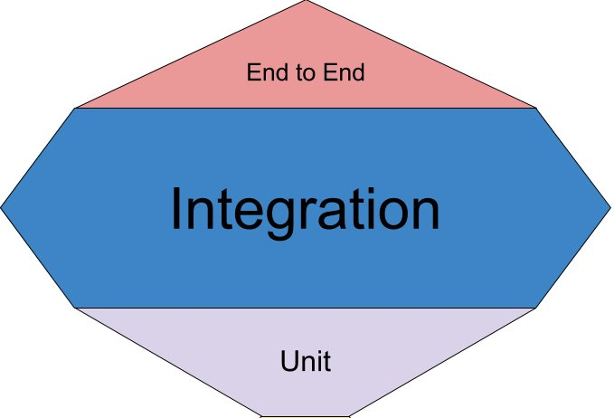
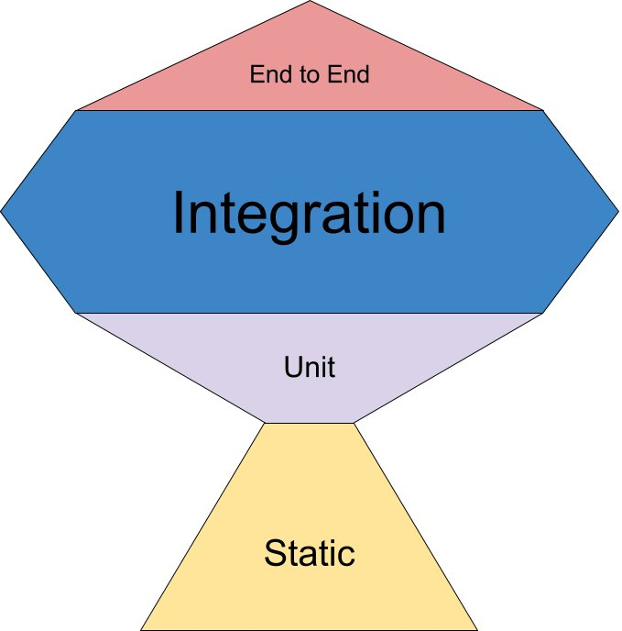
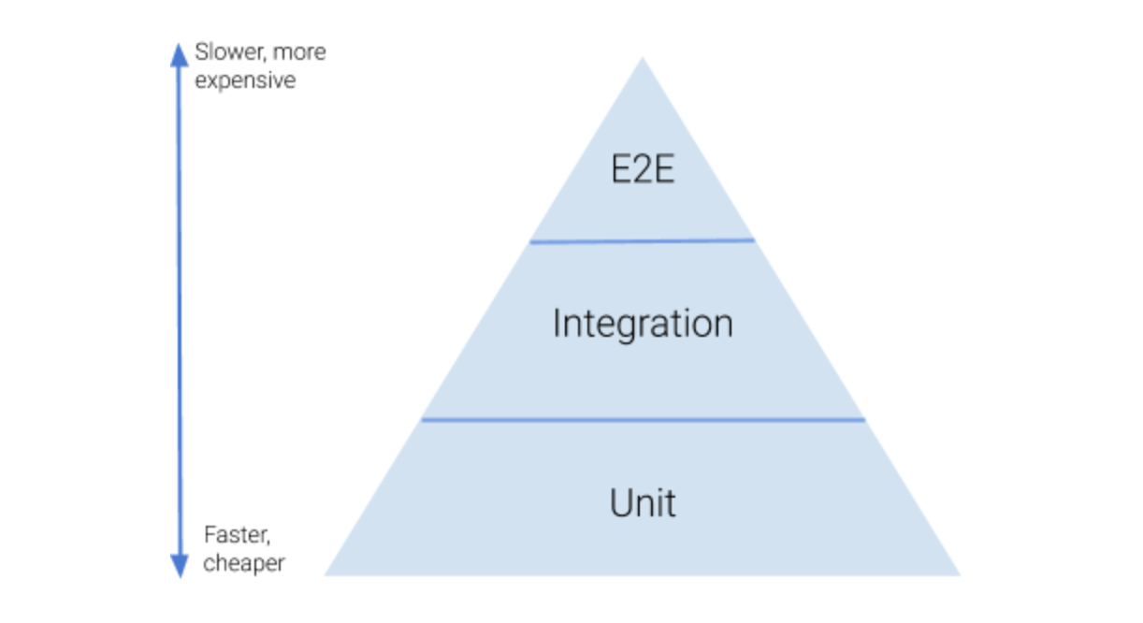

Is It Worth It?
@jmasonlee

Slide 186
Is It Worth It?
TEST 1
The
0 to 1 Phenomenon
TESTS 2-11
TIME
@jmasonlee

Slide 187
This is what we are testing
1
Mobile Review
for
Inglewood Pizza
0
Checkins
at
Inglewood Pizza
1
Review
for
Inglewood Pizza
+
=
@jmasonlee

Slide 188
This is what we want
1
Mobile Review
0
Checkins
1
Review
+
=
Mobile
Reviews
Checkins
1
Mobile Review
1
Checkin
0
Reviews
+
=
@jmasonlee

Slide 189
This is what we want
1
Mobile Review
0
Checkins
1
Review
+
=
Mobile
Reviews
Checkins
1
Mobile Review
1
Checkin
0
Reviews
+
=
@jmasonlee

Slide 190
This is what we are testing
1
Mobile Review
for
Inglewood Pizza
1
Checkin
at
Inglewood Pizza
0
Review
for
Inglewood Pizza
+
=
@jmasonlee

Slide 191
Duplicate the Test
def test_mobile_reviews_count_without_checkins(spark: SparkSession) -> None:
review = [{ "user_id": "0dea283273fa4f40ac12ea210994d5f8", "business_id": "mobile_review_no_checkins", "date": "2022-04-14 07:31:06" }]
mobile_reviews_df = spark.createDataFrame(pd.DataFrame(review))
empty = [{ "user_id": "", "business_id": "", "date": "" }]
browser_reviews_df = spark.createDataFrame(pd.DataFrame(empty))
checkin_df = spark.createDataFrame(pd.DataFrame(empty))
reviews_df = count_reviews(checkin_df, mobile_reviews_df, browser_reviews_df, run_date)
assert_inglewood_pizza_has_correct_review_count(reviews_df, 1)
@jmasonlee

Slide 192
Make the Name Specific
def test_mobile_reviews_count_with_checkins(spark: SparkSession) -> None:
review = [{ "user_id": "0dea283273fa4f40ac12ea210994d5f8", "business_id": "mobile_review_no_checkins", "date": "2022-04-14 07:31:06" }]
mobile_reviews_df = spark.createDataFrame(pd.DataFrame(review))
empty = [{ "user_id": "", "business_id": "", "date": "" }]
browser_reviews_df = spark.createDataFrame(pd.DataFrame(empty))
checkin_df = spark.createDataFrame(pd.DataFrame(empty))
reviews_df = count_reviews(checkin_df, mobile_reviews_df, browser_reviews_df, run_date)
assert_inglewood_pizza_has_correct_review_count(reviews_df, 1)
@jmasonlee

Slide 193
Make the assertion specific
def test_mobile_reviews_count_with_checkins(spark: SparkSession) -> None:
review = [{ "user_id": "0dea283273fa4f40ac12ea210994d5f8", "business_id": "mobile_review_no_checkins", "date": "2022-04-14 07:31:06" }]
mobile_reviews_df = spark.createDataFrame(pd.DataFrame(review))
empty = [{ "user_id": "", "business_id": "", "date": "" }]
browser_reviews_df = spark.createDataFrame(pd.DataFrame(empty))
checkin_df = spark.createDataFrame(pd.DataFrame(empty))
reviews_df = count_reviews(checkin_df, mobile_reviews_df, browser_reviews_df, run_date)
assert_inglewood_pizza_has_correct_review_count(reviews_df, 1)
@jmasonlee

Slide 194
Make the assertion specific
def test_mobile_reviews_count_with_checkins(spark: SparkSession) -> None:
review = [{ "user_id": "0dea283273fa4f40ac12ea210994d5f8", "business_id": "mobile_review_no_checkins", "date": "2022-04-14 07:31:06" }]
mobile_reviews_df = spark.createDataFrame(pd.DataFrame(review))
empty = [{ "user_id": "", "business_id": "", "date": "" }]
browser_reviews_df = spark.createDataFrame(pd.DataFrame(empty))
checkin_df = spark.createDataFrame(pd.DataFrame(empty))
reviews_df = count_reviews(checkin_df, mobile_reviews_df, browser_reviews_df, run_date)
assert_inglewood_pizza_has_correct_review_count(reviews_df, 1)
@jmasonlee

Slide 195
Make the assertion specific
def test_mobile_reviews_count_with_checkins(spark: SparkSession) -> None:
review = [{ "user_id": "0dea283273fa4f40ac12ea210994d5f8", "business_id": "mobile_review_no_checkins", "date": "2022-04-14 07:31:06" }]
mobile_reviews_df = spark.createDataFrame(pd.DataFrame(review))
empty = [{ "user_id": "", "business_id": "", "date": "" }]
browser_reviews_df = spark.createDataFrame(pd.DataFrame(empty))
checkin_df = spark.createDataFrame(pd.DataFrame(empty))
reviews_df = count_reviews(checkin_df, mobile_reviews_df, browser_reviews_df, run_date)
assert_inglewood_pizza_has_correct_review_count(reviews_df, 1)
@jmasonlee

Slide 196
Make the assertion specific
def test_mobile_reviews_count_with_checkins(spark: SparkSession) -> None:
review = [{ "user_id": "0dea283273fa4f40ac12ea210994d5f8", "business_id": "mobile_review_no_checkins", "date": "2022-04-14 07:31:06" }]
mobile_reviews_df = spark.createDataFrame(pd.DataFrame(review))
empty = [{ "user_id": "", "business_id": "", "date": "" }]
browser_reviews_df = spark.createDataFrame(pd.DataFrame(empty))
checkin_df = spark.createDataFrame(pd.DataFrame(empty))
reviews_df = count_reviews(checkin_df, mobile_reviews_df, browser_reviews_df, run_date)
assert_inglewood_pizza_has_correct_review_count(reviews_df, 0)
✗
@jmasonlee

Slide 197
Rename the Matching Properties
def test_mobile_reviews_count_with_checkins(spark: SparkSession) -> None:
review= [{ "user_id": "0dea283273fa4f40ac12ea210994d5f8", "business_id": "mobile_review_no_checkins", "date": "2022-04-14 07:31:06" }]
mobile_reviews_df = spark.createDataFrame(pd.DataFrame(review))
empty = [{ "user_id": "", "business_id": "", "date": "" }]
browser_reviews_df = spark.createDataFrame(pd.DataFrame(empty))
checkin_df = spark.createDataFrame(pd.DataFrame(empty))
reviews_df = count_reviews(checkin_df, mobile_reviews_df, browser_reviews_df, run_date)
assert_inglewood_pizza_has_correct_review_count(reviews_df, 0)
@jmasonlee

Slide 198
Rename the Matching Properties
def test_mobile_reviews_count_with_checkins(spark: SparkSession) -> None:
matching_on = [{ "user_id": "0dea283273fa4f40ac12ea210994d5f8", "business_id": "mobile_review_no_checkins", "date": "2022-04-14 07:31:06" }]
mobile_reviews_df = spark.createDataFrame(pd.DataFrame(matching_on))
empty = [{ "user_id": "", "business_id": "", "date": "" }]
browser_reviews_df = spark.createDataFrame(pd.DataFrame(empty))
checkin_df = spark.createDataFrame(pd.DataFrame(empty))
reviews_df = count_reviews(checkin_df, mobile_reviews_df, browser_reviews_df, run_date)
assert_inglewood_pizza_has_correct_review_count(reviews_df, 0)
@jmasonlee

Slide 199
Rename the Matching Properties
def test_mobile_reviews_count_with_checkins(spark: SparkSession) -> None:
matching_on = [{ "user_id": "0dea283273fa4f40ac12ea210994d5f8", "business_id": "mobile_review_no_checkins", "date": "2022-04-14 07:31:06" }]
mobile_reviews_df = spark.createDataFrame(pd.DataFrame(matching_on))
empty = [{ "user_id": "", "business_id": "", "date": "" }]
browser_reviews_df = spark.createDataFrame(pd.DataFrame(empty))
checkin_df = spark.createDataFrame(pd.DataFrame(empty))
reviews_df = count_reviews(checkin_df, mobile_reviews_df, browser_reviews_df, run_date)
assert_inglewood_pizza_has_correct_review_count(reviews_df, 0)
@jmasonlee

Slide 200
Rename the Matching Properties
def test_mobile_reviews_count_with_checkins(spark: SparkSession) -> None:
matching_on = [{ "user_id": "0dea283273fa4f40ac12ea210994d5f8", "business_id": "mobile_review_no_checkins", "date": "2022-04-14 07:31:06" }]
mobile_reviews_df = spark.createDataFrame(pd.DataFrame(matching_on))
checkin_df = spark.createDataFrame(pd.DataFrame(empty))
empty = [{ "user_id": "", "business_id": "", "date": "" }]
reviews_df = count_reviews(checkin_df, mobile_reviews_df, browser_reviews_df, run_date)
browser_reviews_df = spark.createDataFrame(pd.DataFrame(empty))
assert_inglewood_pizza_has_correct_review_count(reviews_df, 0)
@jmasonlee

Slide 201
Rename the Matching Properties
def test_mobile_reviews_count_with_checkins(spark: SparkSession) -> None:
matching_on = [{ "user_id": "0dea283273fa4f40ac12ea210994d5f8", "business_id": "mobile_review_no_checkins", "date": "2022-04-14 07:31:06" }]
mobile_reviews_df = spark.createDataFrame(pd.DataFrame(matching_on))
checkin_df = spark.createDataFrame(pd.DataFrame(matching_on))
empty = [{ "user_id": "", "business_id": "", "date": "" }]
reviews_df = count_reviews(checkin_df, mobile_reviews_df, browser_reviews_df, run_date)
browser_reviews_df = spark.createDataFrame(pd.DataFrame(empty))
assert_inglewood_pizza_has_correct_review_count(reviews_df, 0)
@jmasonlee

Slide 202
Rename the Matching Properties
def test_mobile_reviews_count_with_checkins(spark: SparkSession) -> None:
matching_on = [{ "user_id": "0dea283273fa4f40ac12ea210994d5f8", "business_id": "mobile_review_no_checkins", "date": "2022-04-14 07:31:06" }]
mobile_reviews_df = spark.createDataFrame(pd.DataFrame(matching_on))
checkin_df = spark.createDataFrame(pd.DataFrame(matching_on))
empty = [{ "user_id": "", "business_id": "", "date": "" }]
reviews_df = count_reviews(checkin_df, mobile_reviews_df, browser_reviews_df, run_date)
browser_reviews_df = spark.createDataFrame(pd.DataFrame(empty))
assert_inglewood_pizza_has_correct_review_count(reviews_df, 0)
✓
@jmasonlee

Slide 203
Multi-Layered Tests
Data Tests
Bug-specific tests
Pipeline
@jmasonlee

Slide 204
Multi-Layered Tests
Data Tests
Large Logic Test
Large Logic Test
Large Logic Test
Large Logic Test
Large Logic Test
Bug-specific tests
Pipeline
@jmasonlee

Slide 205
Resources
github.com/jmasonlee/Talks/blob/master/LearnToEfficientlyTestETLPipelines.md

Slide 206
Thank you
Talk Resources:
Llewellyn Falco
Rocky Rhodes
Tony Vo
Jonathan Rioux
Sam Livingston-Grey
Jay Bazuzi
Stephen Bilston
Hansel Qiu
Jaimie Russ
Lynn Langit
Jacqueline Bilston
Software Developer, Yelp

Slide 207
@jmasonlee
Notes:
Efficient tests are: Fast, Confidence Inspiring, Reproducible and easy to write
The easiest tests to write are the ones that are set up for you.

Slide 208
@jmasonlee
Notes:
Efficient tests are: Fast, Confidence Inspiring, Reproducible and easy to write
The easiest tests to write are the ones that are set up for you.

Slide 209
@jmasonlee
Notes:
Efficient tests are: Fast, Confidence Inspiring, Reproducible and easy to write
The easiest tests to write are the ones that are set up for you.

Slide 210
@jmasonlee
Notes:
Efficient tests are: Fast, Confidence Inspiring, Reproducible and easy to write
The easiest tests to write are the ones that are set up for you.

Slide 211
@jmasonlee
Notes:
Efficient tests are: Fast, Confidence Inspiring, Reproducible and easy to write
The easiest tests to write are the ones that are set up for you.

Slide 212
@jmasonlee
Notes:
Efficient tests are: Fast, Confidence Inspiring, Reproducible and easy to write
The easiest tests to write are the ones that are set up for you.

Slide 213
@jmasonlee
Notes:
Efficient tests are: Fast, Confidence Inspiring, Reproducible and easy to write
The easiest tests to write are the ones that are set up for you.

Slide 214
@jmasonlee
Notes:
Efficient tests are: Fast, Confidence Inspiring, Reproducible and easy to write
The easiest tests to write are the ones that are set up for you.

Slide 215


The Problematic Batch Job
Where exactly is the issue?
BUSINESS
REVIEWS
TIPS
pandemic_recovery
CHECKINS
@jmasonlee
Notes:
-Lucky to be working on the Clickstream team, which means we help analyze user events.
- With a team passionate about quality software
Already had some testing infrastructure set up
Automated testing for data pipelines is HARD
Lots of integration points
Dealing with large amounts of data
pySpark isn’t optimized for working with small datasets
Can be costly to run pySpark many times
Dataframes with many columns
Often multiple sources of inputs and out puts

Slide 216
Where’s the Bug?
@jmasonlee

Slide 217
@jmasonlee

Slide 218


Left-Anti Join
Inner Join
Mobile
Reviews
Checkins
Mobile
Reviews
Checkins
num_checkins: 2
num_reviews: 2
num_interactions: 4
num_checkins: 2
num_reviews: 1
num_interactions: 3

Slide 219
DBT Tests
(Data Build Tool)
Ensure our code behaves as expected in production
Generic Test:
models:
- name: pandemic_recovery
columns:
- name: business_id
tests:
- not_null
- unique
Specific Test:
select
business_id,
num_interactions
from {{ ref('pandemic_recovery')}}
where num_interactions !=
num_reviews +
num_checkins +
num_tips
@jmasonlee
Notes:
DBT is the Data Build Tool
It is traditionally an ELT tool that allows you to transform data in your warehouse, but it has a bunch of features that also make it useful for ETL too.
In this specific case, it allows us to place checks on our output datasets in production and set alerts on that output.

Slide 220
5 days to find the bug,
Fixing
Running the job
Time
@jmasonlee

Slide 221
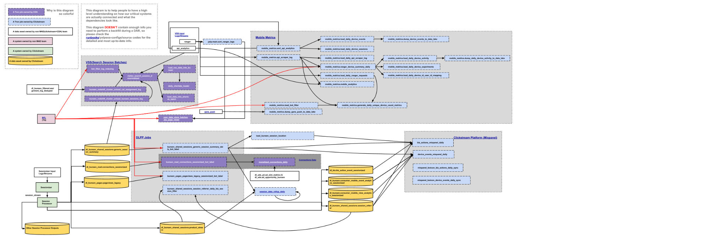
@jmasonlee
Notes:
I don’t just work on one pipeline. I work on a system of pipelines, each of which depends on one another.
This is a diagram one of my teammates made for one half of the system I help maintain.
Manually checking that each one of these pieces works together would be a nightmare
My data is important. It’s used to inform machine learning models that have a direct impact on our customers, and the small businesses we try to support.
This means that my team prefers to automate all the testing we can.

Slide 222
Efficient tests are:
Reproducible
✓
✗
Fast
✓
✗
Confidence Inspiring
✓
✗
Easy to write
✗
✓
@jmasonlee
Notes:
Efficient tests are: Fast, Confidence Inspiring, Reproducible and easy to write
The easiest tests to write are the ones that are set up for you.

Slide 223
Automated tests are:
Reproducible
✗
✓
✗
Fast
✗
✓
✗
Confidence Inspiring
✗
✓
✗
Easy to write
✗
✗
✓
@jmasonlee
Notes:
Efficient tests are: Fast, Confidence Inspiring, Reproducible and easy to write
The easiest tests to write are the ones that are set up for you.

Slide 224
Automated tests are:
Reproducible
✗
✓
✗
Fast
✗
✓
✗
Confidence Inspiring
✗
✓
✗
Easy to write
✗
✗
✓
@jmasonlee
Notes:
Efficient tests are: Fast, Confidence Inspiring, Reproducible and easy to write
The easiest tests to write are the ones that are set up for you.

Slide 225
Automated tests are:
Reproducible
✗
✓
✗
Fast
✗
✓
✗
Confidence Inspiring
✗
✓
✗
Easy to write
✗
✗
✓
@jmasonlee
Notes:
Efficient tests are: Fast, Confidence Inspiring, Reproducible and easy to write
The easiest tests to write are the ones that are set up for you.

Slide 226
Automated tests are:
Reproducible
✗
✓
✗
Fast
✗
✓
✗
Confidence Inspiring
✗
✓
✗
Easy to write
✗
✗
✓
@jmasonlee
Notes:
Efficient tests are: Fast, Confidence Inspiring, Reproducible and easy to write
The easiest tests to write are the ones that are set up for you.

Slide 227
Our tests are:
Reproducible
✗
Fast
✗
Confidence Inspiring
✗
Easy to write
✗
@jmasonlee
Notes:
Efficient tests are: Fast, Confidence Inspiring, Reproducible and easy to write
The easiest tests to write are the ones that are set up for you.

Slide 228
Make the assertion specific
def test_will_count_mobile_reviews_without_matching_checkins(spark: SparkSession) -> None:
browser_reviews_df = create_df_from_json("fixtures/browser_reviews.json", spark) checkin_df = create_df_from_json("fixtures/checkin.json", spark) tips_df = create_df_from_json("fixtures/tips.json", spark) business_df = create_df_from_json("fixtures/business.json", spark) mobile_reviews_df = create_df_from_json("fixtures/mobile_reviews.json", spark) actual_df = transform( business_df, checkin_df, browser_reviews_df, tips_df, mobile_reviews_df, datetime(2022, 4, 14) ) expected_json = read_json() assert data_frame_to_json(actual_df) == expected_json #overwrite_expected(actual_df)
@jmasonlee

Slide 229
mobile_reviews.json
[ { "review_id": "XQfwVwDr-v0ZS3_CbbE5Xw", "user_id": "mh_-eMZ6K5RLWhZyISBhwA", "business_id": "Pns2l4eNsfO8kk83dixA6A", "stars": 3.0, "useful": 0, "funny": 0, "cool": 0, "text": "If you decide to eat here, just be aware it is going to take about 2 hours from beginning to end. We have tried it multiple times, because I want to like it! I have been to its other locations in NJ and never had a bad experience. \n\nThe food is good, but it takes a very long time to come out. The waitstaff is very young, but usually pleasant. We have just had too many experiences where we spent way too long waiting. We usually opt for another diner or restaurant on the weekends, in order to be done quicker.", "date": "2018-07-07 22:09:11" }, { "review_id": "7ATYjTIgM3jUlt4UM3IypQ", "user_id": "OyoGAe7OKpv6SyGZT5g77Q", "business_id": "qkRM_2X51Yqxk3btlwAQIg", "stars": 5.0, "useful": 1, "funny": 0, "cool": 1, "text": "Ive taken a lot of spin classes over the years, and nothing compares to the classes at Body Cycle. From the nice, clean space and amazing bikes, to the welcoming and motivating instructors, every class is a top notch work out.\n\nFor anyone who struggles to fit workouts in, the online scheduling system makes it easy to plan ahead (and theres no need to line up way in advanced like many gyms make you do).\n\nThere is no way I can write this review without giving Russell, the owner of Body Cycle, a shout out. Russells passion for fitness and cycling is so evident, as is his desire for all of his clients to succeed. He is always dropping in to classes to check in\/provide encouragement, and is open to ideas and recommendations from anyone. Russell always wears a smile on his face, even when hes kicking your butt in class!", "date": "2022-04-14 13:18:32" }, { "review_id": "YjUWPpI6HXG530lwP-fb2A", "user_id": "8g_iMtfSiwikVnbP2etR0A", "business_id": "Pns2l4eNsfO8kk83dixA6A", "stars": 3.0, "useful": 0, "funny": 0, "cool": 0, "text": "Family diner. Had the buffet. Eclectic assortment: a large chicken leg, fried jalapeño, tamale, two rolled grape leaves, fresh melon. All good. Lots of Mexican choices there. Also has a menu with breakfast served all day long. Friendly, attentive staff. Good place for a casual relaxed meal with no expectations. Next to the Clarion Hotel.", "date": "2022-04-14 16:23:50" }, { "review_id": "kxX2SOes4o-D3ZQBkiMRfA", "user_id": "_7bHUi9Uuf5__HHc_Q8guQ", "business_id": "bBDDEgkFA1Otx9Lfe7BZUQ", "stars": 5.0, "useful": 1, "funny": 0, "cool": 1, "text": "Wow! Yummy, different, delicious. Our favorite is the lamb curry and korma. With 10 different kinds of naan!!! Dont let the outside deter you (because we almost changed our minds)...go in and try something new! Youll be glad you did!", "date": "2021-01-04 00:01:03" }, { "review_id": "e4Vwtrqf-wpJfwesgvdgxQ", "user_id": "bcjbaE6dDog4jkNY91ncLQ", "business_id": "tUFrWirKiKi_TAnsVWINQQ", "stars": 4.0, "useful": 1, "funny": 0, "cool": 1, "text": "Cute interior and owner (?) gave us tour of upcoming patio\/rooftop area which will be great on beautiful days like today. Cheese curds were very good and very filling. Really like that sandwiches come w salad, esp after eating too many curds! Had the onion, gruyere, tomato sandwich. Wasnt too much cheese which I liked. Needed something else...pepper jelly maybe. Would like to see more menu options added such as salads w fun cheeses. Lots of beer and wine as well as limited cocktails. Next time I will try one of the draft wines.", "date": "2017-01-14 20:54:15" }, { "review_id": "kxX2SOes4o-D3ZQBkiMRfA", "user_id": "_7bHUi9Uuf5__HHc_Q8guQ", "business_id": "mpf3x-BjTdTEA3yCZrAYPw", "stars": 5.0, "useful": 1, "funny": 0, "cool": 1, "text": "Wow! Yummy, different, delicious. Our favorite is the lamb curry and korma. With 10 different kinds of naan!!! Dont let the outside deter you (because we almost changed our minds)...go in and try something new! Youll be glad you did!", "date": "2022-04-14 00:01:03" }, { "review_id": "bBDDEgkFA1Otx9Lfe7BZUQ", "user_id": "r3zeYsv1XFBRA4dJpL78cw", "business_id": "mWMc6_wTdE0EUBKIGXDVfA", "stars": 5.0, "useful": 0, "funny": 2, "cool": 0, "text": "Loved this tour! I grabbed a groupon and the price was great. It was the perfect way to explore New Orleans for someone whod never been there before and didnt know a lot about the history of the city. Our tour guide had tons of interesting tidbits about the city, and I really enjoyed the experience. Highly recommended tour. I actually thought we were just going to tour through the cemetery, but she took us around the French Quarter for the first hour, and the cemetery for the second half of the tour. Youll meet up in front of a grocery store (seems strange at first, but its not terribly hard to find, and itll give you a chance to get some water), and youll stop at a visitor center part way through the tour for a bathroom break if needed. This tour was one of my favorite parts of my trip!", "date": "2021-01-03 23:21:18" }, { "review_id": "LHSTtnW3YHCeUkRDGyJOyw", "user_id": "yfFzsLmaWF2d4Sr0UNbBgg", "business_id": "_ZeMknuYdlQcUqng_Im3yg", "stars": 5.0, "useful": 2, "funny": 0, "cool": 0, "text": "Amazingly amazing wings and homemade bleu cheese. Had the ribeye: tender, perfectly prepared, delicious. Nice selection of craft beers. Would DEFINITELY recommend checking out this hidden gem.", "date": "2021-08-07 02:29:16" }, { "review_id": "B5XSoSG3SfvQGtKEGQ1tSQ", "user_id": "wSTuiTk-sKNdcFyprzZAjg", "business_id": "k0hlBqXX-Bt0vf1op7Jr1w", "stars": 3.0, "useful": 1, "funny": 1, "cool": 0, "text": "This easter instead of going to Lopez Lake we went to Los Padres National Forest which is really pretty but if you go to white rock the staff needs to cut down all the dead grass that invades the rock and the water. I would wish the staff would also clean or get rid of the dead grass thats also living by the water. The water is really green and dirty. Los padres national forest staff need to work hard to maintain this forest looking pretty and not like a dumpster. Even Cachuma lake looks like they put a bit more effort.", "date": "2022-04-14 22:46:33" }, { "review_id": "gebiRewfieSdtt17PTW6Zg", "user_id": "59MxRhNVhU9MYndMkz0wtw", "business_id": "pUycOfUwM8vqX7KjRRhUEA", "stars": 3.0, "useful": 0, "funny": 0, "cool": 0, "text": "Had a party of 6 here for hibachi. Our waitress brought our separate sushi orders on one plate so we couldnt really tell whos was whos and forgot several items on an order. I understand making mistakes but the restaraunt was really quiet so we were kind of surprised. Usually hibachi is a fun lively experience and our cook said maybe three words, but he cooked very well his name was Francisco. Service was fishy, food was pretty good, and im hoping it was just an off night here. But for the money I wouldnt go back.", "date": "2016-07-25 07:31:06" },
{ "review_id": "be02921c1ccd4c5dabdc63bd29f3bd35", "user_id": "0dea283273fa4f40ac12ea210994d5f8", "business_id": "mobile_review_no_checkins", "stars": 5.0, "useful": 1, "funny": 0, "cool": 0, "text": "They have the absolute best pizza on this entire planet. Gooey and greasy, without the soggy crust, they are allergy friendly and know what is in all their ingredients and their dough!", "date": "2022-04-14 07:31:06" } ]

Slide 230
[ { "review_id": "XQfwVwDr-v0ZS3_CbbE5Xw", "user_id": "mh_-eMZ6K5RLWhZyISBhwA", "business_id": "Pns2l4eNsfO8kk83dixA6A", "stars": 3.0, "useful": 0, "funny": 0, "cool": 0, "text": "If you decide to eat here, just be aware it is going to take about 2 hours from beginning to end. We have tried it multiple times, because I want to like it! I have been to its other locations in NJ and never had a bad experience. \n\nThe food is good, but it takes a very long time to come out. The waitstaff is very young, but usually pleasant. We have just had too many experiences where we spent way too long waiting. We usually opt for another diner or restaurant on the weekends, in order to be done quicker.", "date": "2018-07-07 22:09:11" }, { "review_id": "7ATYjTIgM3jUlt4UM3IypQ", "user_id": "OyoGAe7OKpv6SyGZT5g77Q", "business_id": "qkRM_2X51Yqxk3btlwAQIg", "stars": 5.0, "useful": 1, "funny": 0, "cool": 1, "text": "Ive taken a lot of spin classes over the years, and nothing compares to the classes at Body Cycle. From the nice, clean space and amazing bikes, to the welcoming and motivating instructors, every class is a top notch work out.\n\nFor anyone who struggles to fit workouts in, the online scheduling system makes it easy to plan ahead (and theres no need to line up way in advanced like many gyms make you do).\n\nThere is no way I can write this review without giving Russell, the owner of Body Cycle, a shout out. Russells passion for fitness and cycling is so evident, as is his desire for all of his clients to succeed. He is always dropping in to classes to check in\/provide encouragement, and is open to ideas and recommendations from anyone. Russell always wears a smile on his face, even when hes kicking your butt in class!", "date": "2022-04-14 13:18:32" }, { "review_id": "YjUWPpI6HXG530lwP-fb2A", "user_id": "8g_iMtfSiwikVnbP2etR0A", "business_id": "Pns2l4eNsfO8kk83dixA6A", "stars": 3.0, "useful": 0, "funny": 0, "cool": 0, "text": "Family diner. Had the buffet. Eclectic assortment: a large chicken leg, fried jalapeño, tamale, two rolled grape leaves, fresh melon. All good. Lots of Mexican choices there. Also has a menu with breakfast served all day long. Friendly, attentive staff. Good place for a casual relaxed meal with no expectations. Next to the Clarion Hotel.", "date": "2022-04-14 16:23:50" }, { "review_id": "kxX2SOes4o-D3ZQBkiMRfA", "user_id": "_7bHUi9Uuf5__HHc_Q8guQ", "business_id": "bBDDEgkFA1Otx9Lfe7BZUQ", "stars": 5.0, "useful": 1, "funny": 0, "cool": 1, "text": "Wow! Yummy, different, delicious. Our favorite is the lamb curry and korma. With 10 different kinds of naan!!! Dont let the outside deter you (because we almost changed our minds)...go in and try something new! Youll be glad you did!", "date": "2021-01-04 00:01:03" }, { "review_id": "e4Vwtrqf-wpJfwesgvdgxQ", "user_id": "bcjbaE6dDog4jkNY91ncLQ", "business_id": "tUFrWirKiKi_TAnsVWINQQ", "stars": 4.0, "useful": 1, "funny": 0, "cool": 1, "text": "Cute interior and owner (?) gave us tour of upcoming patio\/rooftop area which will be great on beautiful days like today. Cheese curds were very good and very filling. Really like that sandwiches come w salad, esp after eating too many curds! Had the onion, gruyere, tomato sandwich. Wasnt too much cheese which I liked. Needed something else...pepper jelly maybe. Would like to see more menu options added such as salads w fun cheeses. Lots of beer and wine as well as limited cocktails. Next time I will try one of the draft wines.", "date": "2017-01-14 20:54:15" }, { "review_id": "kxX2SOes4o-D3ZQBkiMRfA", "user_id": "_7bHUi9Uuf5__HHc_Q8guQ", "business_id": "mpf3x-BjTdTEA3yCZrAYPw", "stars": 5.0, "useful": 1, "funny": 0, "cool": 1, "text": "Wow! Yummy, different, delicious. Our favorite is the lamb curry and korma. With 10 different kinds of naan!!! Dont let the outside deter you (because we almost changed our minds)...go in and try something new! Youll be glad you did!", "date": "2022-04-14 00:01:03" }, { "review_id": "bBDDEgkFA1Otx9Lfe7BZUQ", "user_id": "r3zeYsv1XFBRA4dJpL78cw", "business_id": "mWMc6_wTdE0EUBKIGXDVfA", "stars": 5.0, "useful": 0, "funny": 2, "cool": 0, "text": "Loved this tour! I grabbed a groupon and the price was great. It was the perfect way to explore New Orleans for someone whod never been there before and didnt know a lot about the history of the city. Our tour guide had tons of interesting tidbits about the city, and I really enjoyed the experience. Highly recommended tour. I actually thought we were just going to tour through the cemetery, but she took us around the French Quarter for the first hour, and the cemetery for the second half of the tour. Youll meet up in front of a grocery store (seems strange at first, but its not terribly hard to find, and itll give you a chance to get some water), and youll stop at a visitor center part way through the tour for a bathroom break if needed. This tour was one of my favorite parts of my trip!", "date": "2021-01-03 23:21:18" }, { "review_id": "LHSTtnW3YHCeUkRDGyJOyw", "user_id": "yfFzsLmaWF2d4Sr0UNbBgg", "business_id": "_ZeMknuYdlQcUqng_Im3yg", "stars": 5.0, "useful": 2, "funny": 0, "cool": 0, "text": "Amazingly amazing wings and homemade bleu cheese. Had the ribeye: tender, perfectly prepared, delicious. Nice selection of craft beers. Would DEFINITELY recommend checking out this hidden gem.", "date": "2021-08-07 02:29:16" }, { "review_id": "B5XSoSG3SfvQGtKEGQ1tSQ", "user_id": "wSTuiTk-sKNdcFyprzZAjg", "business_id": "k0hlBqXX-Bt0vf1op7Jr1w", "stars": 3.0, "useful": 1, "funny": 1, "cool": 0, "text": "This easter instead of going to Lopez Lake we went to Los Padres National Forest which is really pretty but if you go to white rock the staff needs to cut down all the dead grass that invades the rock and the water. I would wish the staff would also clean or get rid of the dead grass thats also living by the water. The water is really green and dirty. Los padres national forest staff need to work hard to maintain this forest looking pretty and not like a dumpster. Even Cachuma lake looks like they put a bit more effort.", "date": "2022-04-14 22:46:33" }, { "review_id": "gebiRewfieSdtt17PTW6Zg", "user_id": "59MxRhNVhU9MYndMkz0wtw", "business_id": "pUycOfUwM8vqX7KjRRhUEA", "stars": 3.0, "useful": 0, "funny": 0, "cool": 0, "text": "Had a party of 6 here for hibachi. Our waitress brought our separate sushi orders on one plate so we couldnt really tell whos was whos and forgot several items on an order. I understand making mistakes but the restaraunt was really quiet so we were kind of surprised. Usually hibachi is a fun lively experience and our cook said maybe three words, but he cooked very well his name was Francisco. Service was fishy, food was pretty good, and im hoping it was just an off night here. But for the money I wouldnt go back.", "date": "2016-07-25 07:31:06" }, { "review_id": "be02921c1ccd4c5dabdc63bd29f3bd35", "user_id": "0dea283273fa4f40ac12ea210994d5f8", "business_id": "mobile_review_no_checkins", "stars": 5.0, "useful": 1, "funny": 0, "cool": 0, "text": "They have the absolute best pizza on this entire planet. Gooey and greasy, without the soggy crust, they are allergy friendly and know what is in all their ingredients and their dough!", "date": "2022-04-14 07:31:06" } ]

Slide 231
[ { "review_id": "XQfwVwDr-v0ZS3_CbbE5Xw", "user_id": "mh_-eMZ6K5RLWhZyISBhwA", "business_id": "Pns2l4eNsfO8kk83dixA6A", "stars": 3.0, "useful": 0, "funny": 0, "cool": 0, "text": "If you decide to eat here, just be aware it is going to take about 2 hours from beginning to end. We have tried it multiple times, because I want to like it! I have been to its other locations in NJ and never had a bad experience. \n\nThe food is good, but it takes a very long time to come out. The waitstaff is very young, but usually pleasant. We have just had too many experiences where we spent way too long waiting. We usually opt for another diner or restaurant on the weekends, in order to be done quicker.", "date": "2018-07-07 22:09:11" }, { "review_id": "7ATYjTIgM3jUlt4UM3IypQ", "user_id": "OyoGAe7OKpv6SyGZT5g77Q", "business_id": "qkRM_2X51Yqxk3btlwAQIg", "stars": 5.0, "useful": 1, "funny": 0, "cool": 1, "text": "Ive taken a lot of spin classes over the years, and nothing compares to the classes at Body Cycle. From the nice, clean space and amazing bikes, to the welcoming and motivating instructors, every class is a top notch work out.\n\nFor anyone who struggles to fit workouts in, the online scheduling system makes it easy to plan ahead (and theres no need to line up way in advanced like many gyms make you do).\n\nThere is no way I can write this review without giving Russell, the owner of Body Cycle, a shout out. Russells passion for fitness and cycling is so evident, as is his desire for all of his clients to succeed. He is always dropping in to classes to check in\/provide encouragement, and is open to ideas and recommendations from anyone. Russell always wears a smile on his face, even when hes kicking your butt in class!", "date": "2022-04-14 13:18:32" }, { "review_id": "YjUWPpI6HXG530lwP-fb2A", "user_id": "8g_iMtfSiwikVnbP2etR0A", "business_id": "Pns2l4eNsfO8kk83dixA6A", "stars": 3.0, "useful": 0, "funny": 0, "cool": 0, "text": "Family diner. Had the buffet. Eclectic assortment: a large chicken leg, fried jalapeño, tamale, two rolled grape leaves, fresh melon. All good. Lots of Mexican choices there. Also has a menu with breakfast served all day long. Friendly, attentive staff. Good place for a casual relaxed meal with no expectations. Next to the Clarion Hotel.", "date": "2022-04-14 16:23:50" }, { "review_id": "kxX2SOes4o-D3ZQBkiMRfA", "user_id": "_7bHUi9Uuf5__HHc_Q8guQ", "business_id": "bBDDEgkFA1Otx9Lfe7BZUQ", "stars": 5.0, "useful": 1, "funny": 0, "cool": 1, "text": "Wow! Yummy, different, delicious. Our favorite is the lamb curry and korma. With 10 different kinds of naan!!! Dont let the outside deter you (because we almost changed our minds)...go in and try something new! Youll be glad you did!", "date": "2021-01-04 00:01:03" }, { "review_id": "e4Vwtrqf-wpJfwesgvdgxQ", "user_id": "bcjbaE6dDog4jkNY91ncLQ", "business_id": "tUFrWirKiKi_TAnsVWINQQ", "stars": 4.0, "useful": 1, "funny": 0, "cool": 1, "text": "Cute interior and owner (?) gave us tour of upcoming patio\/rooftop area which will be great on beautiful days like today. Cheese curds were very good and very filling. Really like that sandwiches come w salad, esp after eating too many curds! Had the onion, gruyere, tomato sandwich. Wasnt too much cheese which I liked. Needed something else...pepper jelly maybe. Would like to see more menu options added such as salads w fun cheeses. Lots of beer and wine as well as limited cocktails. Next time I will try one of the draft wines.", "date": "2017-01-14 20:54:15" }, { "review_id": "kxX2SOes4o-D3ZQBkiMRfA", "user_id": "_7bHUi9Uuf5__HHc_Q8guQ", "business_id": "mpf3x-BjTdTEA3yCZrAYPw", "stars": 5.0, "useful": 1, "funny": 0, "cool": 1, "text": "Wow! Yummy, different, delicious. Our favorite is the lamb curry and korma. With 10 different kinds of naan!!! Dont let the outside deter you (because we almost changed our minds)...go in and try something new! Youll be glad you did!", "date": "2022-04-14 00:01:03" }, { "review_id": "bBDDEgkFA1Otx9Lfe7BZUQ", "user_id": "r3zeYsv1XFBRA4dJpL78cw", "business_id": "mWMc6_wTdE0EUBKIGXDVfA", "stars": 5.0, "useful": 0, "funny": 2, "cool": 0, "text": "Loved this tour! I grabbed a groupon and the price was great. It was the perfect way to explore New Orleans for someone whod never been there before and didnt know a lot about the history of the city. Our tour guide had tons of interesting tidbits about the city, and I really enjoyed the experience. Highly recommended tour. I actually thought we were just going to tour through the cemetery, but she took us around the French Quarter for the first hour, and the cemetery for the second half of the tour. Youll meet up in front of a grocery store (seems strange at first, but its not terribly hard to find, and itll give you a chance to get some water), and youll stop at a visitor center part way through the tour for a bathroom break if needed. This tour was one of my favorite parts of my trip!", "date": "2021-01-03 23:21:18" }, { "review_id": "LHSTtnW3YHCeUkRDGyJOyw", "user_id": "yfFzsLmaWF2d4Sr0UNbBgg", "business_id": "_ZeMknuYdlQcUqng_Im3yg", "stars": 5.0, "useful": 2, "funny": 0, "cool": 0, "text": "Amazingly amazing wings and homemade bleu cheese. Had the ribeye: tender, perfectly prepared, delicious. Nice selection of craft beers. Would DEFINITELY recommend checking out this hidden gem.", "date": "2021-08-07 02:29:16" }, { "review_id": "B5XSoSG3SfvQGtKEGQ1tSQ", "user_id": "wSTuiTk-sKNdcFyprzZAjg", "business_id": "k0hlBqXX-Bt0vf1op7Jr1w", "stars": 3.0, "useful": 1, "funny": 1, "cool": 0, "text": "This easter instead of going to Lopez Lake we went to Los Padres National Forest which is really pretty but if you go to white rock the staff needs to cut down all the dead grass that invades the rock and the water. I would wish the staff would also clean or get rid of the dead grass thats also living by the water. The water is really green and dirty. Los padres national forest staff need to work hard to maintain this forest looking pretty and not like a dumpster. Even Cachuma lake looks like they put a bit more effort.", "date": "2022-04-14 22:46:33" }, { "review_id": "gebiRewfieSdtt17PTW6Zg", "user_id": "59MxRhNVhU9MYndMkz0wtw", "business_id": "pUycOfUwM8vqX7KjRRhUEA", "stars": 3.0, "useful": 0, "funny": 0, "cool": 0, "text": "Had a party of 6 here for hibachi. Our waitress brought our separate sushi orders on one plate so we couldnt really tell whos was whos and forgot several items on an order. I understand making mistakes but the restaraunt was really quiet so we were kind of surprised. Usually hibachi is a fun lively experience and our cook said maybe three words, but he cooked very well his name was Francisco. Service was fishy, food was pretty good, and im hoping it was just an off night here. But for the money I wouldnt go back.", "date": "2016-07-25 07:31:06" }, { "review_id": "be02921c1ccd4c5dabdc63bd29f3bd35", "user_id": "0dea283273fa4f40ac12ea210994d5f8", "business_id": "mobile_review_no_checkins", "stars": 5.0, "useful": 1, "funny": 0, "cool": 0, "text": "They have the absolute best pizza on this entire planet. Gooey and greasy, without the soggy crust, they are allergy friendly and know what is in all their ingredients and their dough!", "date": "2022-04-14 07:31:06" } ]

Slide 232
expected.json
[ { "business_id": "mobile_review_no_checkins", "name": ”Inglewood Pizza", "num_tips": 0, "num_checkins": 0, "num_reviews": 1, "num_interactions": 1, "dt": "2022-04-14" },
{ "business_id": "MTSW4McQd7CbVtyjqoe9mw", "name": "St Honore Pastries", "num_tips": 0, "num_checkins": 13, "num_reviews": 1, "num_interactions": 14, "dt": "2022-04-14" }, { "business_id": "Pns2l4eNsfO8kk83dixA6A", "name": "Abby Rappoport, LAC, CMQ", "num_tips": 1, "num_checkins": 6, "num_reviews": 1, "num_interactions": 8, "dt": "2022-04-14" }, { "business_id": "bBDDEgkFA1Otx9Lfe7BZUQ", "name": "Sonic Drive-In", "num_tips": 0, "num_checkins": 0, "num_reviews": 0, "num_interactions": 0, "dt": "2022-04-14" }, { "business_id": "k0hlBqXX-Bt0vf1op7Jr1w", "name": "Tsevi's Pub And Grill", "num_tips": 0, "num_checkins": 0, "num_reviews": 2, "num_interactions": 2, "dt": "2022-04-14" }, { "business_id": "mWMc6_wTdE0EUBKIGXDVfA", "name": "Perkiomen Valley Brewery", "num_tips": 0, "num_checkins": 10, "num_reviews": 1, "num_interactions": 11, "dt": "2022-04-14" }, { "business_id": "mpf3x-BjTdTEA3yCZrAYPw", "name": "The UPS Store", "num_tips": 1, "num_checkins": 1, "num_reviews": 1, "num_interactions": 3, "dt": "2022-04-14" }, { "business_id": "n_0UpQx1hsNbnPUSlodU8w", "name": "Famous Footwear", "num_tips": 0, "num_checkins": 8, "num_reviews": 0, "num_interactions": 8, "dt": "2022-04-14" }, { "business_id": "qkRM_2X51Yqxk3btlwAQIg", "name": "Temple Beth-El", "num_tips": 0, "num_checkins": 1, "num_reviews": 1, "num_interactions": 2, "dt": "2022-04-14" }, { "business_id": "tUFrWirKiKi_TAnsVWINQQ", "name": "Target", "num_tips": 0, "num_checkins": 1, "num_reviews": 0, "num_interactions": 1, "dt": "2022-04-14" }]

Slide 233
expected.json
[ { "business_id": "mobile_review_no_checkins", "name": ”Inglewood Pizza", "num_tips": 0, "num_checkins": 0, "num_reviews": 1, "num_interactions": 1, "dt": "2022-04-14" },
{ "business_id": "MTSW4McQd7CbVtyjqoe9mw", "name": "St Honore Pastries", "num_tips": 0, "num_checkins": 13, "num_reviews": 1, "num_interactions": 14, "dt": "2022-04-14" }, { "business_id": "Pns2l4eNsfO8kk83dixA6A", "name": "Abby Rappoport, LAC, CMQ", "num_tips": 1, "num_checkins": 6, "num_reviews": 1, "num_interactions": 8, "dt": "2022-04-14" }, { "business_id": "bBDDEgkFA1Otx9Lfe7BZUQ", "name": "Sonic Drive-In", "num_tips": 0, "num_checkins": 0, "num_reviews": 0, "num_interactions": 0, "dt": "2022-04-14" }, { "business_id": "k0hlBqXX-Bt0vf1op7Jr1w", "name": "Tsevi's Pub And Grill", "num_tips": 0, "num_checkins": 0, "num_reviews": 2, "num_interactions": 2, "dt": "2022-04-14" }, { "business_id": "mWMc6_wTdE0EUBKIGXDVfA", "name": "Perkiomen Valley Brewery", "num_tips": 0, "num_checkins": 10, "num_reviews": 1, "num_interactions": 11, "dt": "2022-04-14" }, { "business_id": "mpf3x-BjTdTEA3yCZrAYPw", "name": "The UPS Store", "num_tips": 1, "num_checkins": 1, "num_reviews": 1, "num_interactions": 3, "dt": "2022-04-14" }, { "business_id": "n_0UpQx1hsNbnPUSlodU8w", "name": "Famous Footwear", "num_tips": 0, "num_checkins": 8, "num_reviews": 0, "num_interactions": 8, "dt": "2022-04-14" }, { "business_id": "qkRM_2X51Yqxk3btlwAQIg", "name": "Temple Beth-El", "num_tips": 0, "num_checkins": 1, "num_reviews": 1, "num_interactions": 2, "dt": "2022-04-14" }, { "business_id": "tUFrWirKiKi_TAnsVWINQQ", "name": "Target", "num_tips": 0, "num_checkins": 1, "num_reviews": 0, "num_interactions": 1, "dt": "2022-04-14" }]

Slide 234
Make the assertion specific
def test_mobile_reviews_count_without_checkins(spark: SparkSession) -> None: browser_reviews_df = create_df_from_json("fixtures/browser_reviews.json", spark) checkin_df = create_df_from_json("fixtures/checkin.json", spark) tips_df = create_df_from_json("fixtures/tips.json", spark) business_df = create_df_from_json("fixtures/business.json", spark) mobile_reviews_df = create_df_from_json("fixtures/mobile_reviews.json", spark) actual_df = transform( business_df, checkin_df, browser_reviews_df, tips_df, mobile_reviews_df, datetime(2022, 4, 14) ) expected_json = read_json() assert data_frame_to_json(actual_df) == expected_json #overwrite_expected(actual_df)
✓
@jmasonlee

Slide 235
[ { "review_id": "XQfwVwDr-v0ZS3_CbbE5Xw", "user_id": "mh_-eMZ6K5RLWhZyISBhwA", "business_id": "Pns2l4eNsfO8kk83dixA6A", "stars": 3.0, "useful": 0, "funny": 0, "cool": 0, "text": "If you decide to eat here, just be aware it is going to take about 2 hours from beginning to end. We have tried it multiple times, because I want to like it! I have been to its other locations in NJ and never had a bad experience. \n\nThe food is good, but it takes a very long time to come out. The waitstaff is very young, but usually pleasant. We have just had too many experiences where we spent way too long waiting. We usually opt for another diner or restaurant on the weekends, in order to be done quicker.", "date": "2018-07-07 22:09:11" }, { "review_id": "7ATYjTIgM3jUlt4UM3IypQ", "user_id": "OyoGAe7OKpv6SyGZT5g77Q", "business_id": "qkRM_2X51Yqxk3btlwAQIg", "stars": 5.0, "useful": 1, "funny": 0, "cool": 1, "text": "Ive taken a lot of spin classes over the years, and nothing compares to the classes at Body Cycle. From the nice, clean space and amazing bikes, to the welcoming and motivating instructors, every class is a top notch work out.\n\nFor anyone who struggles to fit workouts in, the online scheduling system makes it easy to plan ahead (and theres no need to line up way in advanced like many gyms make you do).\n\nThere is no way I can write this review without giving Russell, the owner of Body Cycle, a shout out. Russells passion for fitness and cycling is so evident, as is his desire for all of his clients to succeed. He is always dropping in to classes to check in\/provide encouragement, and is open to ideas and recommendations from anyone. Russell always wears a smile on his face, even when hes kicking your butt in class!", "date": "2022-04-14 13:18:32" }, { "review_id": "YjUWPpI6HXG530lwP-fb2A", "user_id": "8g_iMtfSiwikVnbP2etR0A", "business_id": "Pns2l4eNsfO8kk83dixA6A", "stars": 3.0, "useful": 0, "funny": 0, "cool": 0, "text": "Family diner. Had the buffet. Eclectic assortment: a large chicken leg, fried jalapeño, tamale, two rolled grape leaves, fresh melon. All good. Lots of Mexican choices there. Also has a menu with breakfast served all day long. Friendly, attentive staff. Good place for a casual relaxed meal with no expectations. Next to the Clarion Hotel.", "date": "2022-04-14 16:23:50" }, { "review_id": "kxX2SOes4o-D3ZQBkiMRfA", "user_id": "_7bHUi9Uuf5__HHc_Q8guQ", "business_id": "bBDDEgkFA1Otx9Lfe7BZUQ", "stars": 5.0, "useful": 1, "funny": 0, "cool": 1, "text": "Wow! Yummy, different, delicious. Our favorite is the lamb curry and korma. With 10 different kinds of naan!!! Dont let the outside deter you (because we almost changed our minds)...go in and try something new! Youll be glad you did!", "date": "2021-01-04 00:01:03" }, { "review_id": "e4Vwtrqf-wpJfwesgvdgxQ", "user_id": "bcjbaE6dDog4jkNY91ncLQ", "business_id": "tUFrWirKiKi_TAnsVWINQQ", "stars": 4.0, "useful": 1, "funny": 0, "cool": 1, "text": "Cute interior and owner (?) gave us tour of upcoming patio\/rooftop area which will be great on beautiful days like today. Cheese curds were very good and very filling. Really like that sandwiches come w salad, esp after eating too many curds! Had the onion, gruyere, tomato sandwich. Wasnt too much cheese which I liked. Needed something else...pepper jelly maybe. Would like to see more menu options added such as salads w fun cheeses. Lots of beer and wine as well as limited cocktails. Next time I will try one of the draft wines.", "date": "2017-01-14 20:54:15" }, { "review_id": "kxX2SOes4o-D3ZQBkiMRfA", "user_id": "_7bHUi9Uuf5__HHc_Q8guQ", "business_id": "mpf3x-BjTdTEA3yCZrAYPw", "stars": 5.0, "useful": 1, "funny": 0, "cool": 1, "text": "Wow! Yummy, different, delicious. Our favorite is the lamb curry and korma. With 10 different kinds of naan!!! Dont let the outside deter you (because we almost changed our minds)...go in and try something new! Youll be glad you did!", "date": "2022-04-14 00:01:03" }, { "review_id": "bBDDEgkFA1Otx9Lfe7BZUQ", "user_id": "r3zeYsv1XFBRA4dJpL78cw", "business_id": "mWMc6_wTdE0EUBKIGXDVfA", "stars": 5.0, "useful": 0, "funny": 2, "cool": 0, "text": "Loved this tour! I grabbed a groupon and the price was great. It was the perfect way to explore New Orleans for someone whod never been there before and didnt know a lot about the history of the city. Our tour guide had tons of interesting tidbits about the city, and I really enjoyed the experience. Highly recommended tour. I actually thought we were just going to tour through the cemetery, but she took us around the French Quarter for the first hour, and the cemetery for the second half of the tour. Youll meet up in front of a grocery store (seems strange at first, but its not terribly hard to find, and itll give you a chance to get some water), and youll stop at a visitor center part way through the tour for a bathroom break if needed. This tour was one of my favorite parts of my trip!", "date": "2021-01-03 23:21:18" }, { "review_id": "LHSTtnW3YHCeUkRDGyJOyw", "user_id": "yfFzsLmaWF2d4Sr0UNbBgg", "business_id": "_ZeMknuYdlQcUqng_Im3yg", "stars": 5.0, "useful": 2, "funny": 0, "cool": 0, "text": "Amazingly amazing wings and homemade bleu cheese. Had the ribeye: tender, perfectly prepared, delicious. Nice selection of craft beers. Would DEFINITELY recommend checking out this hidden gem.", "date": "2021-08-07 02:29:16" }, { "review_id": "B5XSoSG3SfvQGtKEGQ1tSQ", "user_id": "wSTuiTk-sKNdcFyprzZAjg", "business_id": "k0hlBqXX-Bt0vf1op7Jr1w", "stars": 3.0, "useful": 1, "funny": 1, "cool": 0, "text": "This easter instead of going to Lopez Lake we went to Los Padres National Forest which is really pretty but if you go to white rock the staff needs to cut down all the dead grass that invades the rock and the water. I would wish the staff would also clean or get rid of the dead grass thats also living by the water. The water is really green and dirty. Los padres national forest staff need to work hard to maintain this forest looking pretty and not like a dumpster. Even Cachuma lake looks like they put a bit more effort.", "date": "2022-04-14 22:46:33" }, { "review_id": "gebiRewfieSdtt17PTW6Zg", "user_id": "59MxRhNVhU9MYndMkz0wtw", "business_id": "pUycOfUwM8vqX7KjRRhUEA", "stars": 3.0, "useful": 0, "funny": 0, "cool": 0, "text": "Had a party of 6 here for hibachi. Our waitress brought our separate sushi orders on one plate so we couldnt really tell whos was whos and forgot several items on an order. I understand making mistakes but the restaraunt was really quiet so we were kind of surprised. Usually hibachi is a fun lively experience and our cook said maybe three words, but he cooked very well his name was Francisco. Service was fishy, food was pretty good, and im hoping it was just an off night here. But for the money I wouldnt go back.", "date": "2016-07-25 07:31:06" } ]

Slide 236
[ { "business_id": "CF33F8-E6oudUQ46HnavjQ", "name": "Sonic Drive-In", "num_tips": 1, "num_checkins": 0, "num_reviews": 1, "num_interactions": 2, "dt": "2022-04-14" }, { "business_id": "MTSW4McQd7CbVtyjqoe9mw", "name": "St Honore Pastries", "num_tips": 0, "num_checkins": 13, "num_reviews": 1, "num_interactions": 14, "dt": "2022-04-14" }, { "business_id": "Pns2l4eNsfO8kk83dixA6A", "name": "Abby Rappoport, LAC, CMQ", "num_tips": 1, "num_checkins": 6, "num_reviews": 1, "num_interactions": 8, "dt": "2022-04-14" }, { "business_id": "bBDDEgkFA1Otx9Lfe7BZUQ", "name": "Sonic Drive-In", "num_tips": 0, "num_checkins": 0, "num_reviews": 0, "num_interactions": 0, "dt": "2022-04-14" }, { "business_id": "k0hlBqXX-Bt0vf1op7Jr1w", "name": "Tsevi's Pub And Grill", "num_tips": 0, "num_checkins": 0, "num_reviews": 2, "num_interactions": 2, "dt": "2022-04-14" }, { "business_id": "mWMc6_wTdE0EUBKIGXDVfA", "name": "Perkiomen Valley Brewery", "num_tips": 0, "num_checkins": 10, "num_reviews": 1, "num_interactions": 11, "dt": "2022-04-14" }, { "business_id": "mpf3x-BjTdTEA3yCZrAYPw", "name": "The UPS Store", "num_tips": 1, "num_checkins": 1, "num_reviews": 1, "num_interactions": 3, "dt": "2022-04-14" }, { "business_id": "n_0UpQx1hsNbnPUSlodU8w", "name": "Famous Footwear", "num_tips": 0, "num_checkins": 8, "num_reviews": 0, "num_interactions": 8, "dt": "2022-04-14" }, { "business_id": "qkRM_2X51Yqxk3btlwAQIg", "name": "Temple Beth-El", "num_tips": 0, "num_checkins": 1, "num_reviews": 1, "num_interactions": 2, "dt": "2022-04-14" }, { "business_id": "tUFrWirKiKi_TAnsVWINQQ", "name": "Target", "num_tips": 0, "num_checkins": 1, "num_reviews": 0, "num_interactions": 1, "dt": "2022-04-14" }]

Slide 237
[ { "business_id": "CF33F8-E6oudUQ46HnavjQ", "name": "Sonic Drive-In", "num_tips": 1, "num_checkins": 0, "num_reviews": 1, "num_interactions": 2, "dt": "2022-04-14" }, { "business_id": "MTSW4McQd7CbVtyjqoe9mw", "name": "St Honore Pastries", "num_tips": 0, "num_checkins": 13, "num_reviews": 1, "num_interactions": 14, "dt": "2022-04-14" }, { "business_id": "Pns2l4eNsfO8kk83dixA6A", "name": "Abby Rappoport, LAC, CMQ", "num_tips": 1, "num_checkins": 6, "num_reviews": 1, "num_interactions": 8, "dt": "2022-04-14" }, { "business_id": "bBDDEgkFA1Otx9Lfe7BZUQ", "name": "Sonic Drive-In", "num_tips": 0, "num_checkins": 0, "num_reviews": 0, "num_interactions": 0, "dt": "2022-04-14" }, { "business_id": "k0hlBqXX-Bt0vf1op7Jr1w", "name": "Tsevi's Pub And Grill", "num_tips": 0, "num_checkins": 0, "num_reviews": 2, "num_interactions": 2, "dt": "2022-04-14" }, { "business_id": "mWMc6_wTdE0EUBKIGXDVfA", "name": "Perkiomen Valley Brewery", "num_tips": 0, "num_checkins": 10, "num_reviews": 1, "num_interactions": 11, "dt": "2022-04-14" }, { "business_id": "mpf3x-BjTdTEA3yCZrAYPw", "name": "The UPS Store", "num_tips": 1, "num_checkins": 1, "num_reviews": 1, "num_interactions": 3, "dt": "2022-04-14" }, { "business_id": "n_0UpQx1hsNbnPUSlodU8w", "name": "Famous Footwear", "num_tips": 0, "num_checkins": 8, "num_reviews": 0, "num_interactions": 8, "dt": "2022-04-14" }, { "business_id": "qkRM_2X51Yqxk3btlwAQIg", "name": "Temple Beth-El", "num_tips": 0, "num_checkins": 1, "num_reviews": 1, "num_interactions": 2, "dt": "2022-04-14" }, { "business_id": "tUFrWirKiKi_TAnsVWINQQ", "name": "Target", "num_tips": 0, "num_checkins": 1, "num_reviews": 0, "num_interactions": 1, "dt": "2022-04-14" }]

Slide 238
[ { "business_id": "CF33F8-E6oudUQ46HnavjQ", "name": "Sonic Drive-In", "num_tips": 1, "num_checkins": 0, "num_reviews": 1, "num_interactions": 2, "dt": "2022-04-14" }, { "business_id": "MTSW4McQd7CbVtyjqoe9mw", "name": "St Honore Pastries", "num_tips": 0, "num_checkins": 13, "num_reviews": 1, "num_interactions": 14, "dt": "2022-04-14" }, { "business_id": "Pns2l4eNsfO8kk83dixA6A", "name": "Abby Rappoport, LAC, CMQ", "num_tips": 1, "num_checkins": 6, "num_reviews": 1, "num_interactions": 8, "dt": "2022-04-14" }, { "business_id": "bBDDEgkFA1Otx9Lfe7BZUQ", "name": "Sonic Drive-In", "num_tips": 0, "num_checkins": 0, "num_reviews": 0, "num_interactions": 0, "dt": "2022-04-14" }, { "business_id": "k0hlBqXX-Bt0vf1op7Jr1w", "name": "Tsevi's Pub And Grill", "num_tips": 0, "num_checkins": 0, "num_reviews": 2, "num_interactions": 2, "dt": "2022-04-14" }, { "business_id": "mWMc6_wTdE0EUBKIGXDVfA", "name": "Perkiomen Valley Brewery", "num_tips": 0, "num_checkins": 10, "num_reviews": 1, "num_interactions": 11, "dt": "2022-04-14" }, { "business_id": "mpf3x-BjTdTEA3yCZrAYPw", "name": "The UPS Store", "num_tips": 1, "num_checkins": 1, "num_reviews": 1, "num_interactions": 3, "dt": "2022-04-14" }, { "business_id": "n_0UpQx1hsNbnPUSlodU8w", "name": "Famous Footwear", "num_tips": 0, "num_checkins": 8, "num_reviews": 0, "num_interactions": 8, "dt": "2022-04-14" }, { "business_id": "qkRM_2X51Yqxk3btlwAQIg", "name": "Temple Beth-El", "num_tips": 0, "num_checkins": 1, "num_reviews": 1, "num_interactions": 2, "dt": "2022-04-14" }, { "business_id": "tUFrWirKiKi_TAnsVWINQQ", "name": "Target", "num_tips": 0, "num_checkins": 1, "num_reviews": 0, "num_interactions": 1, "dt": "2022-04-14" }]

Slide 239
The Problematic Batch Job
Where exactly is the issue?
BUSINESS
REVIEWS
TIPS
pandemic_recovery
CHECKINS
@jmasonlee
Notes:
-Lucky to be working on the Clickstream team, which means we help analyze user events.
- With a team passionate about quality software
Already had some testing infrastructure set up
Automated testing for data pipelines is HARD
Lots of integration points
Dealing with large amounts of data
pySpark isn’t optimized for working with small datasets
Can be costly to run pySpark many times
Dataframes with many columns
Often multiple sources of inputs and out puts

Slide 240
The Logic Test
def test_will_do_the_right_thing(spark: SparkSession) -> None:
browser_reviews_df = create_df_from_json("fixtures/browser_reviews.json", spark)
checkin_df = create_df_from_json("fixtures/checkin.json", spark)
tips_df = create_df_from_json("fixtures/tips.json", spark)
business_df = create_df_from_json("fixtures/business.json", spark)
mobile_reviews_df = create_df_from_json("fixtures/mobile_reviews.json", spark)
actual_df = transform(
business_df,
checkin_df,
browser_reviews_df,
tips_df,
mobile_reviews_df,
datetime(2022, 4, 14)
)
assert data_frame_to_json(actual_df) == expected_json()

Slide 241
The Saff Squeeze
Create a simpler test based off of a big one
A large integration test covers all of this code
A Saff Squeeze helps us write smaller tests for specific bugs
@jmasonlee

Slide 242
The Saff Squeeze
Duplicate your test.
Change the assertion
Squeeze the bottom
Clean up
Squeeze the top
Clean up
…and you get a smaller test!
@jmasonlee

Slide 243
Duplicate the test
def test_will_do_the_right_thing():
input_dfs = setup_dataframes()
output_df = transform(input_dfs)
output_json = data_frame_to_json(actual_df)
assert output_json== expected_json()
def test_mobile_reviews_bug():
input_dfs = setup_dataframes()
output_df = transform(input_dfs)
output_json = data_frame_to_json(actual_df)
assert output_json== expected_json()
@jmasonlee

Slide 244
expected.json
[ { "business_id": "mobile_review_no_checkins", "name": ”Inglewood Pizza", "num_tips": 0, "num_checkins": 0, "num_reviews": 1, "num_interactions": 1, "dt": "2022-04-14" },
{ "business_id": "MTSW4McQd7CbVtyjqoe9mw", "name": "St Honore Pastries", "num_tips": 0, "num_checkins": 13, "num_reviews": 1, "num_interactions": 14, "dt": "2022-04-14" }, { "business_id": "Pns2l4eNsfO8kk83dixA6A", "name": "Abby Rappoport, LAC, CMQ", "num_tips": 1, "num_checkins": 6, "num_reviews": 1, "num_interactions": 8, "dt": "2022-04-14" }, { "business_id": "bBDDEgkFA1Otx9Lfe7BZUQ", "name": "Sonic Drive-In", "num_tips": 0, "num_checkins": 0, "num_reviews": 0, "num_interactions": 0, "dt": "2022-04-14" }, { "business_id": "k0hlBqXX-Bt0vf1op7Jr1w", "name": "Tsevi's Pub And Grill", "num_tips": 0, "num_checkins": 0, "num_reviews": 2, "num_interactions": 2, "dt": "2022-04-14" }, { "business_id": "mWMc6_wTdE0EUBKIGXDVfA", "name": "Perkiomen Valley Brewery", "num_tips": 0, "num_checkins": 10, "num_reviews": 1, "num_interactions": 11, "dt": "2022-04-14" }, { "business_id": "mpf3x-BjTdTEA3yCZrAYPw", "name": "The UPS Store", "num_tips": 1, "num_checkins": 1, "num_reviews": 1, "num_interactions": 3, "dt": "2022-04-14" }, { "business_id": "n_0UpQx1hsNbnPUSlodU8w", "name": "Famous Footwear", "num_tips": 0, "num_checkins": 8, "num_reviews": 0, "num_interactions": 8, "dt": "2022-04-14" }, { "business_id": "qkRM_2X51Yqxk3btlwAQIg", "name": "Temple Beth-El", "num_tips": 0, "num_checkins": 1, "num_reviews": 1, "num_interactions": 2, "dt": "2022-04-14" }, { "business_id": "tUFrWirKiKi_TAnsVWINQQ", "name": "Target", "num_tips": 0, "num_checkins": 1, "num_reviews": 0, "num_interactions": 1, "dt": "2022-04-14" }]

Slide 245
expected.json
[ { "business_id": "mobile_review_no_checkins", "name": ”Inglewood Pizza", "num_tips": 0, "num_checkins": 0, "num_reviews": 1, "num_interactions": 1, "dt": "2022-04-14" },
{ "business_id": "MTSW4McQd7CbVtyjqoe9mw", "name": "St Honore Pastries", "num_tips": 0, "num_checkins": 13, "num_reviews": 1, "num_interactions": 14, "dt": "2022-04-14" }, { "business_id": "Pns2l4eNsfO8kk83dixA6A", "name": "Abby Rappoport, LAC, CMQ", "num_tips": 1, "num_checkins": 6, "num_reviews": 1, "num_interactions": 8, "dt": "2022-04-14" }, { "business_id": "bBDDEgkFA1Otx9Lfe7BZUQ", "name": "Sonic Drive-In", "num_tips": 0, "num_checkins": 0, "num_reviews": 0, "num_interactions": 0, "dt": "2022-04-14" }, { "business_id": "k0hlBqXX-Bt0vf1op7Jr1w", "name": "Tsevi's Pub And Grill", "num_tips": 0, "num_checkins": 0, "num_reviews": 2, "num_interactions": 2, "dt": "2022-04-14" }, { "business_id": "mWMc6_wTdE0EUBKIGXDVfA", "name": "Perkiomen Valley Brewery", "num_tips": 0, "num_checkins": 10, "num_reviews": 1, "num_interactions": 11, "dt": "2022-04-14" }, { "business_id": "mpf3x-BjTdTEA3yCZrAYPw", "name": "The UPS Store", "num_tips": 1, "num_checkins": 1, "num_reviews": 1, "num_interactions": 3, "dt": "2022-04-14" }, { "business_id": "n_0UpQx1hsNbnPUSlodU8w", "name": "Famous Footwear", "num_tips": 0, "num_checkins": 8, "num_reviews": 0, "num_interactions": 8, "dt": "2022-04-14" }, { "business_id": "qkRM_2X51Yqxk3btlwAQIg", "name": "Temple Beth-El", "num_tips": 0, "num_checkins": 1, "num_reviews": 1, "num_interactions": 2, "dt": "2022-04-14" }, { "business_id": "tUFrWirKiKi_TAnsVWINQQ", "name": "Target", "num_tips": 0, "num_checkins": 1, "num_reviews": 0, "num_interactions": 1, "dt": "2022-04-14" }]

